Slide 1
Addressing Climate Risks in a Changing World
Asher Siebert, PhD
asherb.siebert@gmail.com, asiebert@iri.columbia.edu
LinkedIn, IRI staff profile, Google Scholar, ORCID, ResearchGate
Assistant Professor Candidate
Earth and Atmospheric Science (EAS) Department
City College of New York (CCNY)
Former Senior Staff Associate (2016-2022)
International Research Institute for Climate and Society (IRI)
Climate School/Earth Institute, Columbia University

Slide 2
Seminar Outline
Aspirations and Motivating Questions
  Research, Collaboration and Funding
  Teaching and Advising
  Justice, Equity, Diversity, Inclusion (JEDI)
Work/Education History
  Senior Staff Associate & Postdoc IRI/Columbia Climate School 2016-2022
  Postdoc Princeton Environment Institute 2015-2016
  PhD Rutgers Geography 2009-2015
  Staff Associate IRI/Columbia 2006-2008
  MA Columbia Climate and Society and NASA-GISS Internship 2005-2006
  Graduate work MIT-WHOI Physical Oceanography 2002-2004
  BA Princeton Geosciences and internship at Ohio State BPRC 1998-2002

Slide 3
Challenges and Research Areas in Climate Risk
Challenges
  Climate risks are growing – geophysical hazard, vulnerability, exposure
  Vulnerability/poverty
  More severe, prolonged and compound extreme events
  Funding for climate resilience/adaptation
Research Areas
  Data analysis
  Predictability/projection
  User/scientist co-production of climate services
  Adaptation/Mitigation synergies
  Sustainable development

Slide 4

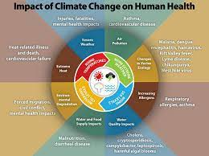
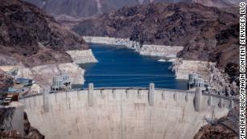
Seasonal Forecasting for Sector Applications
Forecasts need to be understandable, flexible and applicable for the user
Research interest areas include:
  Public Health
  Energy
  Food Security
  Water
  Disaster Management & Humanitarian Response
  Time dependence of planning decisions
  Interrelationship of sectoral impacts
Block Island RI Wind Farm
in Heavy Seas
Lake Mead, NV after
decades of drought

Slide 5
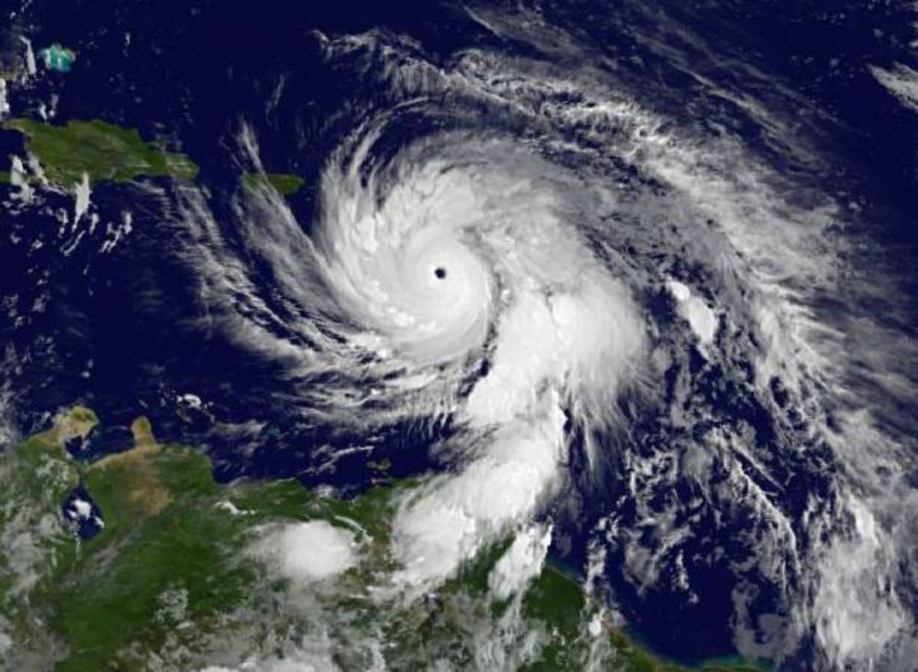
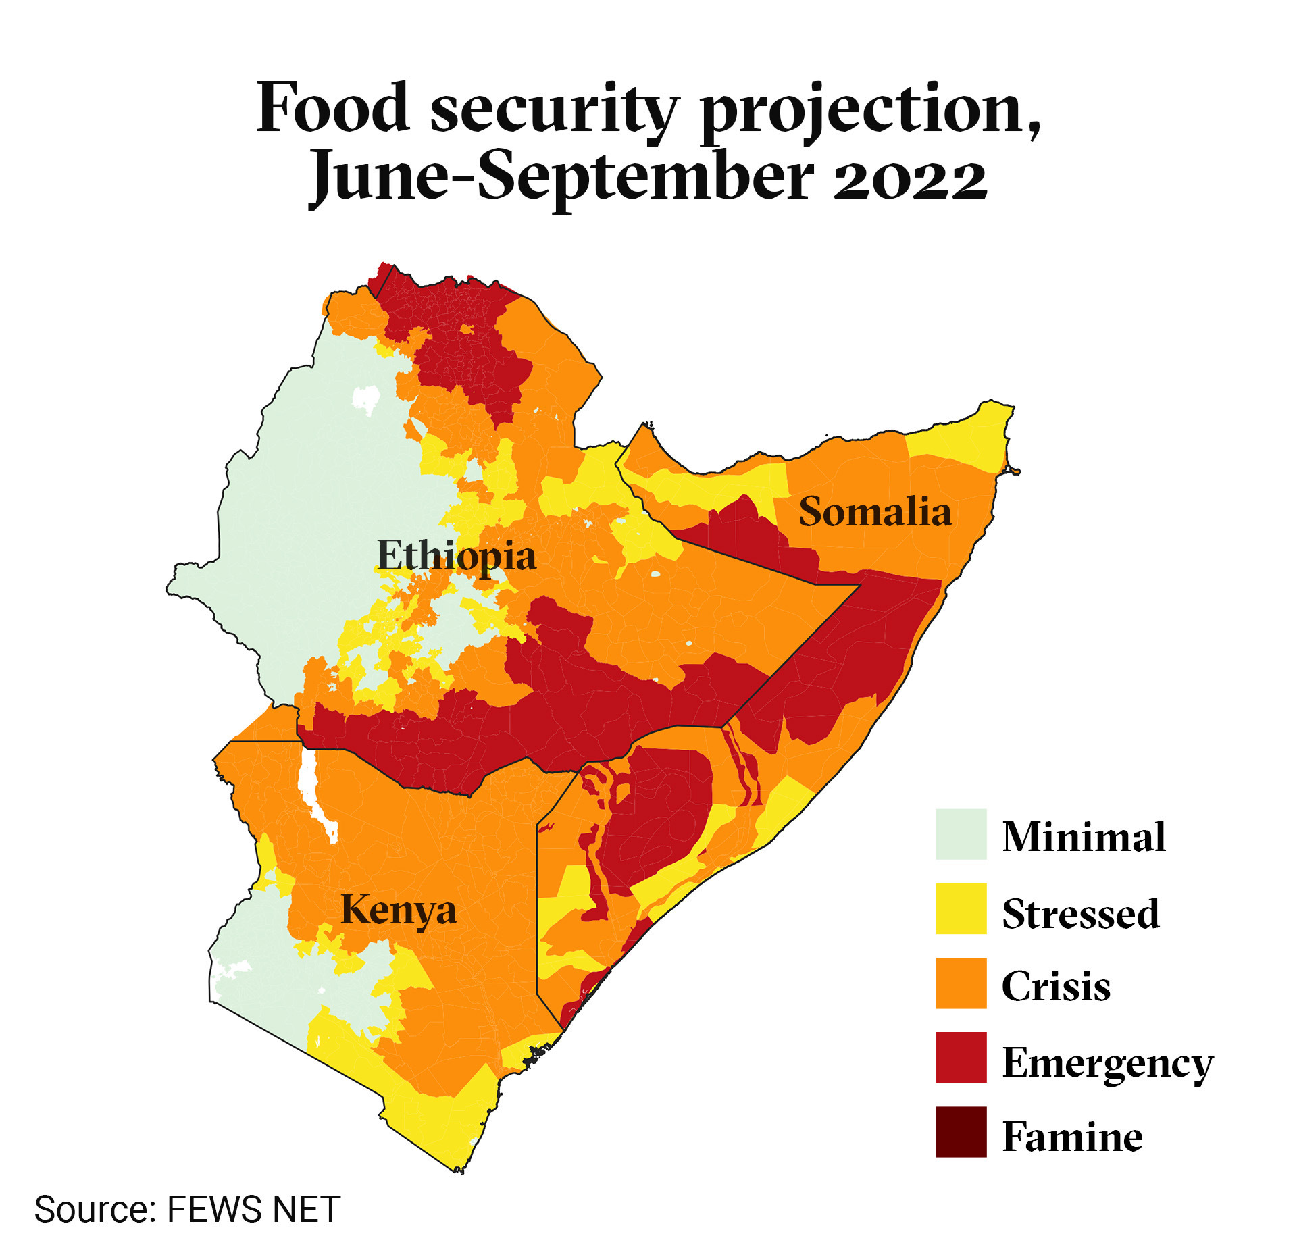
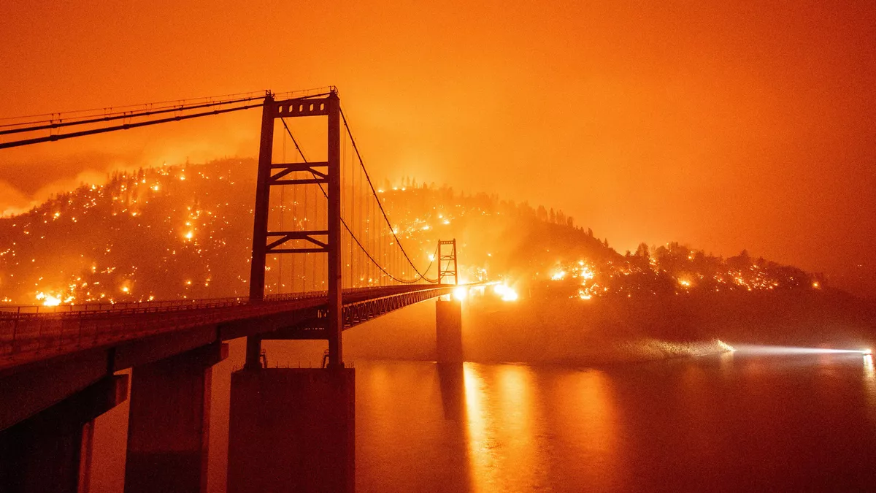
Extreme Events under Climate Change
  Statistical methods
    Monte Carlo and autoregression
    Conditional/Markov analysis
    Distribution analysis – tail behavior and skew
  Dynamical and/or blended methods
    Weather types
    Analogue studies
    Modeling Compound events
  Sector impact modeling (statistical & dynamical methods)
    Combining climate science with sector impacts
    Interrelationships of sectoral impacts
    Tailoring outputs to user needs
Hurricane Maria over
Puerto Rico 2017
Bidwell Bar Bridge, CA 2020

Slide 6
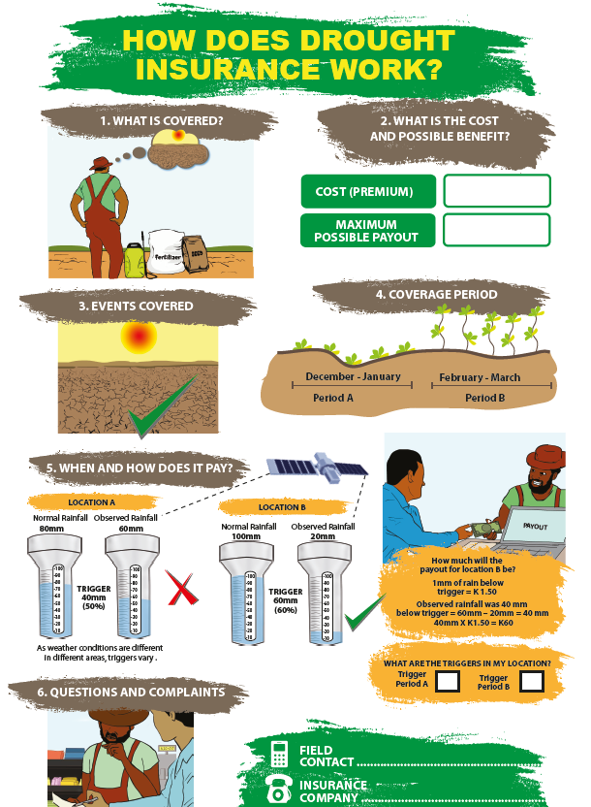

Financial Adaptations to Climate Risk
Weather/Climate Index Insurance
  Premiums depend on liability, historical climate, payout framework and default risk
Forecast Based Financing for Anticipatory Humanitarian Action
  geophysical index/human impact
  payout at threshold
  advantages: speed/timing, impact/reach
  challenges: uninsured/uncovered risks, errors, trust
  current applications: drought/famine risk
  future applications: heat waves, floods, health impacts, energy and water provision, etc.

Slide 7
Collaboration/Funding
EAS faculty: climate/pollutant/health, impacts of extreme events, paleoclimate/contemporary climate, natural disasters
IRI Columbia potential adjunct role
Federal and International Scientific Agencies
  US: NSF, NOAA, NASA, DOE, NIH, USGS, USDA, USGCRP
  International: WCRP, WMO, WHO, Wellcome Trust
Development and Humanitarian Organizations
  International Development: USAID, UKDfID, World Bank, other development banks
  Humanitarian: WFP, Red Cross/IFRC, UNOCHA, other UN
New York or US-based initiatives outside of CUNY
  NESDIS, NOAA CAP/RISA, UCCRN, CCSR
CCNY/CUNY affiliated
  NOAA-CESSRST, NOAA-CREST, CISC

Slide 8
Teaching/Advising/Curriculum
Goals
  Love, curiosity and appreciation for planet and those who inhabit it
  Subject mastery, creativity, teamwork
  Cope with climate risk in life, community and world
  Research program rooted in climate science, statistics, modeling, societal impact and UN Sustainable Development Goals (SDGs)
Existing Courses
  Earth Systems (Atmosphere and Ocean), Climate Change, Natural Disasters, Hydrology, Quantitative Methods
New/Refined Courses
  Climate and Society, Sector Impacts, Applied Forecasting, Quantitative Methods
Seminars
  CCNY/CUNY, other American universities, African institutions or universities
Internships, graduate programs, etc.
  CCNY/CUNY, Columbia, international organizations, African organizations
Earth and Climate Science AP course (with many other EAS scholars)

Slide 9
Challenge Topics
Climate Science
Critical climate uncertainties
Concerning feedback mechanisms
Extreme events: locally, regionally and globally
Coupled processes in a changing climate
Biogeochemical cycles and sequestration of carbon and heat
Climate Services
Tailoring of forecasts/projections
  Health; energy; food security; water management; coastal zones; infrastructure; cities
Interdependencies between sectors
Tradeoff between forecast skill and lead time
Mitigation/Decarbonization and International Policy
Greenhouse gasses (GHG) reduction prioritization
Policy approaches for decarbonization
Carbon negative tech and renewables – viability and scaling
Conference of Parties (COP) GHG reduction
COP loss and damage fund - efficacy

Slide 10
Justice, Equity, Diversity, and Inclusion (JEDI)
Climate Impacts are Justice and Equity Issue (research and teaching)
  IRI work about equity and justice across continents
  Princeton postdoc about justice and equity across societies and generations
  Class curricula at Rutgers focused on equity themes
Pipeline issue - limited racial diversity in Earth and Atmospheric Sciences
  Outreach: other colleges and international organizations
  Outreach: community for citizen science initiatives
  African institutions and universities
Student/researcher/faculty recruitment, hiring and acceptance
Connect with larger thematic initiatives through professional societies: AGU, AMS, AAG

Slide 11
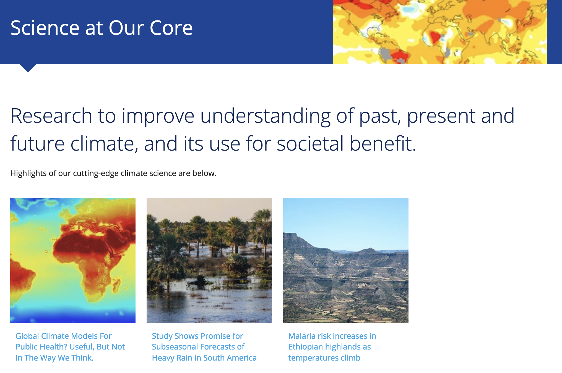
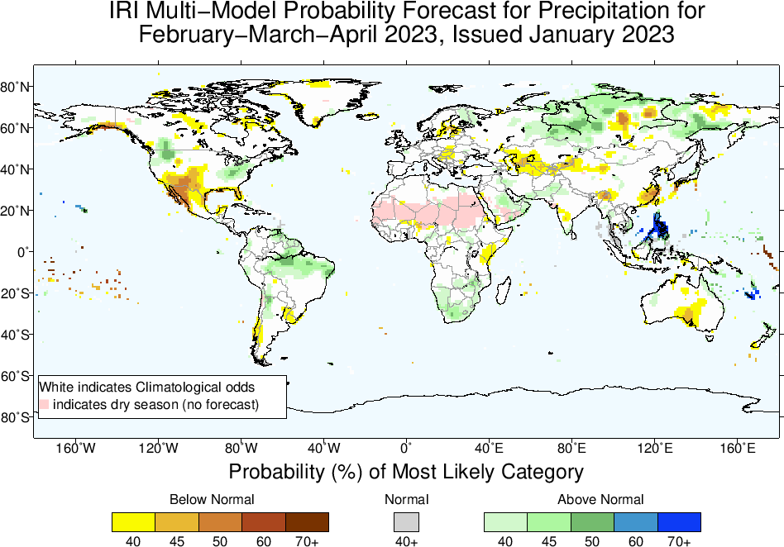
International Research Institute for Climate and Society (IRI)
Columbia’s Earth Institute/Climate School
25 years, grew from first successful El Nino prediction (1980s)
Global service mission (Africa, Latin America, Asia)
Connections with national met services, regional and international organizations
tools and products; digital maprooms, data library, seasonal and subseasonal forecasts, ENSO outlooks, forecasting software, trainings

Slide 12
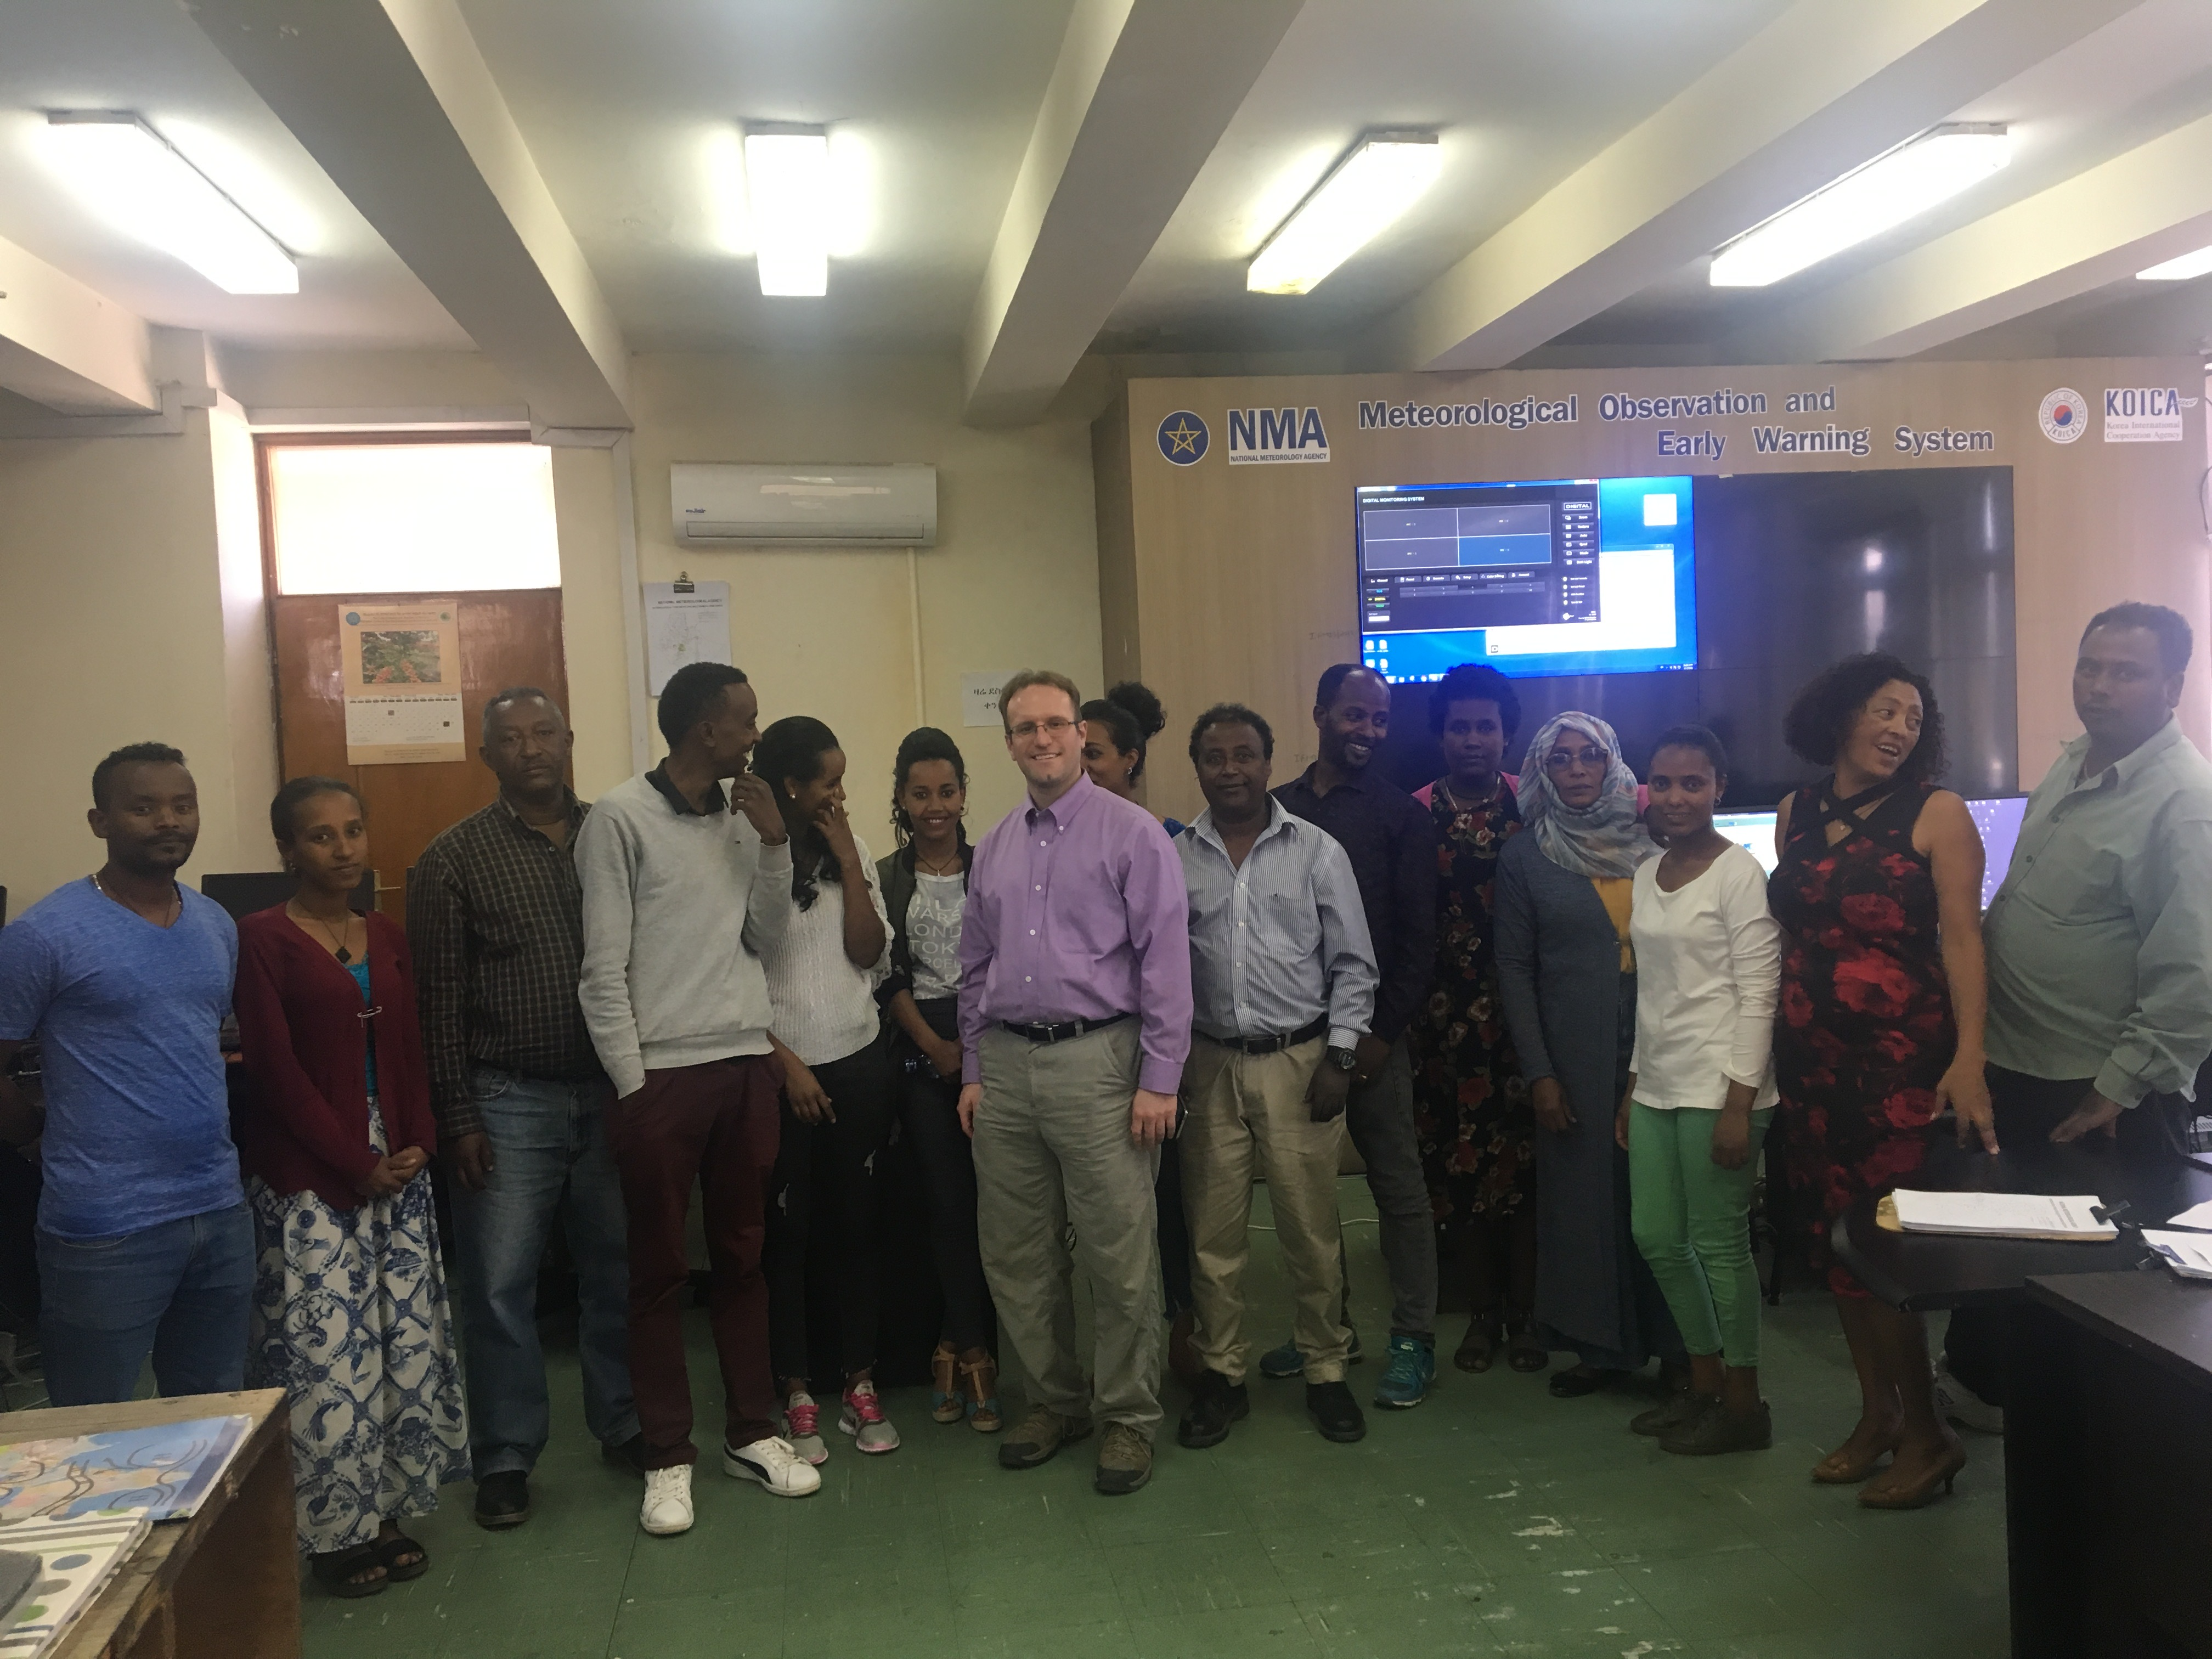
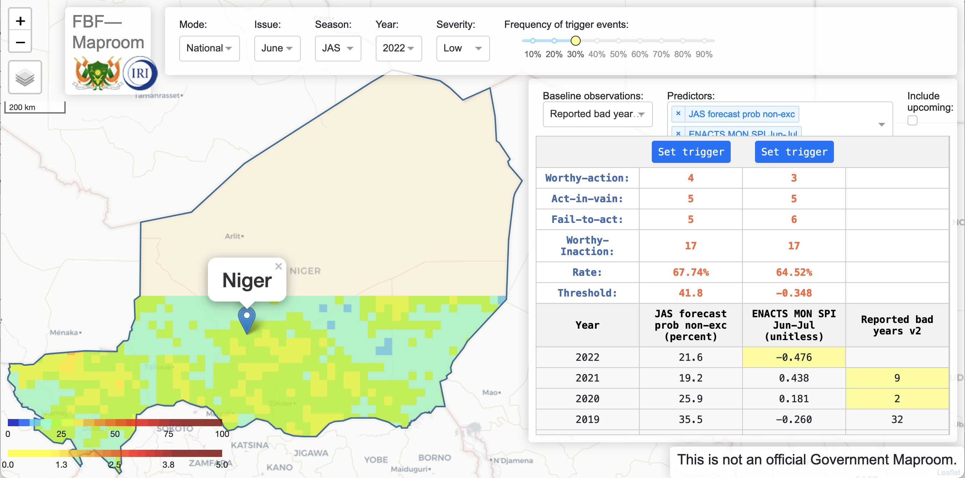
IRI Senior Staff Associate (2019-2022)
World Food Programme (WFP) Forecast-based Financing (FbF)
  Niger FbF project: 10 million USD humanitarian payout in 2022
  Scoping work in Zimbabwe and Malawi
Adapting Agriculture to Climate Today for Tomorrow (ACToday) – Columbia World Project
  Senegal, Ethiopia, Bangladesh(met service links)
  Remote trainings: (English) Zambia, Tanzania, Malawi, French – Senegal, Niger
  Curriculum development (2020-2022): CRMAE – Ethiopia (undergrad, grad short courses)
  Conference presentations - AGU, AMS, ITISE, NOAA CDPW
  Coauthor papers – Clim Dynamics, Atm Research, Atm and Clim Services, Int J of Clim, Malaria Journal (in review)
Forthcoming lead author papers – Climate Services (Senegal), Frontiers in Climate (Niger FbF)
Climate and energy: NOAA proposal, committee
Climate and health: Wellcome Trust proposal
Training in Addis Ababa, Ethiopia 2019
Niger FbF maproom tool

Slide 13
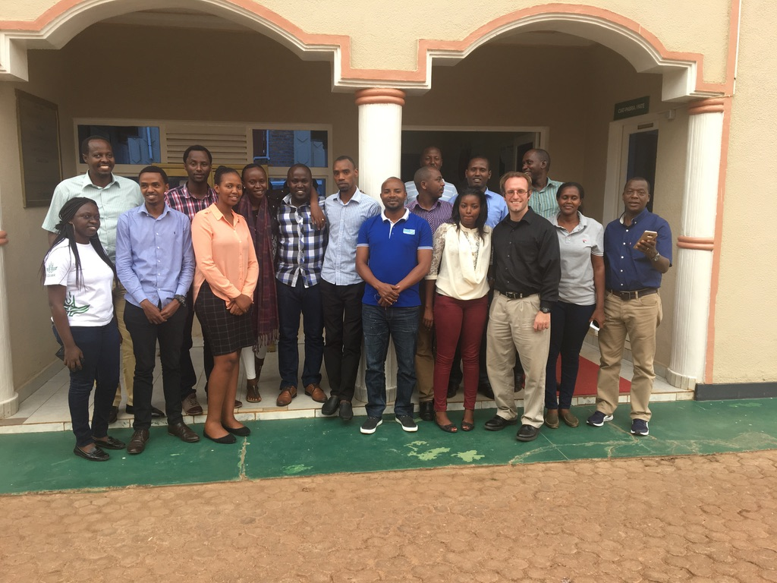
IRI Postdoc (2016-2019)
Climate Change, Agriculture and Food Security (CCAFS) Rwanda (USAID) (2016-2019)
  Worked with staff at MeteoRwanda, Rwanda Agriculture Board (RAB) and CIAT-Rwanda
  Forecasting multiple variables, seasons and pilot locations
  Training trips (6 to Africa, 1 to Bangladesh)
  Collaborative research/advising (external adviser for two MS theses among MeteoRwanda staff)
  2018 Africa Climate Smart Project of the year
  Lead author paper - Int J of Clim (data gap)
USAID/ UKDfID (CCAFS/WISER) (2016-2019)
  Forecasting training/collaboration with regional African partners (ICPAC, AGRHYMET)
Conference presentations – AGU, AMS, GHACOF
Training in Kigali, Rwanda 2017
From Siebert et al. 2019 International Journal of Climatology

Slide 14
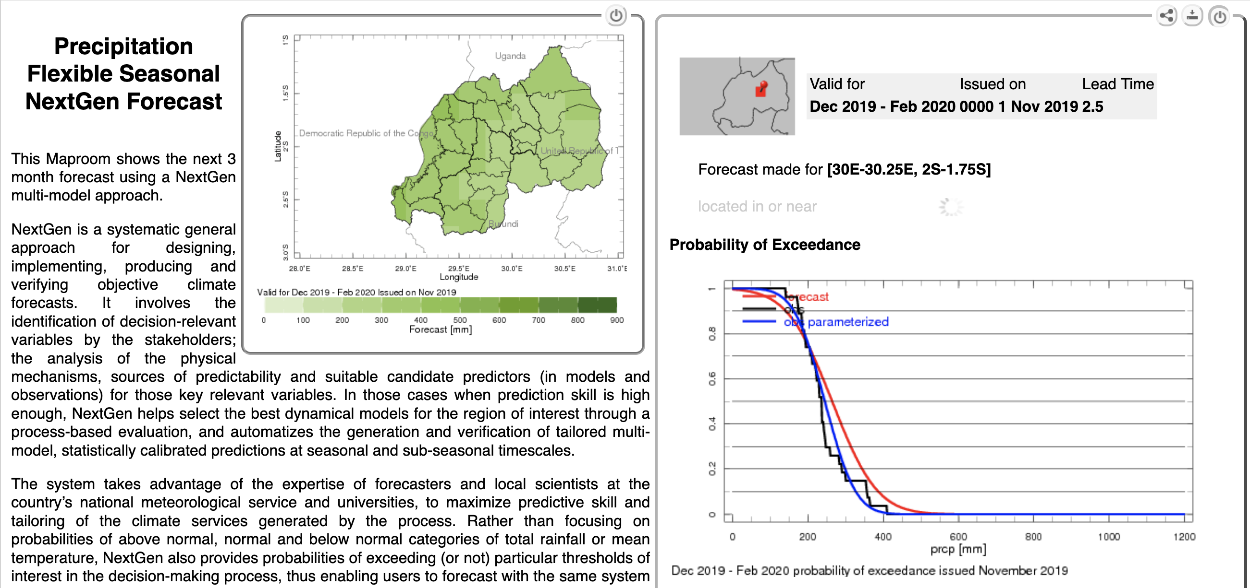
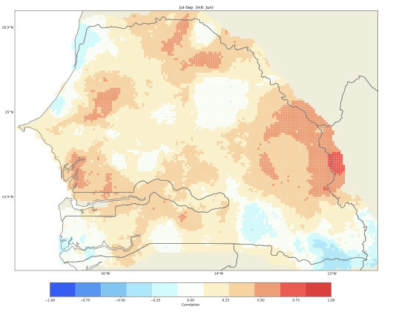
Methods and Tools
Quantitative
  Data types – station, satellite, reanalysis, GCM
  Data fields – precipitation, temperature, SST, winds, NDVI, population, income, vulnerability
  Software – Matlab, R, Python, GIS
  IRI specific tools and data – Ingrid, CPT, PyCPT, CDT, ENACTS, IRIDL
  Methods – correlation and regression (forecasting), Monte Carlo, Integrated Assessment Models (IAMs), wavelet analysis
Qualitative and mixed
  Interviews and Surveys
  Vulnerability data
  Stakeholder workshops/User trainings
Future Research
  Data sources/platforms – remotely sensed data, GCMs/RCMs, Google Earth Engine
  Software – R, Python, Matlab, GIS/QGIS,
  Methods – cluster analysis, weather types, Markov analysis, Bayesian methods, extreme value theory
Nov issue DJF 2019/20 rainfall forecast Rwanda
Correlation of NMME JAS rainfall forecast
(from June) with observations for Senegal

Slide 15
Princeton Postdoc (2015-2016)
Princeton Environment Institute
  research with economists, public health experts, engineers and philosophers
Climate-economy IAMs of carbon tax, emissions and impacts
  Economic distribution of damages
  Economic distribution of mitigation costs
  Population scenarios
  Health co-benefits and risks
Coauthor papers in Proc Nat Acad Sciences, Clim. Change, WB Econ Rev
From Dennig et al. 2015 PNAS
From Scovronick et al. 2017 PNAS

Slide 16
PhD, Rutgers Geography (2009-2015)
Dissertation (2014-15): index insurance as a risk adaptation in the Sahel with climate change and multi-decadal variability
  Data – station and merged rainfall, ENSO, NDVI, hydrology/streamflow, GCMs from CMIP5
  Statistical methods (Monte Carlo and autoregression)
  Research trip to Niger 2010 (ACMAD, AGRHYMET, Niger Basin Authority)
Teaching
  Dissertation Teaching Award; Climate and Society (undergrad 2014)
  Rutgers Geography (undergrad 2010-2013)
  Columbia Climate & Society (grad 2009, 2010)
Qualifying Exams (2011)
  Climatology, Hydrology, Adaptation/Insurance, Geography
Conferences - AAG, AMS, (US) WCRP, AMMA (France 2010, 2012)
Lead author papers: Afr. Geog. Review; GeoCompass; Clim. Change; Wea Clim and Soc, J App Met Clim (AAG CSG Award)
From Siebert and Ward 2014 African Geographical Review
From Siebert 2016 Weather, Climate and Society

Slide 17
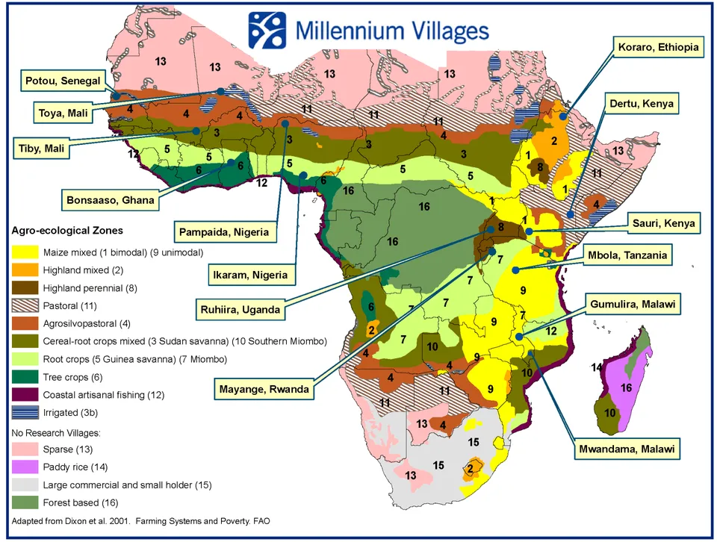
Pre-PhD (before 2009)
Staff Associate IRI (2006-2008)
  Developed drought index insurance contracts for 12 locations across Africa (Millennium Villages Project)
  Work funded by Swiss Reinsurance
  Conferences - AMS
MA, Columbia Climate and Society (2005-2006)
  Internship at NASA-GISS CCSR working with NYCDEP
Grad student, MIT-WHOI (2002-2004)
BA, Princeton Geosciences (1998-2002)
  Internship at Ohio State BPRC, senior thesis on analysis of ENSO record from Andean ice core
NYC DEP 2008 Climate Change Report
From Siebert and Ward 2011 JAMC

Slide 18
Summary
Research
  Seasonal forecasting for sectoral applications (particularly health and energy)
  Extreme events in a changing climate (statistical, dynamical, sector impact modeling)
  Financial adaptations to climate risk (index insurance, forecast based financing)
Collaboration
  EAS faculty, CCNY/larger CUNY community, social sciences, IRI/Columbia, international partners
Funding
  Federal and international scientific agencies, international development and humanitarian organizations
Teaching/Curriculum Development
  Teach or co-teach existing courses on climate, earth system science, natural disasters and quantitative methods
  Develop new courses on societal impact, applied forecasting, quantitative methods
  Outreach to other universities and international contacts for joint seminars/classes
Advising
  climate services framework rooted in earth system science and societal impact
  internship potential through local resources, Columbia, and international partners
Justice, Equity, Diversity, Inclusion (JEDI)
  Climate impacts as a justice and equity issue, pipeline issue for underserved minorities in Geosciences, community outreach, connect with larger initiatives through professional societies

Slide 19
Personal
family – wife and two little kids, ages 3 and 1
music – trumpet, piano; classical, klezmer, and jazz, composition
website – climate writing, science, code (in development)
recreation - hiking, martial arts, tennis, various other sports
energy at home - plug in hybrid car, renewable energy supplier
Severance filming
environmental and socioeconomic justice causes

Slide 20
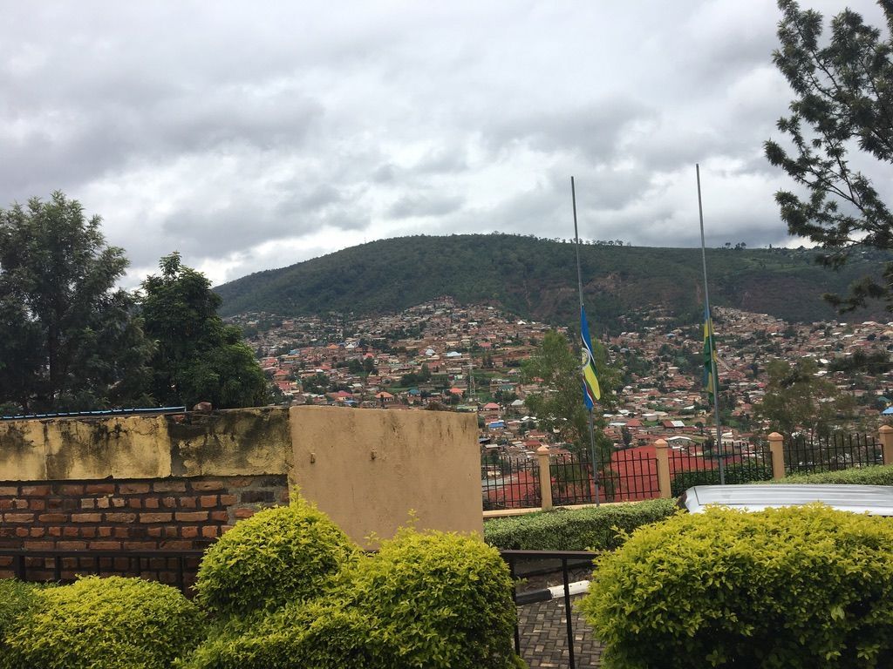
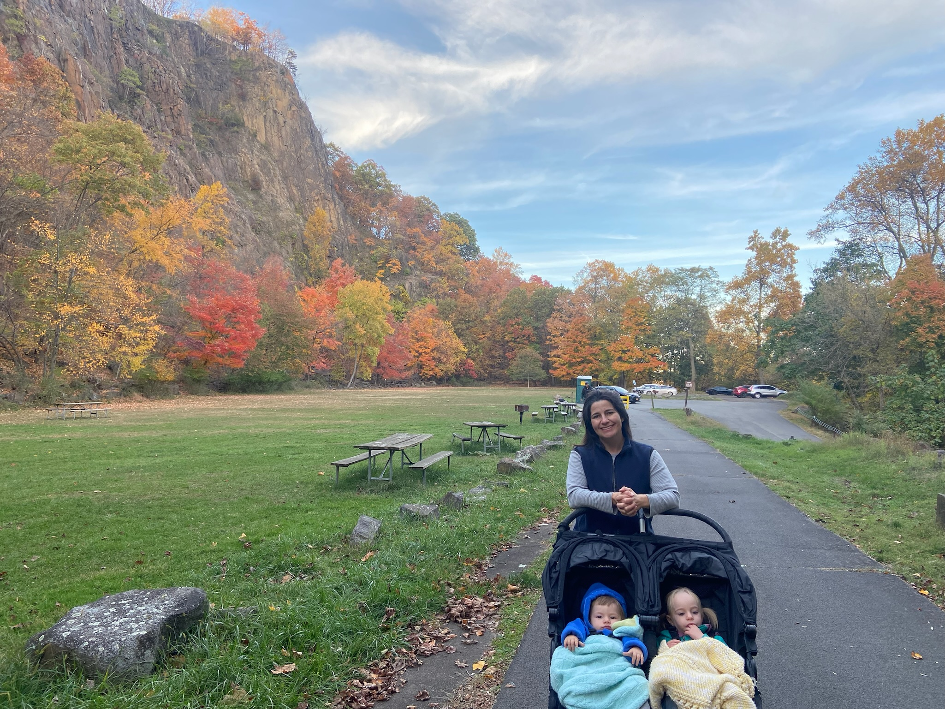
Thanks
CCNY EAS Search Committee
  Professors Zhengzhao Luo, Pengfei Zhang, Zhengrong Wang, Maria Tzortziou, and Karin Block
IRI Colleagues
  Andrew Robertson, Daniel Osgood, James Hansen, Tufa Dinku, Simon Mason, John Furlow, Remi Cousin, Sylwia Trzaska
  Funding organizations: USAID, WFP, WMO, UKDfID, CWP, Swiss Re
Rutgers PhD Committee
  David Robinson, Neil Ward, Robin Leichenko, Asa Rennermalm, Kenneth Mitchell
Other Mentors
  Princeton: Robert Socolow, Marc Fleurbaey (postdoc), George Philander, Jorge Sarmiento (undergrad)
  Columbia: Mark Cane, Tony Barnston, Mingfang Ting, Upmanu Lall, Lisa Goddard
  Internships: Cynthia Rosenzweig (NASA-GISS), Lonnie Thompson (OSU BPRC)
  Africa: Desire Kagabo (CIAT-Rwanda), Ousmane Ndiaye (ANACIM), Zewdu Segele (ICPAC), Mohammed Kadi (ACMAD), Dawit Solomon (EIAR -Ethiopia)
Family
Kigali, Rwanda
Hook Mountain Plateau, Nyack, NY
Notes:
Explain the pics

Slide 21
Acronyms and Links
AAG – Association of American Geographers
ACMAD – African Center for Meteorological Application to Development (Niamey, Niger)
ACToday – Adapting Agriculture to Climate Today for Tomorrow (CWP)
AGRHYMET –Center for Agriculture, Hydrology and Meteorology (Niamey, Niger)
AGU – American Geophysical Union
AMMA – African Monsoon Multidisciplinary Analysis
AMS – American Meteorological Service
ANACIM – Agence Nationale de l’Aviation Civile et de la Météorologie (Senegal)
BPRC – Byrd Polar Research Center (Ohio State)
CCAFS – Climate Change, Agriculture and Food Security
CCSR – Center for Climate Systems Research
CDPW - Climate Diagnostics and Prediction Workshop (NOAA)
CDT – Climate Data Tools
CGIAR – Consultative Group for International Agricultural Research
CIAT – International Center for Tropical Agriculture
CISC – CUNY Institute for Sustainable Cities
CMIP – Coupled Model Intercomparison Project
CPT – Climate Predictability Tool
CRMAE – Climate Risk Management for Agricultural Extension
CWP – Columbia World Projects
EIAR – Ethiopian Institute of Agricultural Research
ENACTS – Enhancing National Climate Services
ENSO – El Nino Southern Oscillation
FbF – Forecast Based Financing
GCM – Global Climate Model
GHACOF – Greater Horn of Africa Climate Outlook Forum
IAM – Integrated Assessment Model
ICPAC – Intergovernmental Authority on Development (IGAD) Climate Prediction and Applications Centre (Nairobi, Kenya)
IRI – International Research Institute for Climate and Society (Palisades, NY)
IRIDL – IRI Data Library
ITISE – International Conference on Time Series and Forecasting
JEDI – Justice, Equity, Diversity, and Inclusion
NASA-GISS – NASA-Goddard Institute for Space Studies (New York)
NDVI – Normalized Difference Vegetation Index
NESDIS – National Environmental Satellite Data Information Service
NMME – North American Multi-Model Ensemble
NOAA CAP/RISA – Climate Adaptation Partnerships (regional within US)
NOAA-CESSRST - Center for Earth System Sciences and Remote Sensing Technologies
NOAA-CREST - Cooperative Remote Sensing and Technology Center
NYCDEP – Department of Environmental Protection
RAB – Rwanda Agriculture Board
RICE – Regional Integrated Climate-Economy Model
PyCPT – Python based CPT
UCCRN – Urban Climate Change Research Network
UKDfID – UK Department for International Development
UNOCHA – Organization for the Coordination of Humanitarian Affairs
USAID – US Agency for International Development
WCRP – World Climate Research Program
WHO – World Health Organization
WHOI – Woods Hole Oceanographic Institute
WISER – UK Met Office Weather and Climate Information Services
WFP – World Food Programme
WMO – World Meteorological Organization

