Slide 1
Climate Forecasting and Societal Impact
Asher Siebert
Applied Climate Scientist
ClimateBase Fellow
November 2023
https://www.linkedin.com/in/asher-siebert-7016065/
https://asclimateservices.org/
asherb.siebert@gmail.com

Slide 2
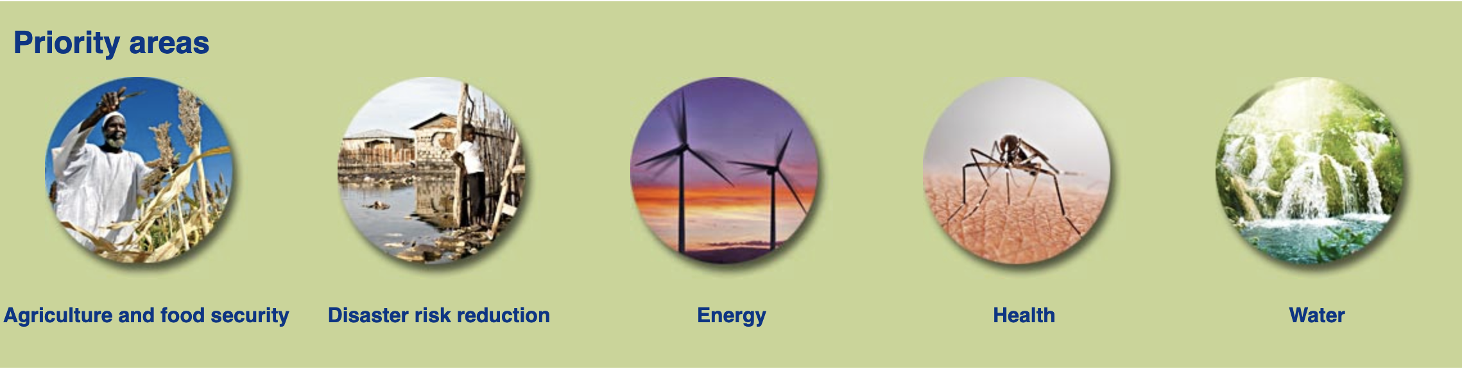
Overview of Global Climate Services
Climate Services: motivated by user-defined needs and decisions, sound science, co-production, tailored to application and time scale
World Meteorological Organization Global Framework for Climate Services (GFCS)
Principles
UN Sustainable Development Goals (SDGs)– 17 goals
  Poverty, hunger, health, education, gender equality, water/sanitation, energy, economic growth, infrastructure, inequality, sustainability, consumption/production, climate, biosphere oceans, biosphere land, peace, partnerships
GFCS Priority Areas
Global: Governance (UN), Scientific (IPCC, WMO, WHO), Humanitarian (WFP, IFRC), Financial (World Bank, IMF)
Regional: Scientific, Humanitarian, Financial
National: Governance, Scientific, Civil Society, Financial
Sub-National: Governance, Scientific and extension, Local Organizations, Financial Institutions, Public-private partnerships

Slide 3
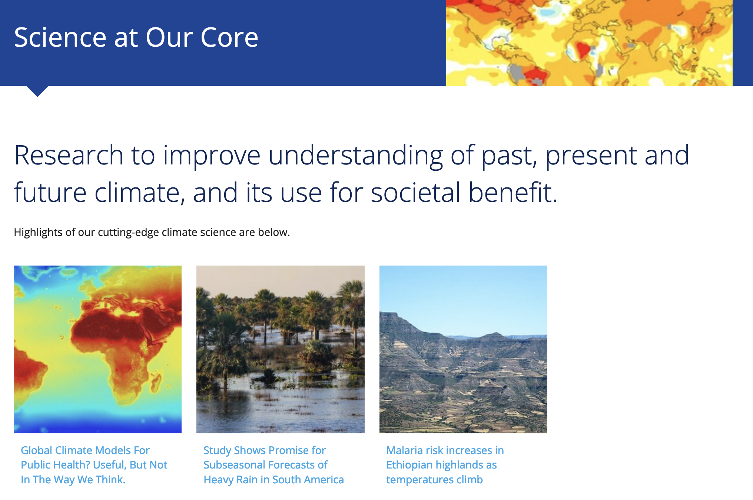
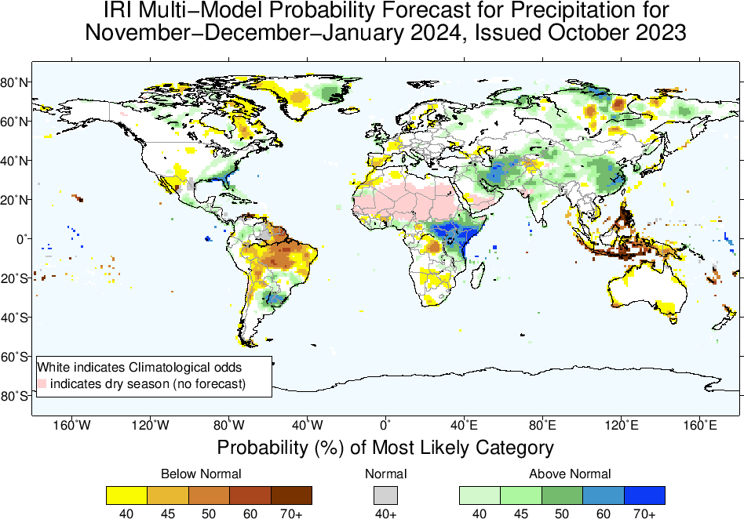
International Research Institute for Climate and Society (IRI), Columbia University Climate School
26 years: grew from first successful El Nino prediction (1980s)
NOAA core grant period 1997-2012, soft money period 2012-present, ACToday (2017-2022)
Global climate services mission (Africa, Latin America, Asia)
Connections with national met services, regional and international science, agricultural, financial, humanitarian and development organizations
Core Expertise
  Seasonal Forecasting
  ENSO outlooks
  Subseasonal Forecasting
Tools
  Forecasting Software
  Data library
  Maprooms
  ENACTS (Enhancing NAtional ClimaTe Services)
Mission
  Agriculture and Food Security support (crop calendars, climate risk matrix, crop modeling)
  Public Health planning, water/vector-borne disease
  Financial Instruments: Forecast-based Finance, Index Insurance
  Training and Capacity Building

Slide 4
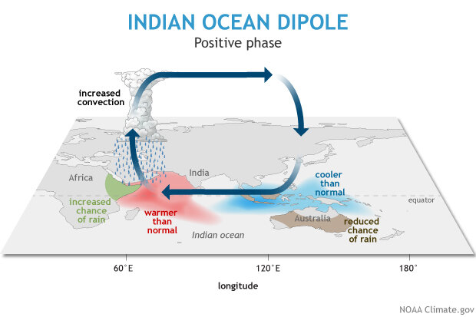
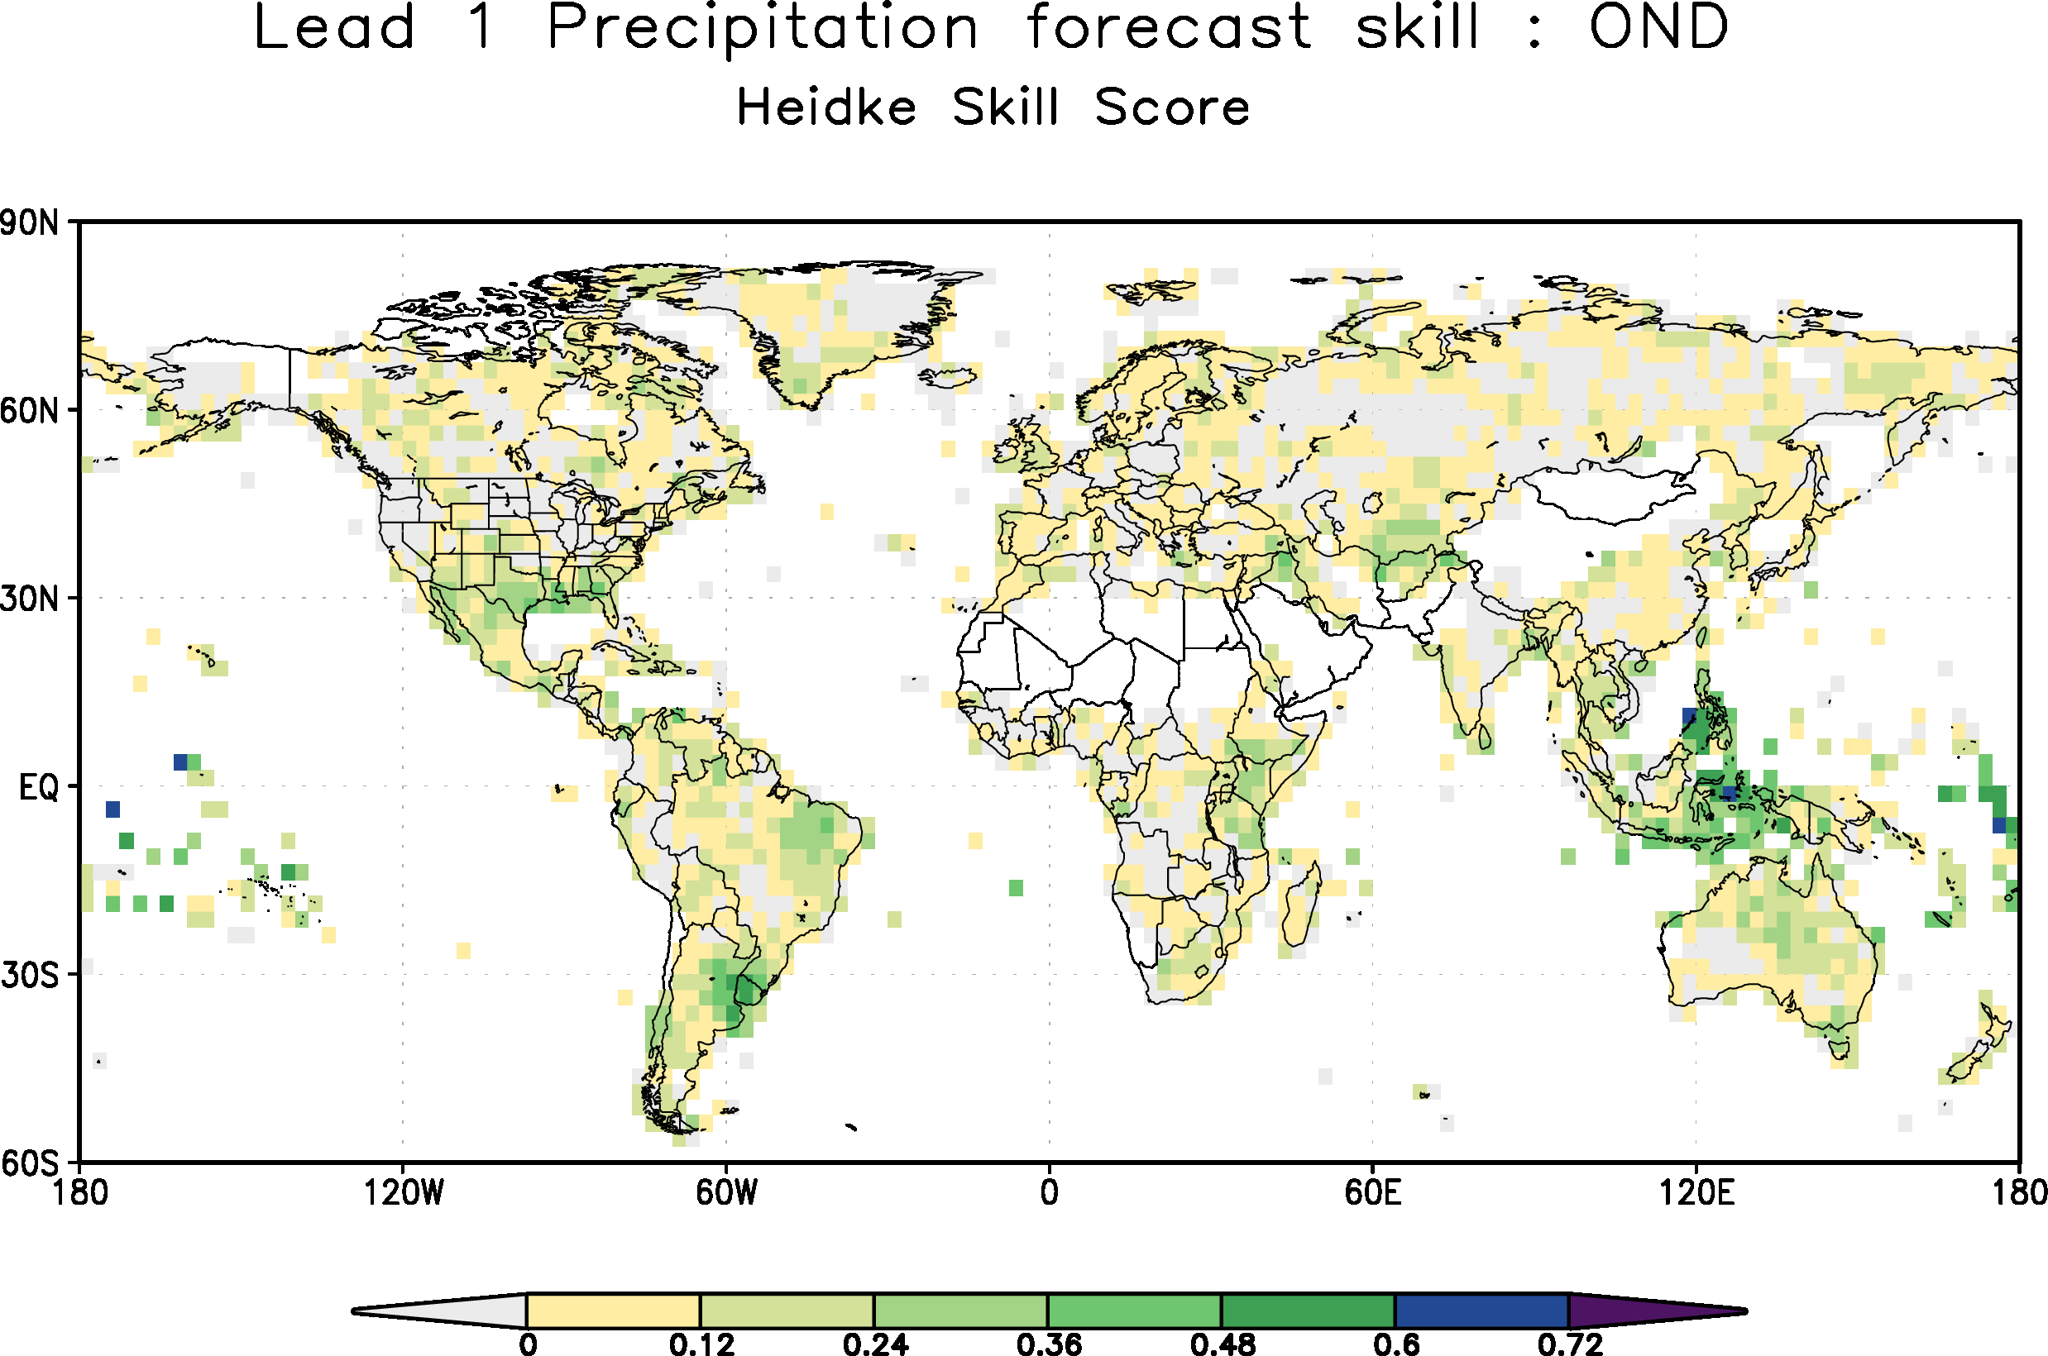
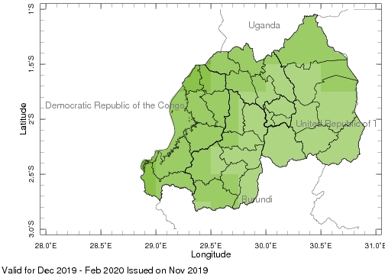
Seasonal Forecasting
Time Scale: 2 months to a year
Sources of Predictability: El Nino/La Nina (ENSO), and other coupled oscillations
Methods: Regression-based calibrated multi-model ensemble forecasts
Skill assessment of forecasts
Global forecasts
National and regional forecasts
Climate Predictability Tool (CPT) and PyCPT

Slide 5
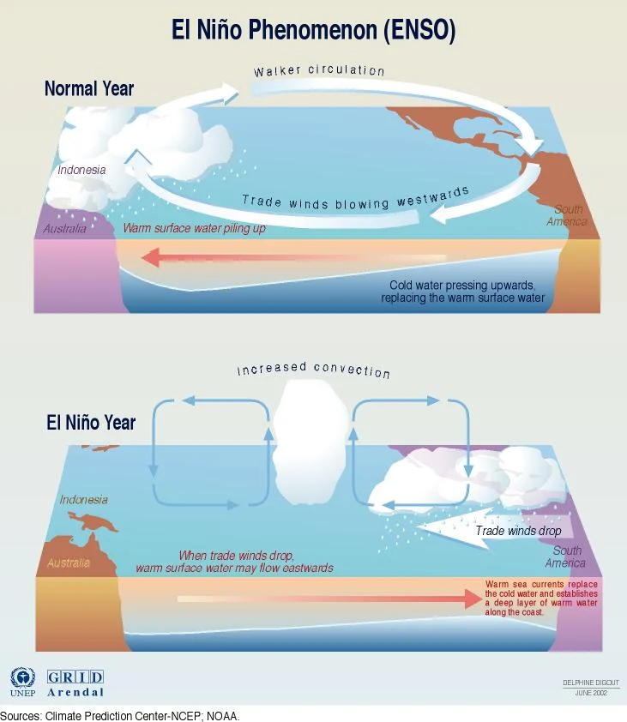
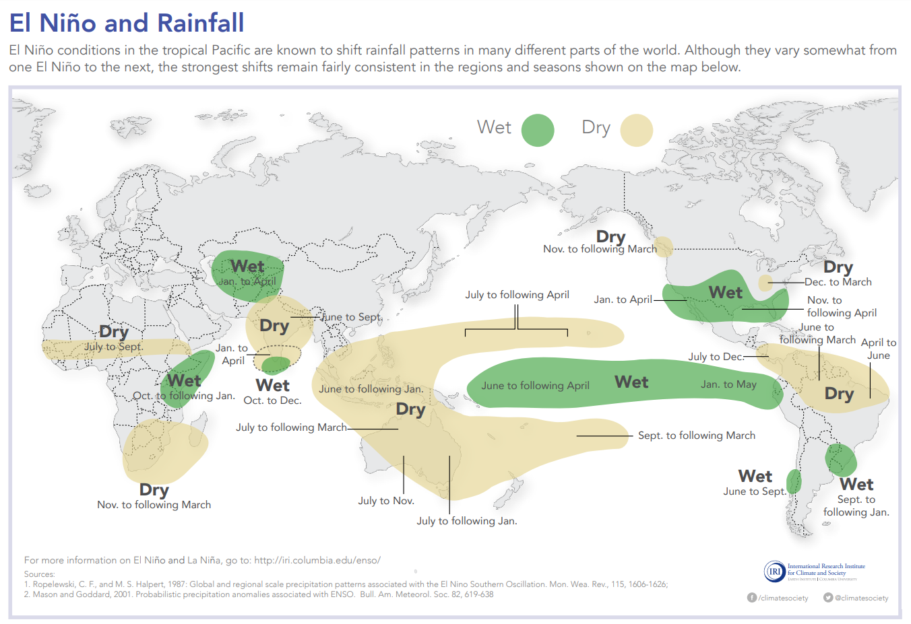
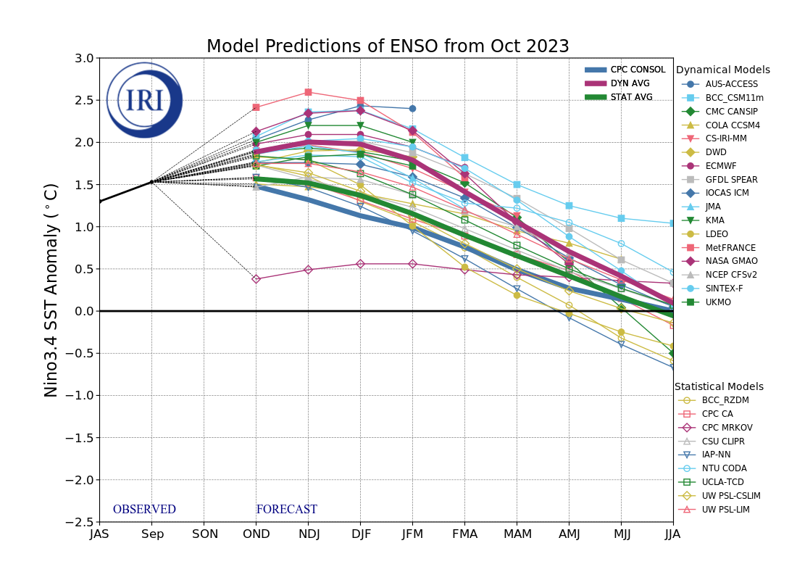
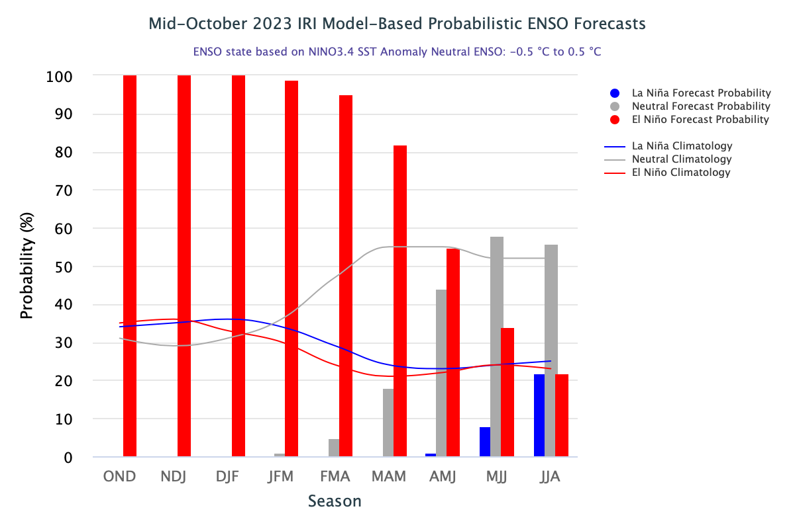
ENSO outlooks
El Nino a major driver of global climate on a 2-7 year period
Global teleconnections to all ocean basins and the extra-tropics but signal strongest in the tropics
Multi-Model Plume based forecast
2023 is moderately strong El Nino

Slide 6
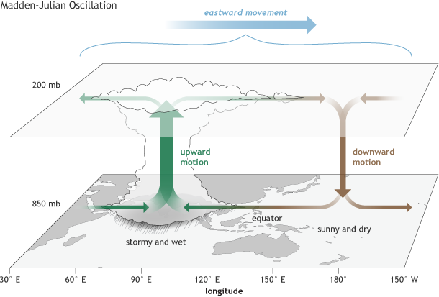
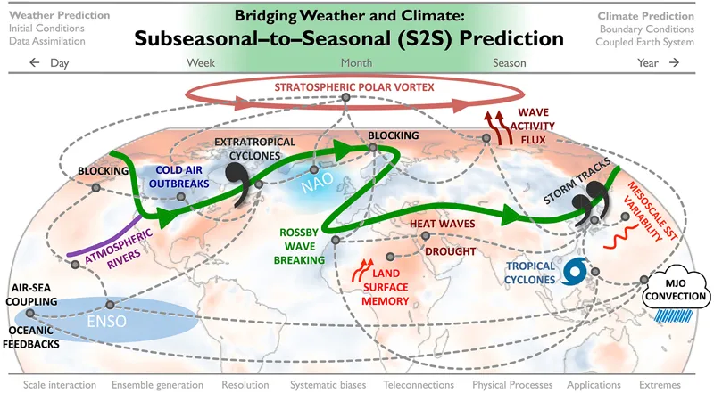
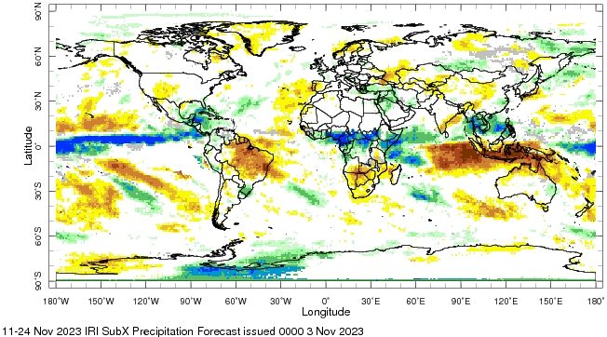
Subseasonal Forecasting
Time Scale: 2 weeks to two months
Can have lower predictive skill than at seasonal time scales, but critically important for many decisions
Sources of Predictability: Madden Julian Oscillation (MJO),
Methods: Regression-based Calibrated Multi-Model Ensemble Forecasts
Skill assessment of forecasts
Global S2S prediction project
NOAA Climate Program Office SubX project
IRI S2S page

Slide 7
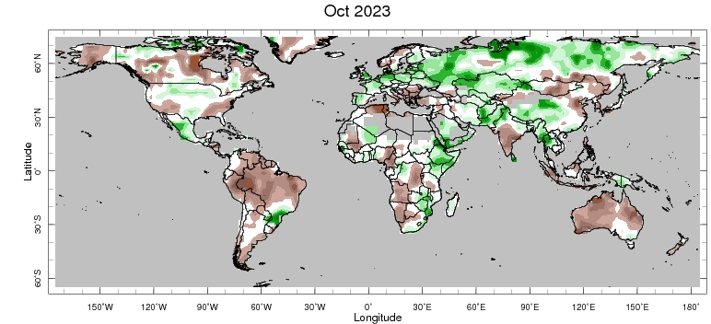
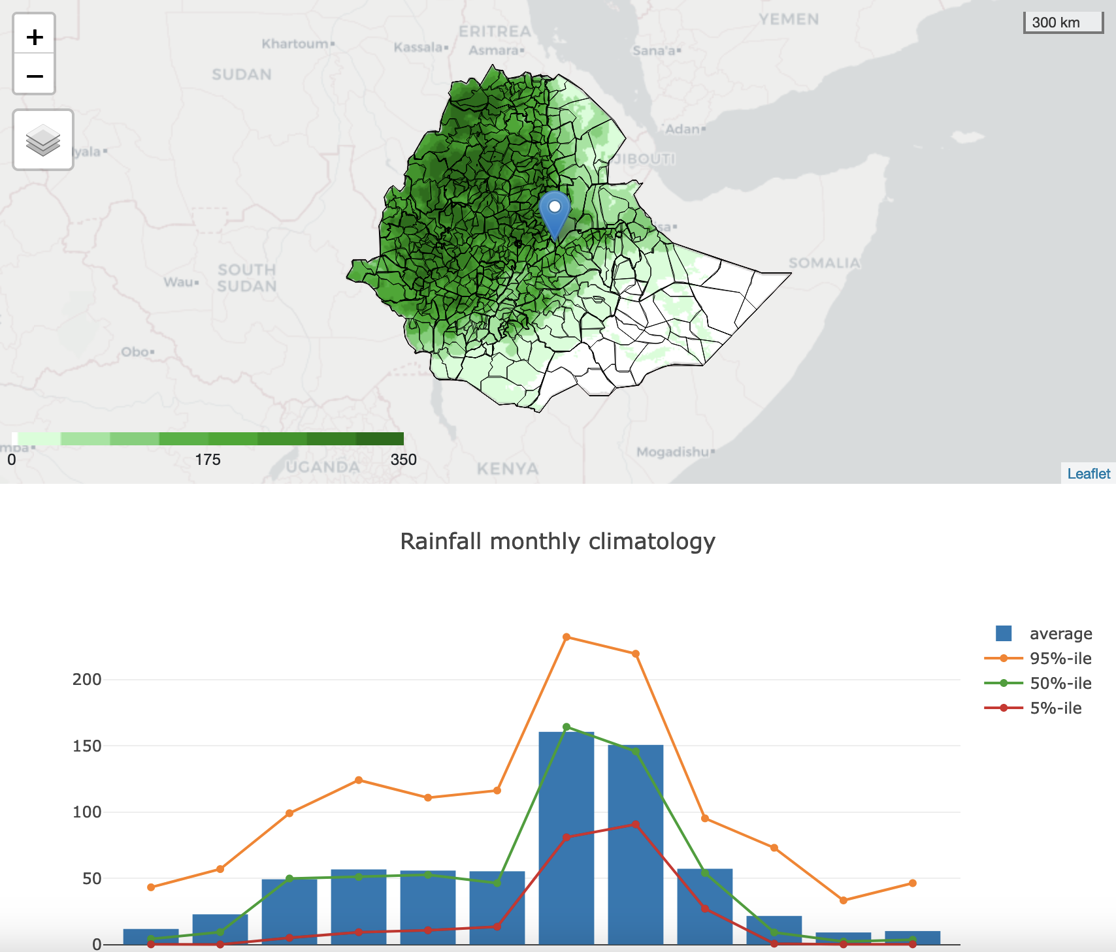
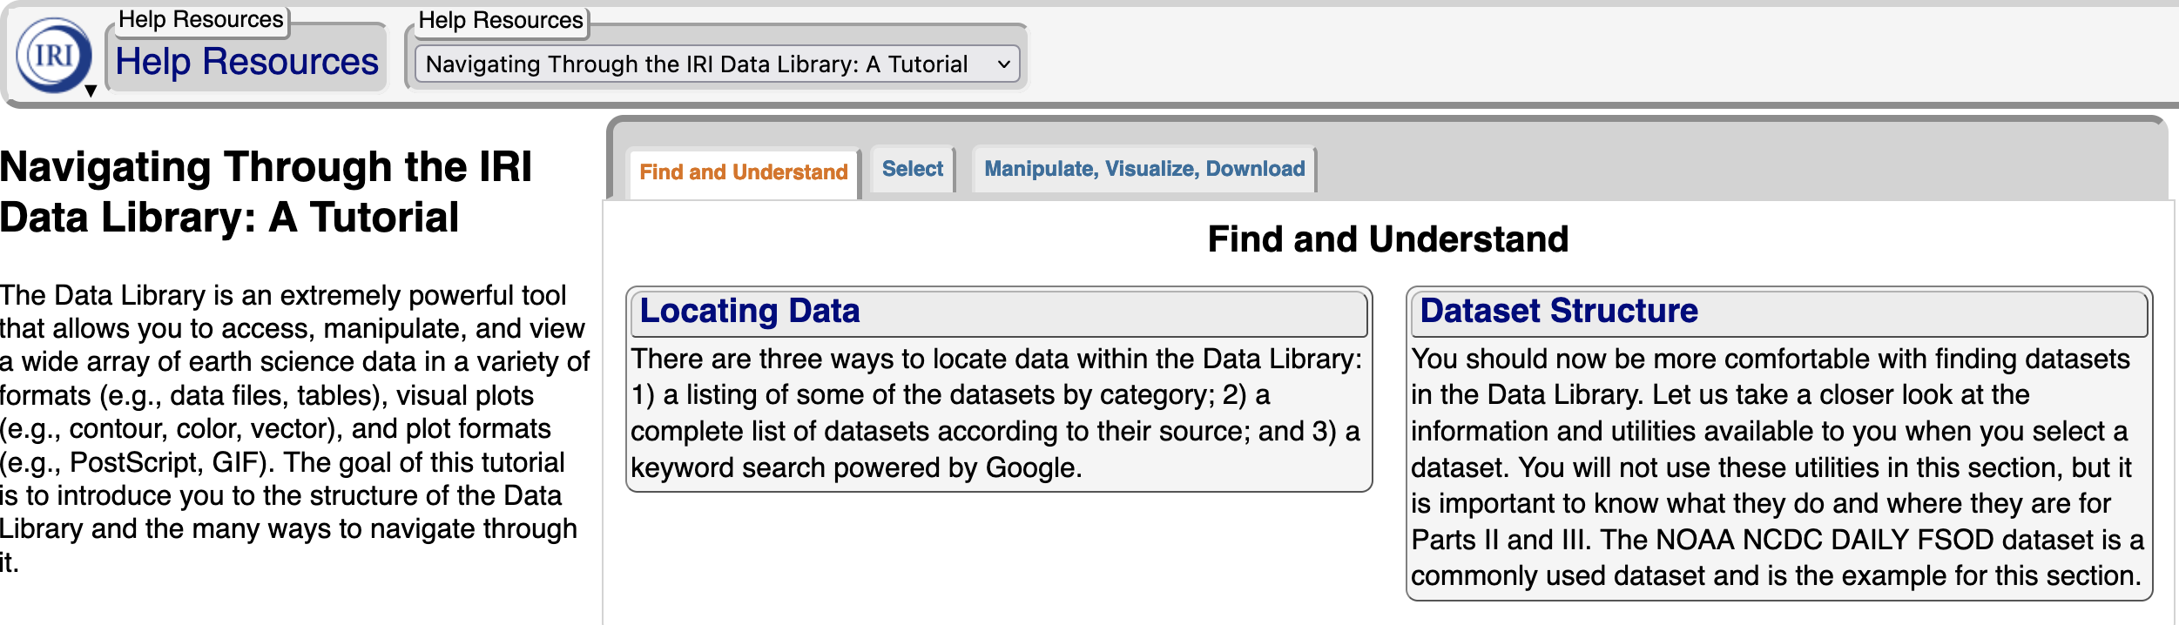
Data Library and Maprooms
IRIDL hosts several hundred datasets of geophysical and ”impact” data from a wide array of sources and the link is here: iridl.ldeo.columbia.edu
Can select dataset of choice, time frame, geography, and conduct analysis
Server side analysis leads to unique URL for each analysis/download
Maprooms available for many climate fields and regions
Also installed on partner sites: example from Ethiopia

Slide 8
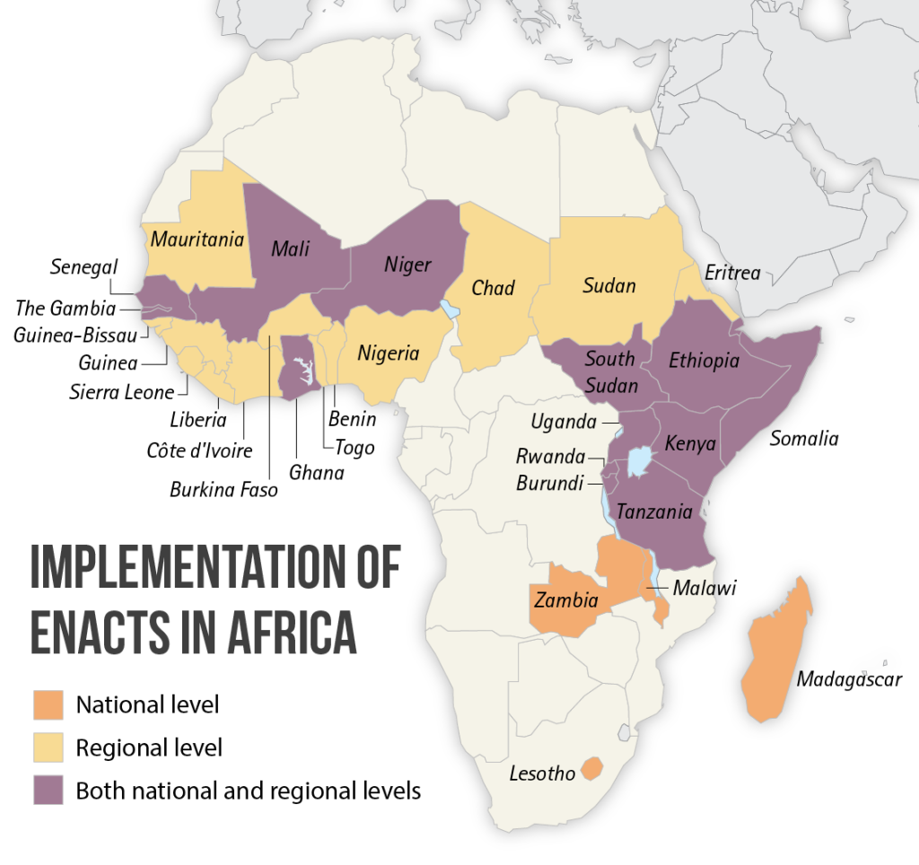
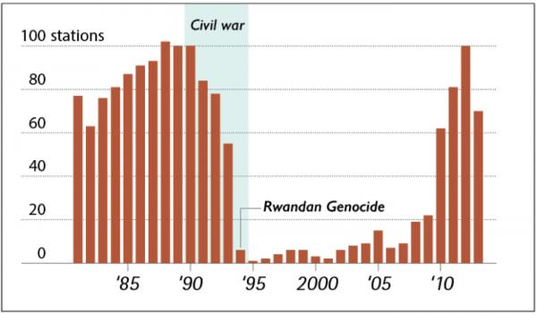
Enhancing National ClimaTe Services (ENACTS)
Data limitations pose a significant challenge in developing world
ENACTS is an collaboration with NMHS to produce satellite-station blended data to
fill spatial and temporal gaps
refine the quality of the product
promote the access to the data
facilitate the use across sectors

Slide 9
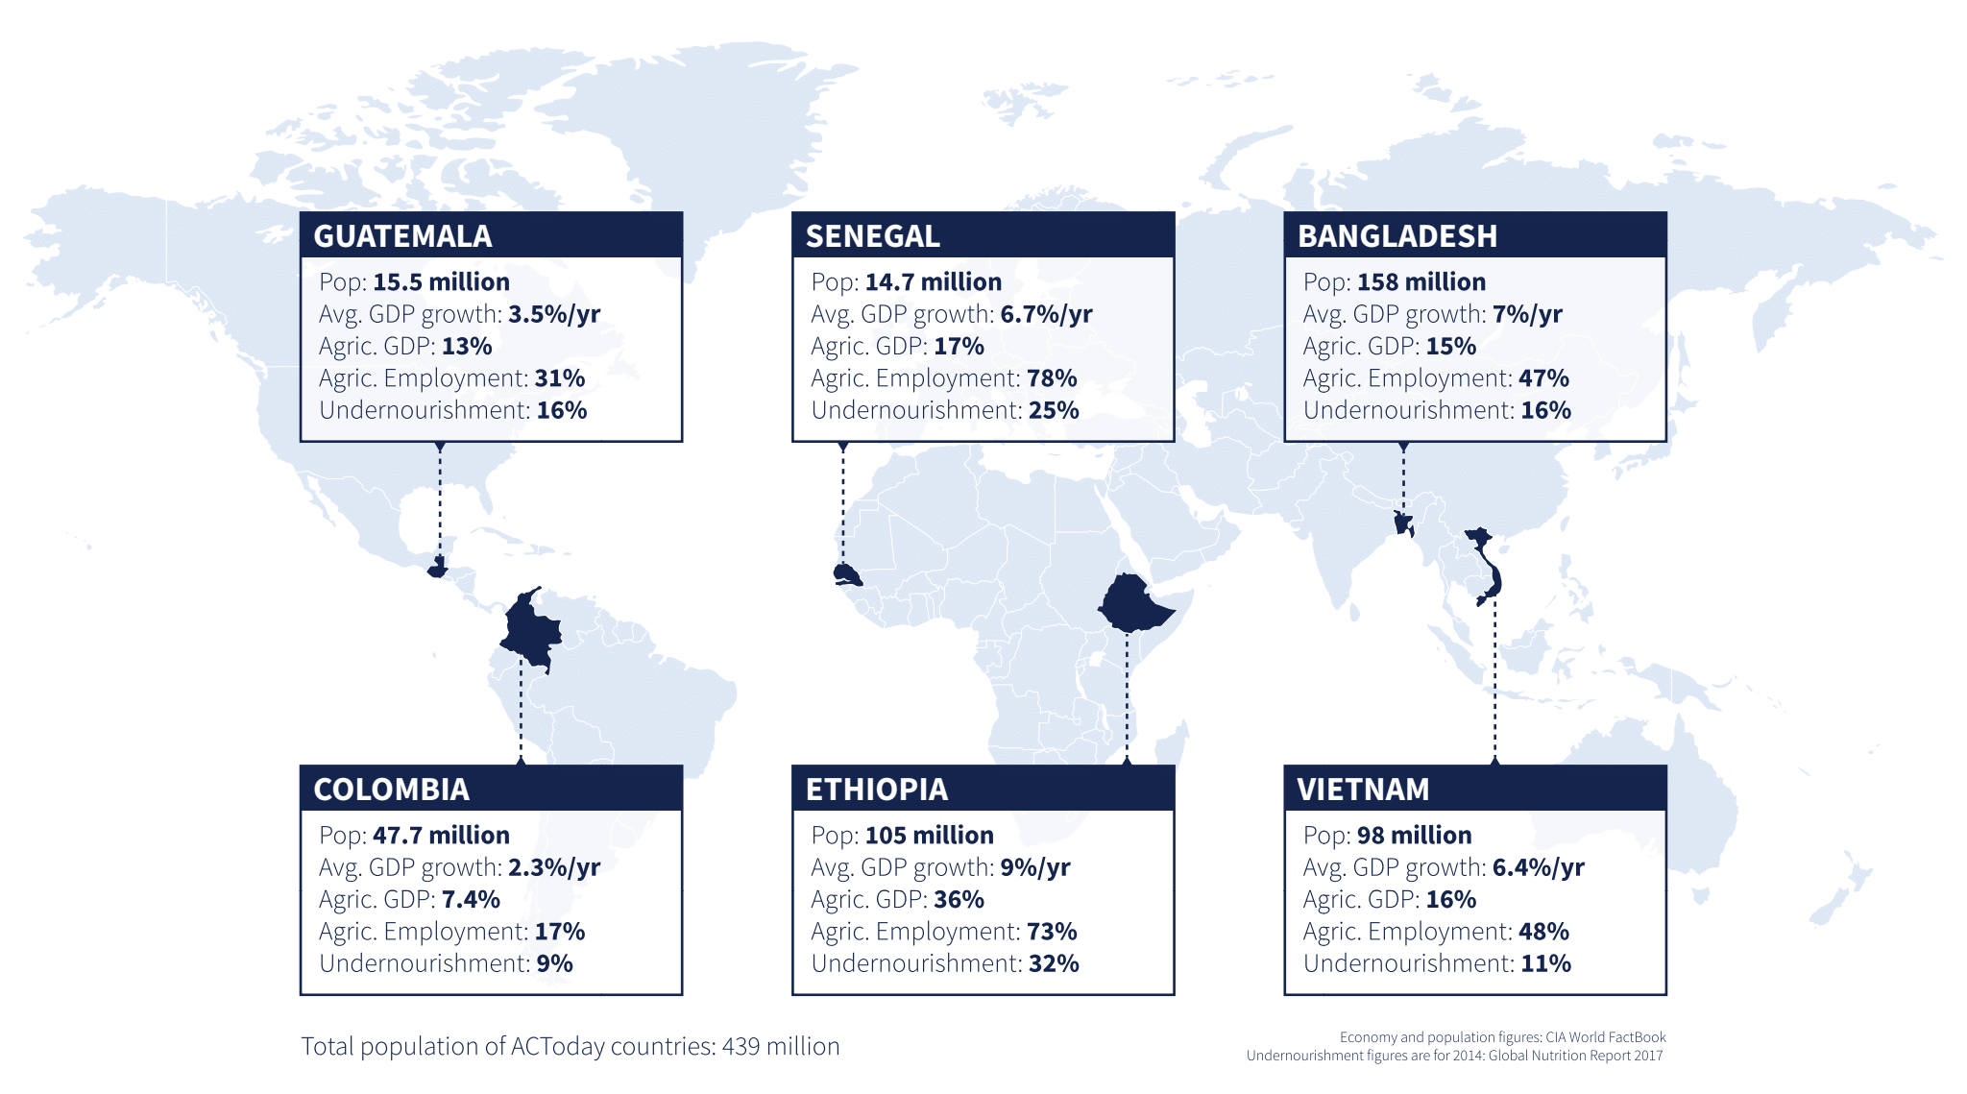
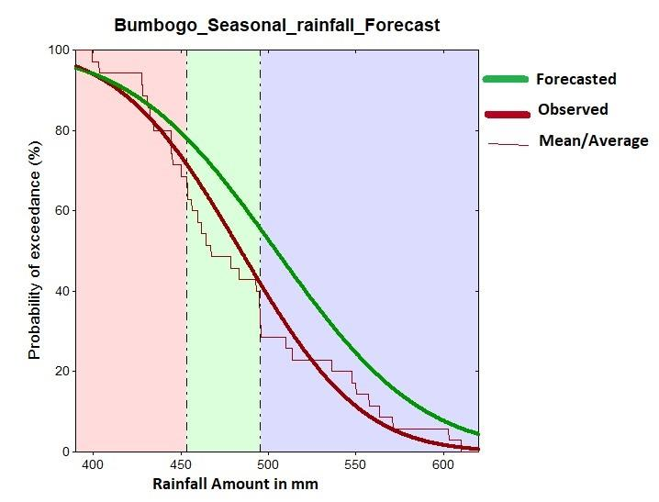
Agriculture and Food Security
Much of the work that IRI does is at the climate-agriculture nexus – frequent project partnerships with Ministries of Agriculture
Forecasting targeted at sub-seasonal variability, onset date, dry spell frequency, crop yield
Climate forecasting coupled with crop modeling
Adapting to Climate Today for Tomorrow (ACToday) project designed to address SDG 2 on hunger in Guatemala, Colombia, Senegal, Ethiopia, Bangladesh and Vietnam
CGIAR’s Climate Change, Agriculture and Food Security (CCAFS) projects
Village level forecast - part of Rwanda CCAFS project

Slide 10
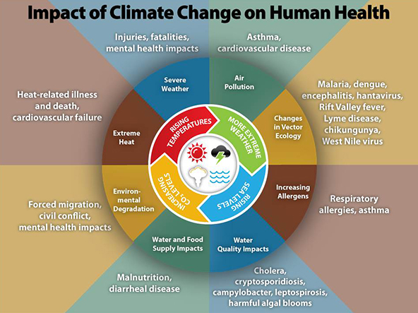
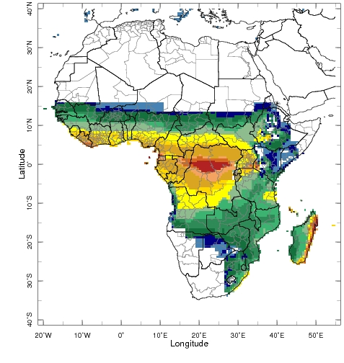
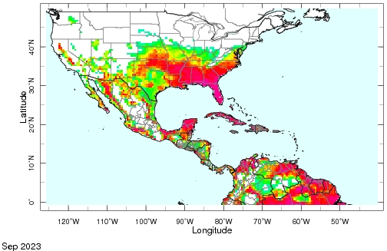
Public Health
IRI climate and health work – focused particularly focusing on vector borne diseases and bacterial meningitis
Goal of improving early warning systems with better forecast information
Below are digital maprooms targeted to specific diseases
Malaria
Meningitis
AeDES
It should be noted that other climate extremes: heat, drought, wildfires and flooding/severe storms all also have significant health ramifications
Below is a link to a recent article on the potential for malaria risk to re-emerge in Ethiopia in response to El Nino: https://www.carbonbrief.org/malaria-resurgence-feared-in-ethiopia-amid-el-nino-and-climate-change/
# of months of environmental suitability for malaria transmission in Africa
AeDES risk in the Americas Sep 2023

Slide 11
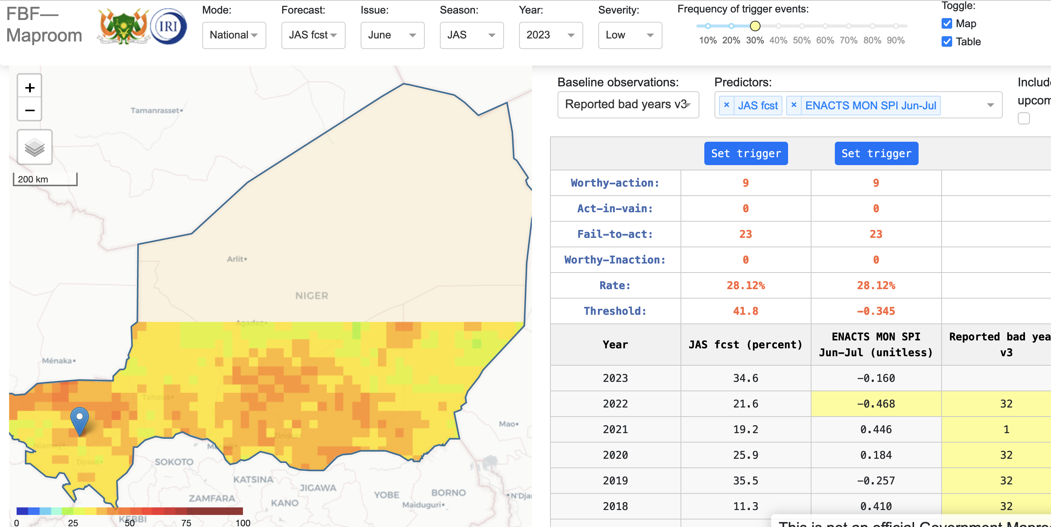
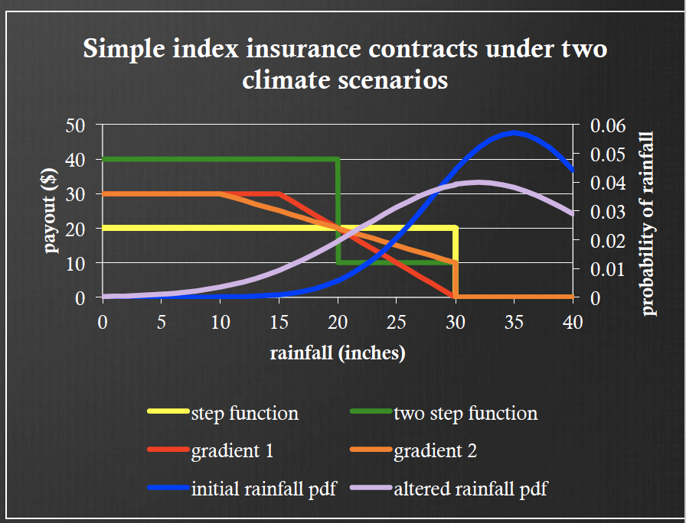
Financial Instrument Sector Team (FIST)
Forecast-based Anticipatory Financing for Humanitarian Response:
  Proactive rather than reactive
  Bigger positive impact, more cost effective
  Complicated triggering mechanisms – forecasts and monitoring used in concert
  WFP, IFRC
Index Insurance – parametric insurance based on geophysical variable (not verified losses)
  Economy of scale
  Payout frequency dependent on level of extreme event and liability coverage
  Can help farmers be less risk averse and evade the poverty trap
  World Bank, WFP R4

Slide 12
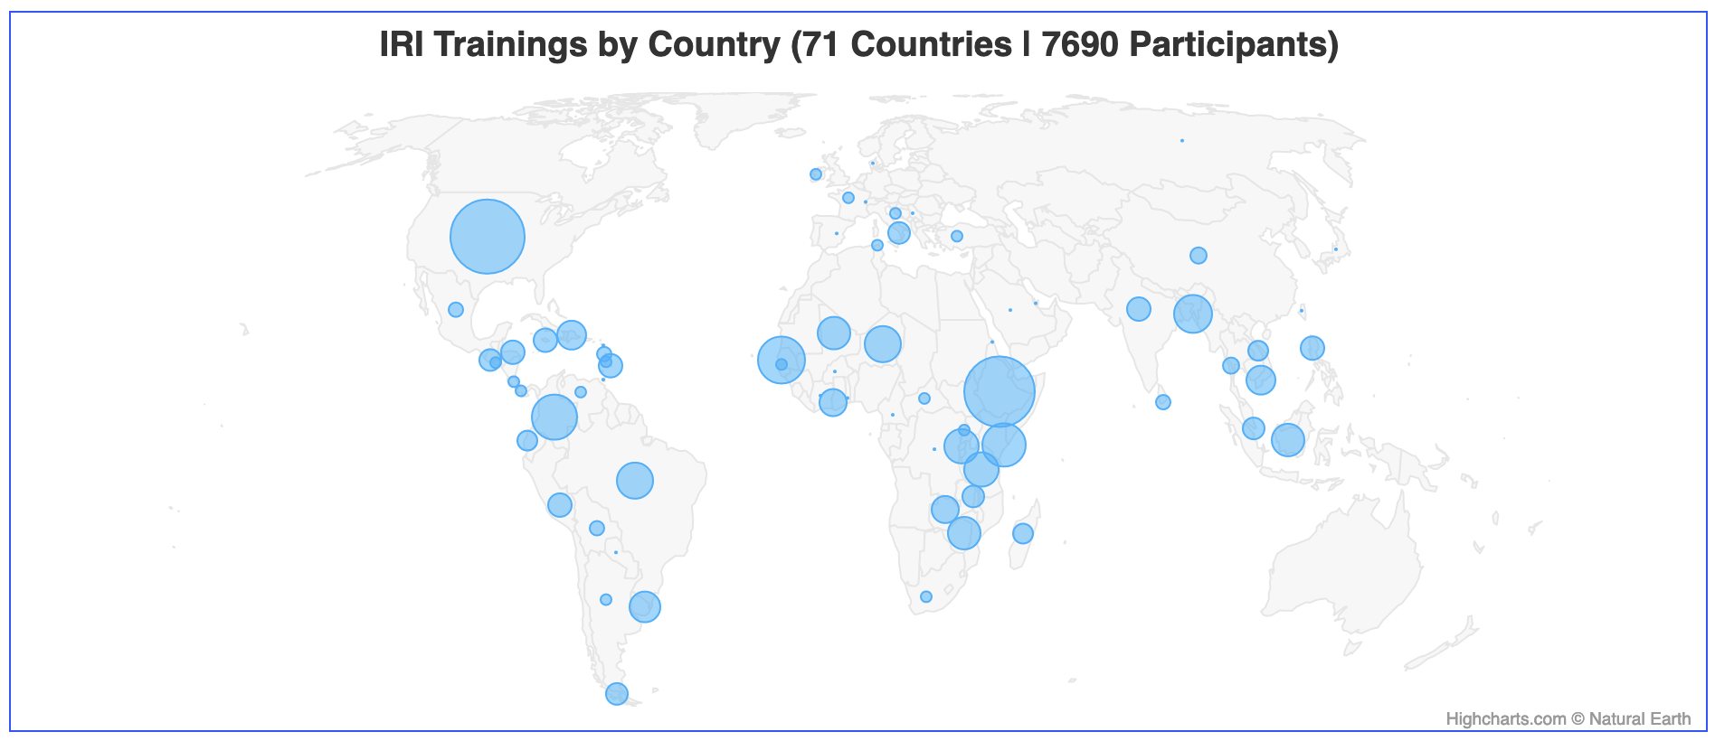
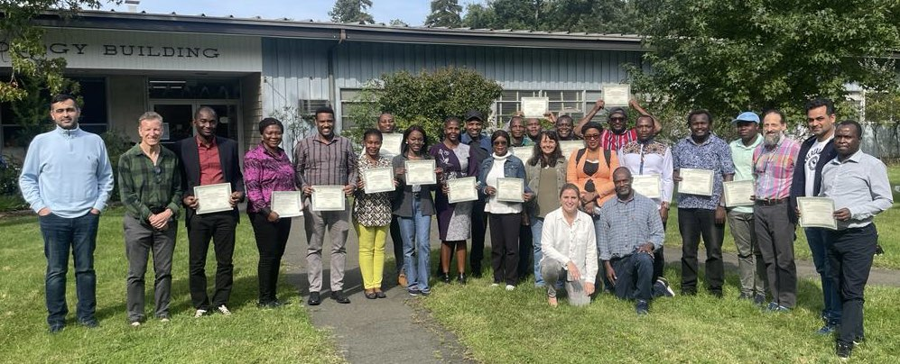
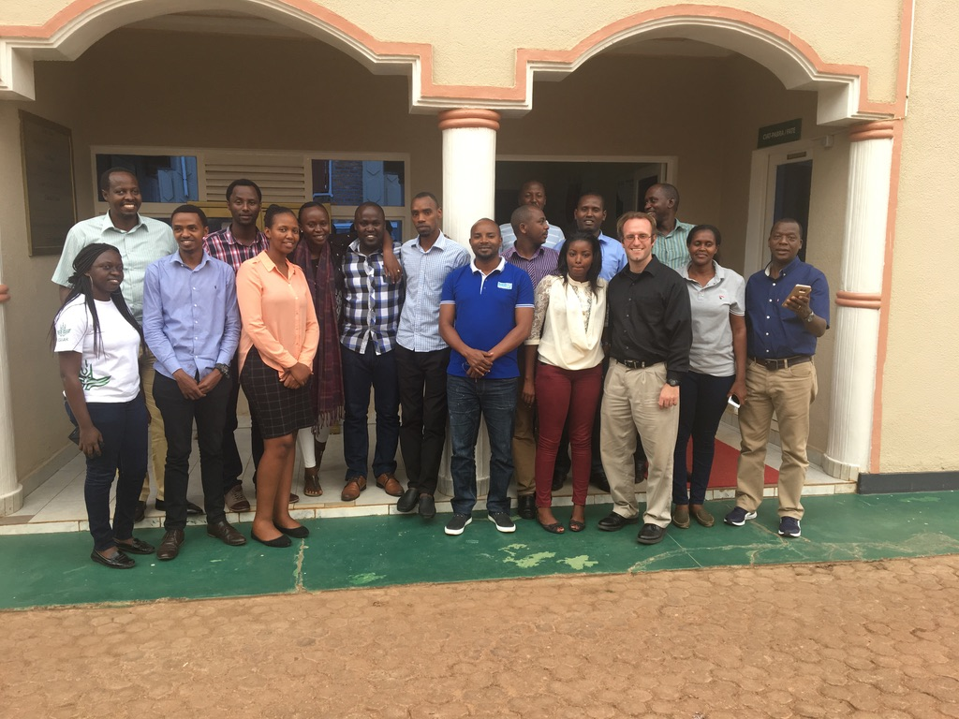
Capacity Building and Training
Training and capacity building have always been central to IRI’s mission and the broader goal of climate services
Partnerships with national, regional and global meteorology, agriculture, health, development, humanitarian orgs
travel prior to covid, shift to digital during covid and return to travel after
Climate Service Academies
IRI Wikipage
MeteoRwanda training, Kigali, Rwanda 2017
Recent AICCRA training in Palisades NY

Slide 13
Climate Research and Academics at Columbia
IRI is on the LDEO campus – home of LDEO, CIESIN and IRI
IRI used to be part of Earth Institute, now part of new Climate School – launched in 2020
IRI has historically had close ties with the MA program in Climate and Society
MA program is a one year interdisciplinary MA program and is now flagship academic program of the Climate School (now about 90 students a cohort)
Climate School was conceived before the pandemic and began during pandemic – nice idea, but limited resource commitment (no new endowment funding)
Former president Bollinger stepped down this summer – new president Minouche Shafik
A lot of great climate research at Columbia: LDEO (basic science research), NASA-GISS (climate and impact modeling), SIPA (energy and policy), IRI and CIESIN (applications oriented), CUIMC – public health, Water Center (water management and engineering), etc.

Slide 14
Current Challenges and Future Needs
IRI’s work is very collaborative (both internally and with international partners)
Unique interdisciplinary ecosystem to do interesting, important work
IRI funding and sustainability challenges – ACToday is over, limited external funding…in new Climate School, but no endowment commitment
How to preserve capabilities and continue to provide valuable services to populations that could benefit while managing funding shortfall
How to maintain essential IRI functions
How do ex-IRI people find jobs in a different context and transfer specialized skills to other contexts
My job ended Dec. 2022 – any ideas?

