Slide 1
El Niño and Other Climatic Drivers of Epidemic Malaria in Ethiopia: New Tools for National Health Adaptation Plans*
AGU Chapman Conference: Climate and Health in Africa
Washington DC, June 2023
Adugna Woyessa¹, Asher Siebert² , Aisha Owusu³, Rémi Cousin², Tufa Dinku², and
Madeleine C. Thomson²
* manuscript in revision for Malaria Journal
1 – Ethiopian Public Health Institute
2 – Columbia University International Research Institute for Climate and Society, current and former
3 – University of Oklahoma College of Atmospheric and Geographical Science
asherb.siebert@gmail.com, adugnawoyessa@gmail.com

Slide 2
Motivation and framework
Motivation: historical relationships between climate variables and malaria epidemics in Ethiopia -> public health response and early warning systems
Framework/Outline
  Literature analysis of epidemics from 1950-2015
  Statistical analysis of SST indices and temperature/rainfall
  Statistical analysis of climate variables and malaria index – focus on Amhara
  Conclusions, developing El Nino, recommendations

Slide 3
Literature analysis
Timing of malaria epidemics and El Niño
El Niño | Concurrent |  | Following | El Niño | Concurrent |  | Following | El Niño | Concurrent |  | Following | El Niño | Concurrent |  | Following
Weak | Drought | Epidemic (W) | Epidemic (W) | Moderate | Drought | Epidemic (W) | Epidemic (W) | Strong | Drought | Epidemic (W) | Epidemic (W) | Very Strong | Severe Drought | Epidemic (W) | Epidemic (W)
1952-53 |  |  |  | 1951-52 |  |  |  | 1957-58 | X |  | X | 1982-83 | X
1953-54 | X | X |  | 1963-64 |  |  |  | 1965-66 | X | X |  | 1997-98 | X | X | X
1958-59 | X | X |  | 1968-69 |  |  |  | 1972-73 | X |  | X | 2015-16 | X | N/A | N/A
1969-70 |  |  |  | 1986-87 | X |  | X | 1987-88 | X
1976-77 |  |  |  | 1994-95 | X | X |  | 1991-92 | X | X | X
1977-78 |  |  |  | 2002-03 | X | X | X
1979-80 |  |  |  | 2009-10 | X
2004-05 |  | X | X
2006-07 |  | X
2014-15
2018-19
11 | 2 | 4 | 1 | 7 | 4 | 2 | 2 | 5 | 5 | 2 | 3 | 3 | 3 | 1 | 1

Slide 4
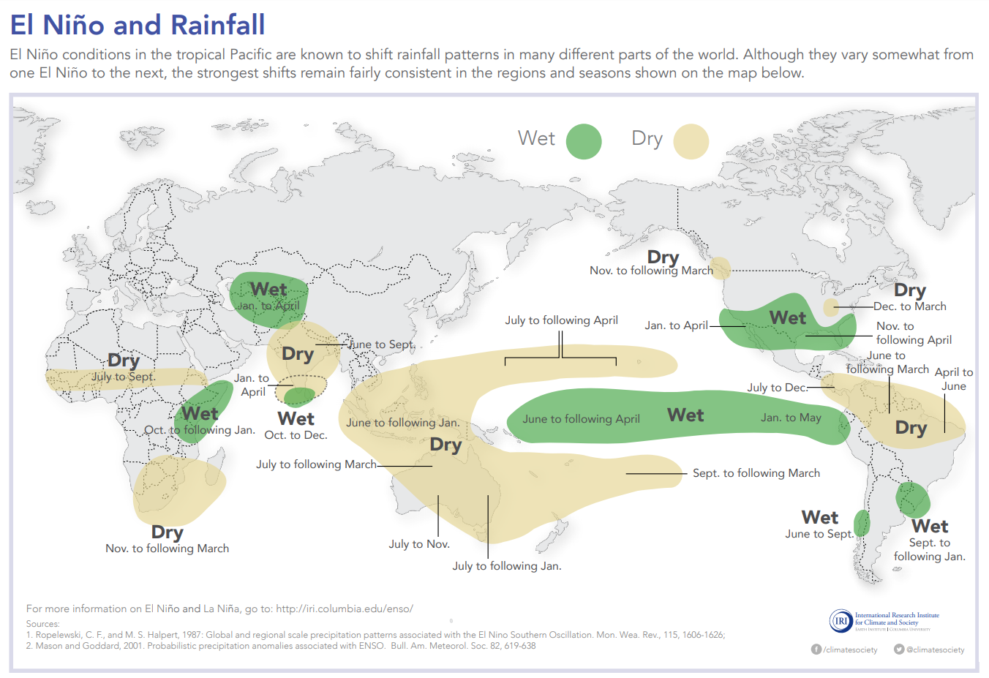
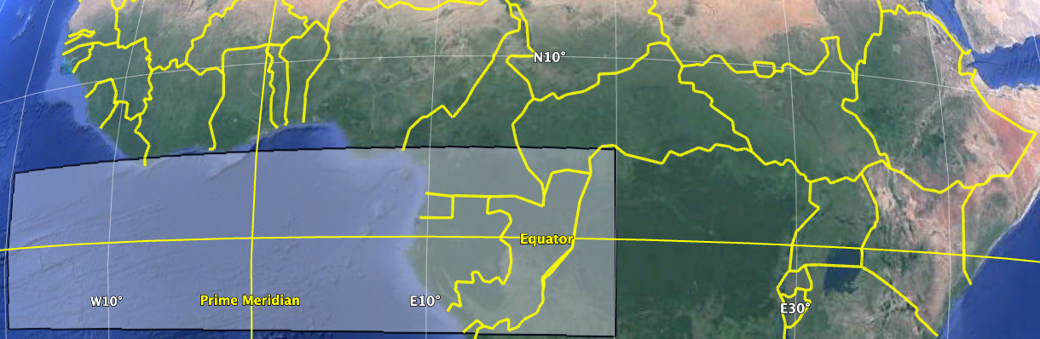
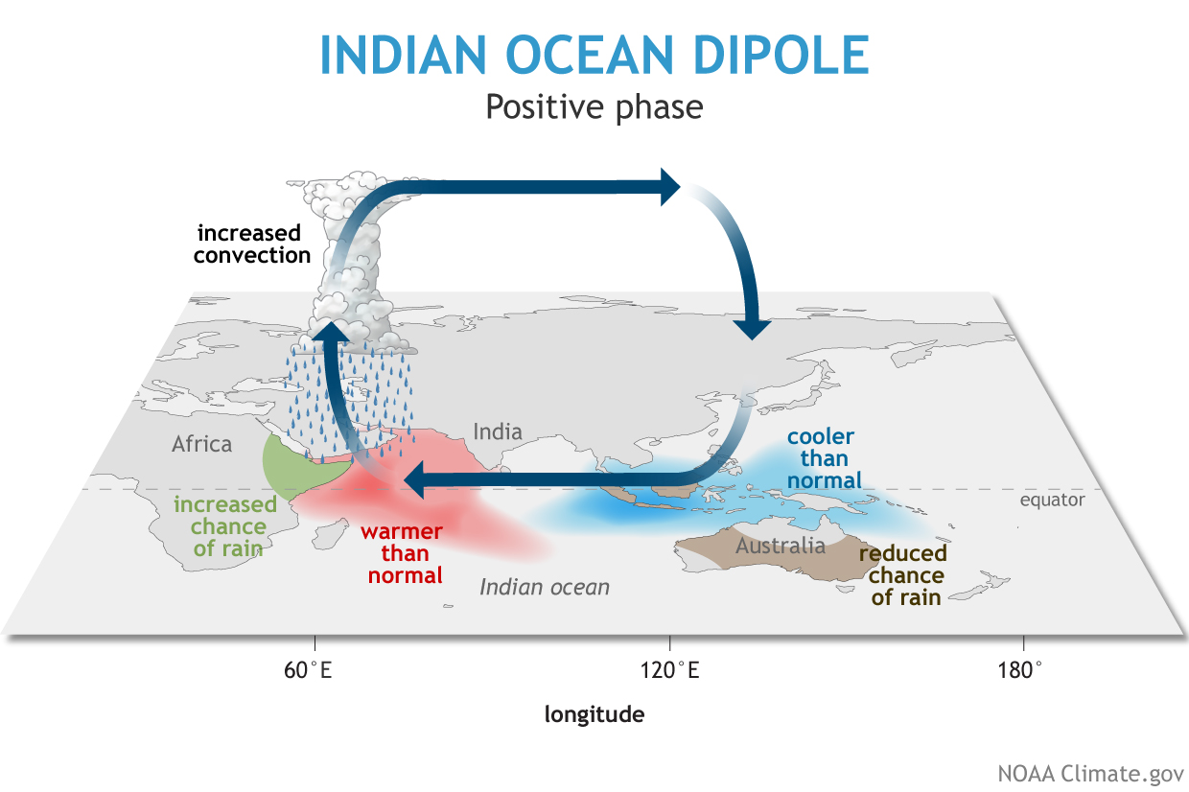
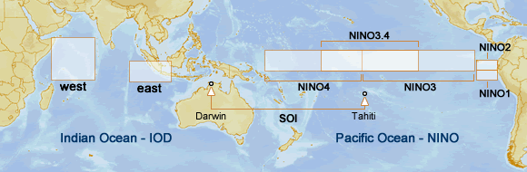
Climate Variables
El Niño is a global driver of climate variability
Indian Ocean Dipole (IOD) also has a regional impact
Tropical Atlantic (Gulf of Guinea) is an moisture source for NW Ethiopia
3 category Gerrity Skill Score analysis

Slide 5
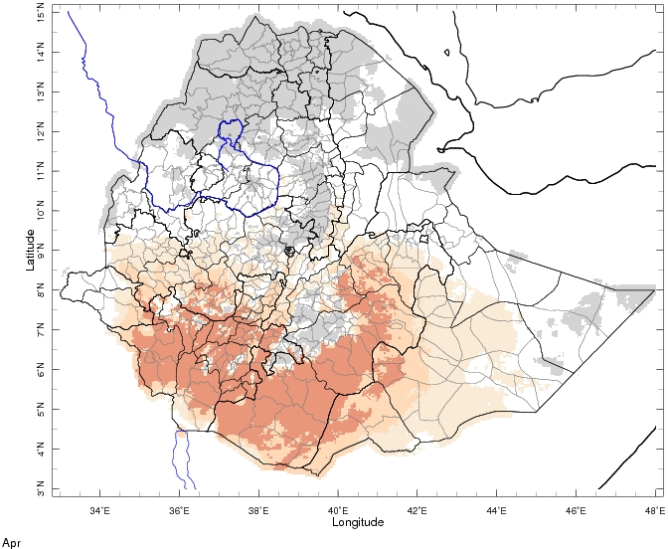
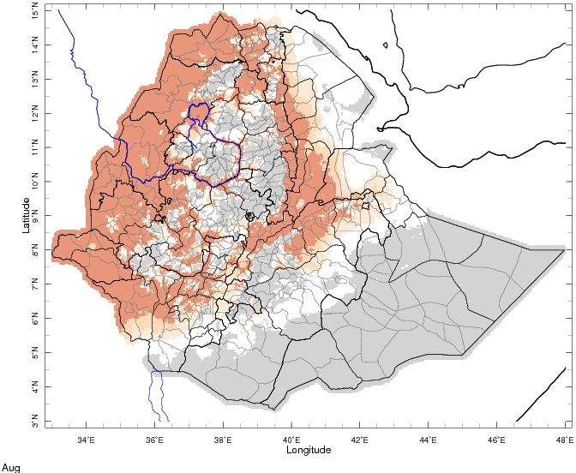
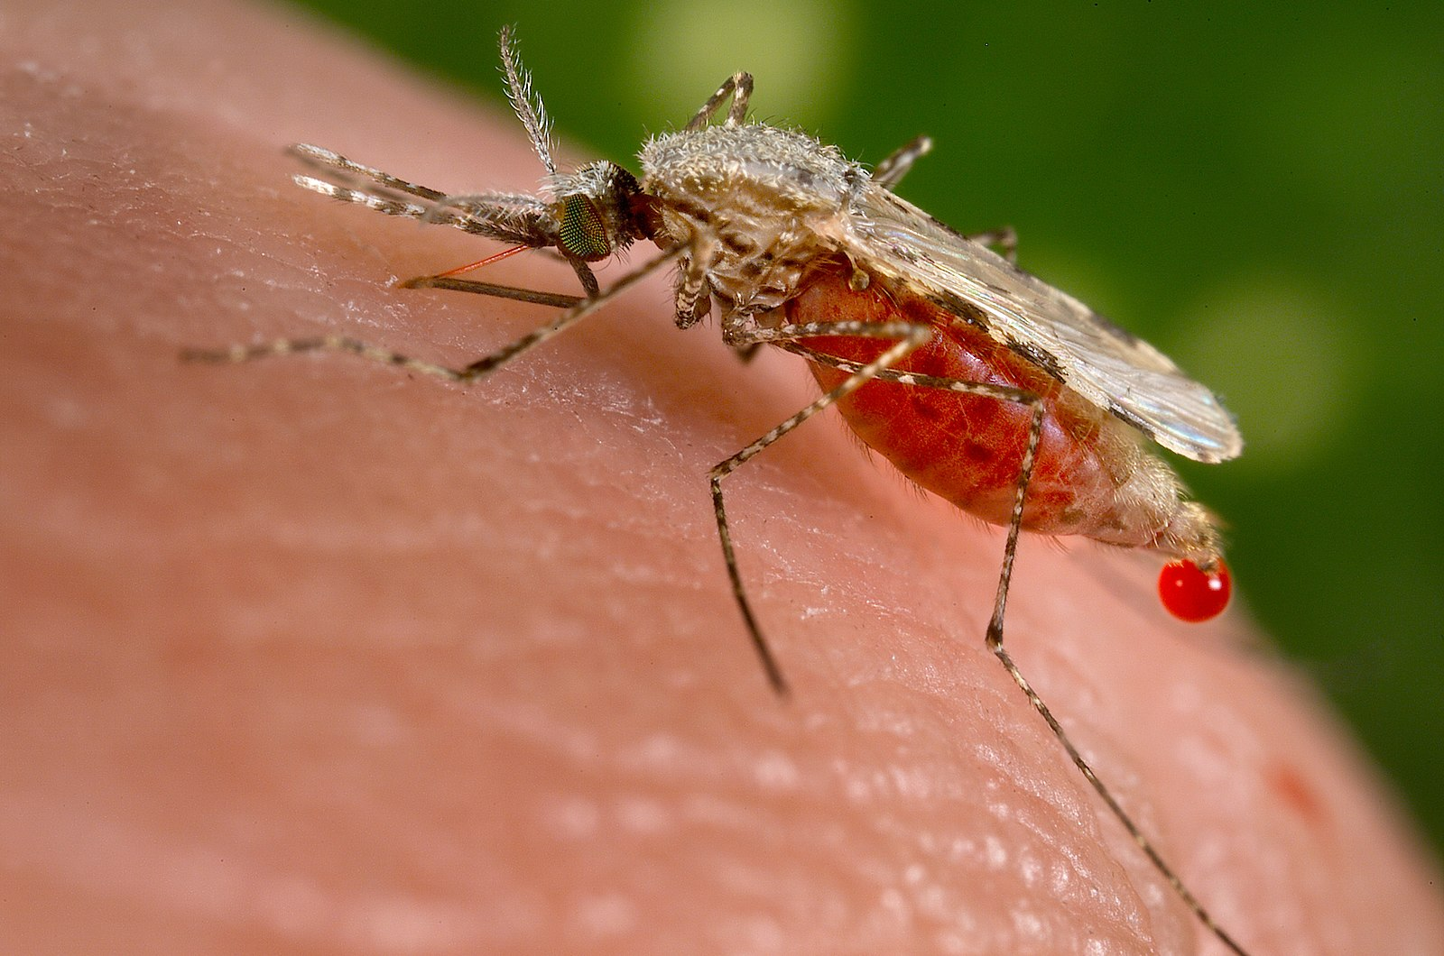
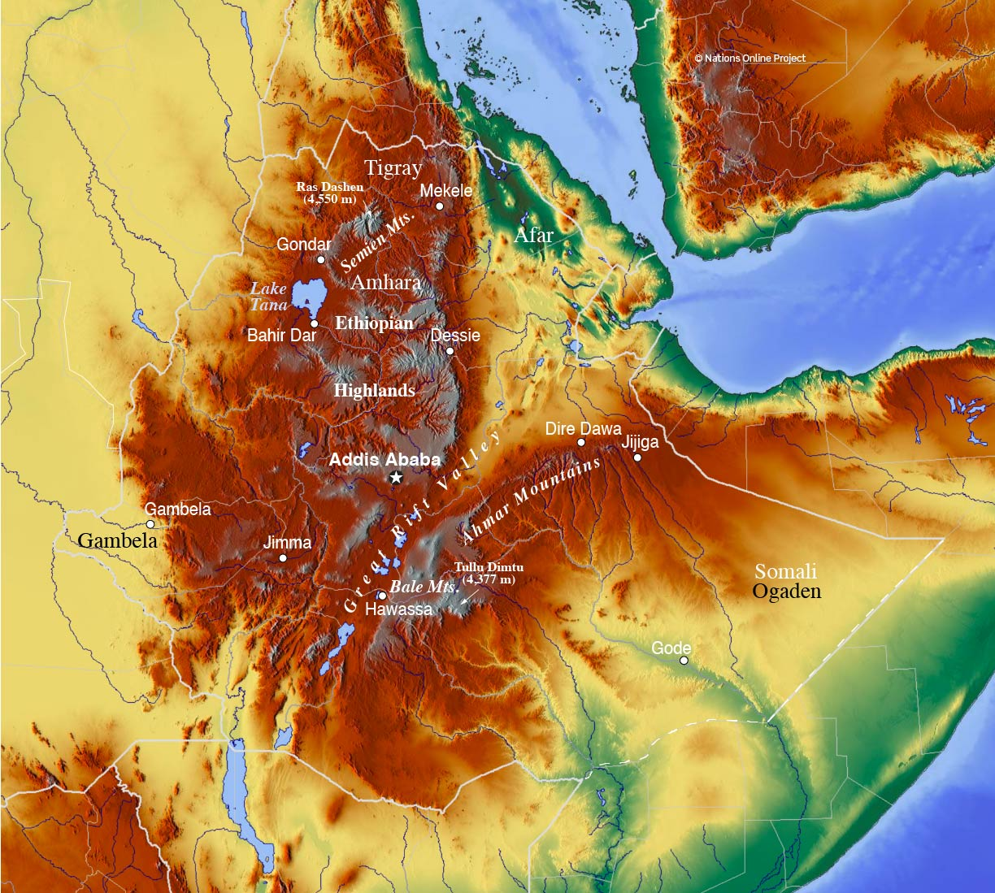
Seasonality and Geography of Ethiopian Malaria Epidemics
Suitability for malaria
  Warm (18-32 C), wet/humid conditions
Rainfall seasonality
  Kiremt (JJAS) (north and center)
  Bimodal region (Southeast)
Epidemic seasonality
  During or shortly after rainy season (OND)
Limitations on malaria risk
  Lowlands: Rainfall/humidity
  Highlands: temperature
April climatic suitability
August climatic suitability

Slide 6
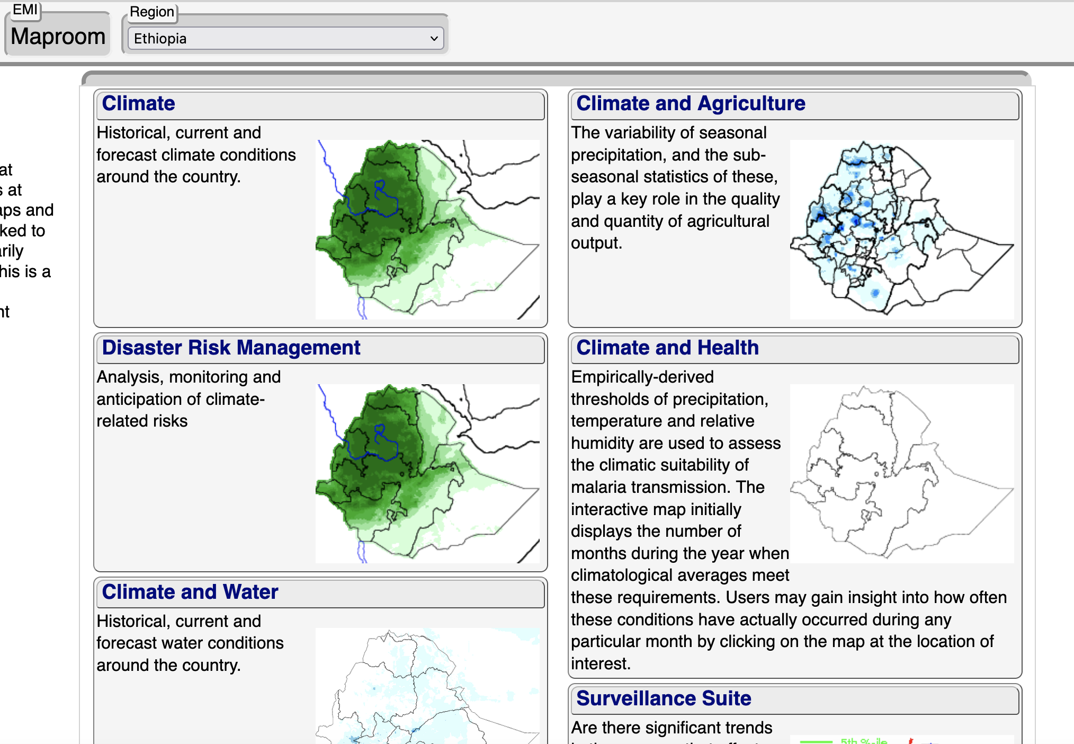
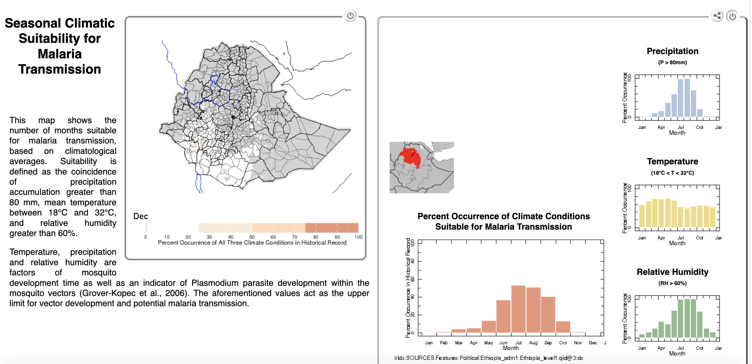
Ethiopia climate maproom pages
http://213.55.84.78:8082/maproom/
General landing page
Climate and Health landing page
Seasonal climatic suitability for malaria; temperature, RH and rainfall thresholds and WASP index
Climate landing page
Daily; Monthly; Seasonal; Trend analysis; Extremes; ENSO and IOD conditional analysis; Monitoring; SPI; Seasonal MME forecast

Slide 7
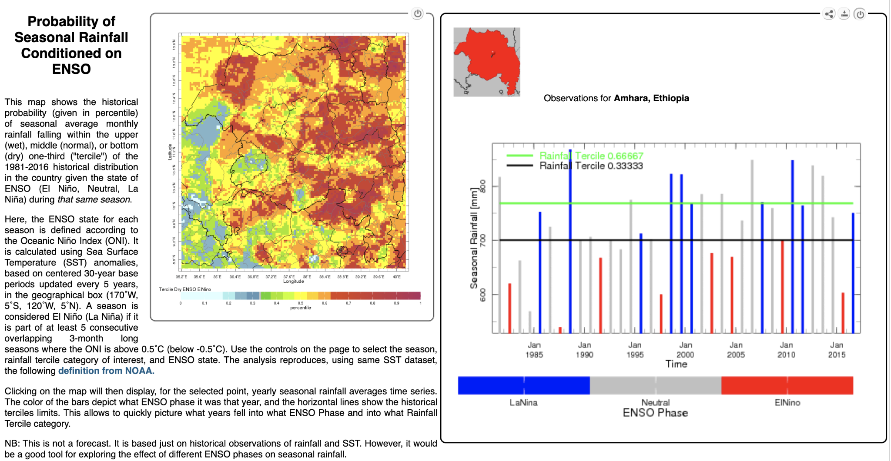
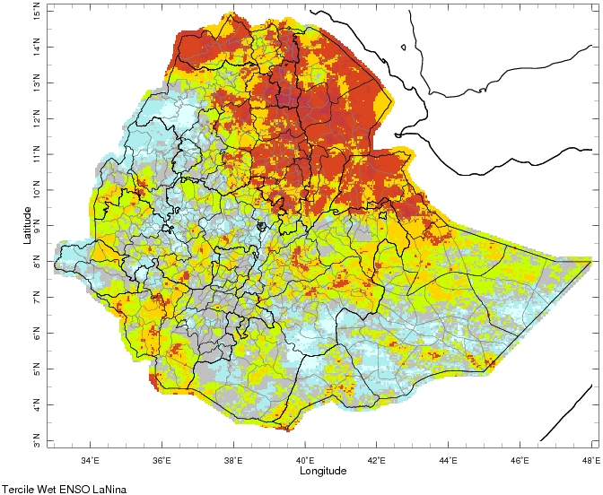
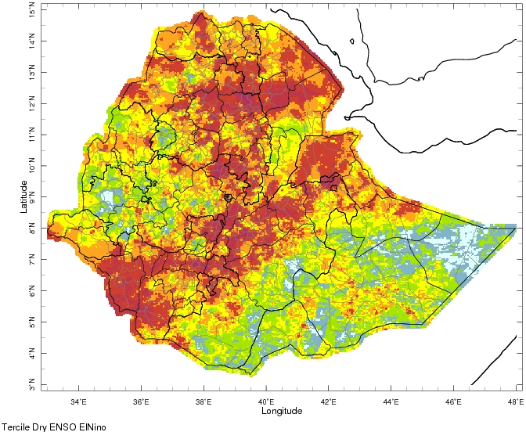
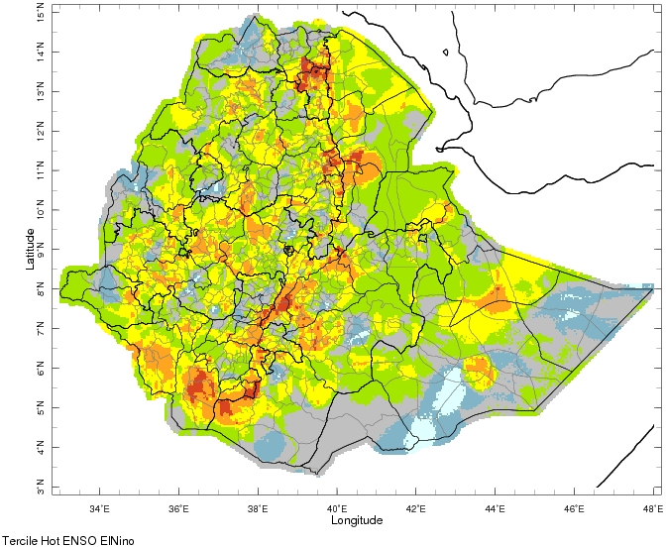
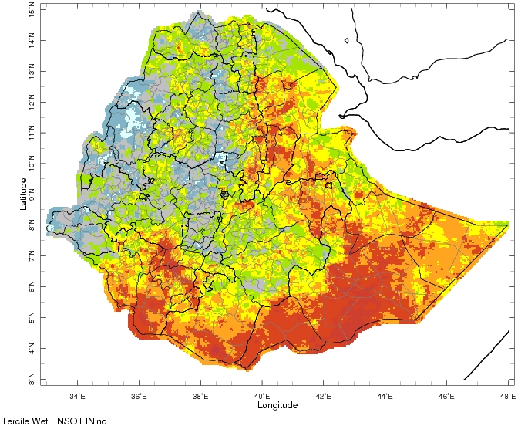
Seasonal climate conditioned on ENSO
http://213.55.84.78:8082/maproom/Climatology/index.html
International Research Institute for Climate and Society (IRI) Ethiopian Meteorological Institute (EMI) partnership
Enhancing National Climate Services (ENACTS) data
  high resolution merged satellite/station data
Tercile Wet La Nina JAS
Tercile Dry El Nino JAS
Tercile Hot El Nino JAS
Tercile Wet El Nino OND

Slide 8

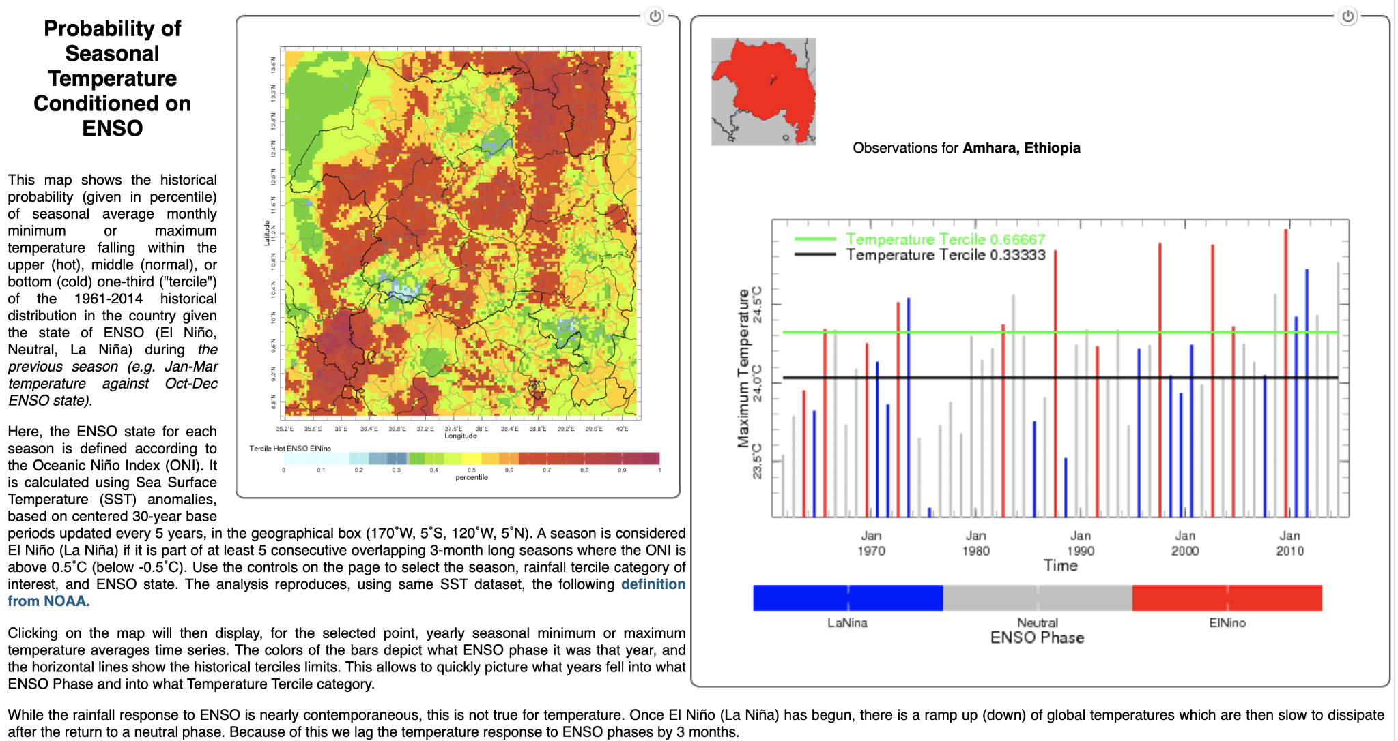
Amhara specific observations
Amhara chosen as a focus because of documentation
Amhara Tercile Dry El Nino JAS
Amhara Tercile Hot Tmax El Nino JAS

Slide 9
Pearson correlations between climate variables
Climate Variables | JAS NINO3.4 | MAM NINO3.4 | JAS IOD | JAS Tropical Atlantic | JAS Amhara rainfall | JAS Amhara Tmax | JAS Amhara Tmin
JAS NINO3.4 | 1 | 0.217 | 0.379* | -0.362* | -0.582** | 0.287 | 0.124
MAM NINO3.4 |  | 1 | -0.358* | -0.357* | -0.229 | -0.222 | 0.382*
JAS IOD |  |  | 1 | 0.167 | 0.029 | 0.041 | -0.189
JAS Tropical Atlantic |  |  |  | 1 | 0.383* | 0.039 | 0.260
JAS Amhara rainfall |  |  |  |  | 1 | -0.369* | -0.177
JAS Amhara Tmax |  |  |  |  |  | 1 | -0.004
JAS Amhara Tmin |  |  |  |  |  |  | 1
* indicates p<0.1, ** indicates p<0.05

Slide 10
Analysis of climate data and Amhara epidemics 1991-2014
Epidemic data limitations prior to 1990
Epidemic classification:
  none (0),
  localized (1)
  widespread (2)
Climate index | r with malaria index
JAS NINO3.4 | 0.004
MAM NINO3.4 | 0.111
JAS IOD | 0.184
JAS Trop Atl | 0.396
Amhara JAS rainfall | 0.201
Amhara JAS Tmax | -0.448
Amhara JAS Tmin | 0.381

Slide 11
Pivot Table and Gerrity Skill score analysis
The Gerrity Skill score is a categorical metric
  GSS = 1: perfect forecast
  GSS>0: some skill
  GSS = 0: random guessing
Climate indices | No Epidemic (0) | Localized Epidemic (1) | Widespread Epidemic (2) | Gerrity Skill Score
Temperature variables (ºC)
JAS NINO 3.4 | 0.094 | -0.159 | 0.085 | 0.079
MAM NINO 3.4 | 0.041 | -0.231 | 0.156 | 0.041
JAS IOD | -0.165 | 0.025 | 0.031 | -0.012
JAS Trop Atlantic | -0.111 | 0.231 | 0.160 | 0.187
JAS Amhara Tmax | 24.6 | 24.5 | 24.2 | 0.287*
JAS Amhara Tmin | 13 | 13.1 | 13.2 | 0.272
Rainfall variable (mm)
JAS Amhara rainfall | 689 | 767 | 724 | 0.249
* Inverse relation

Slide 12
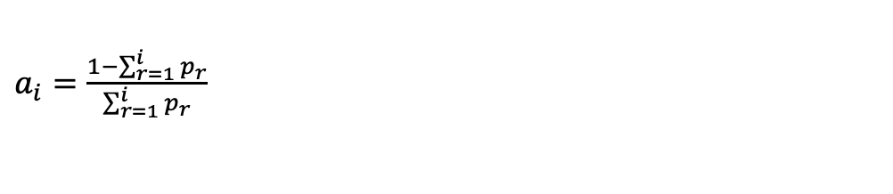
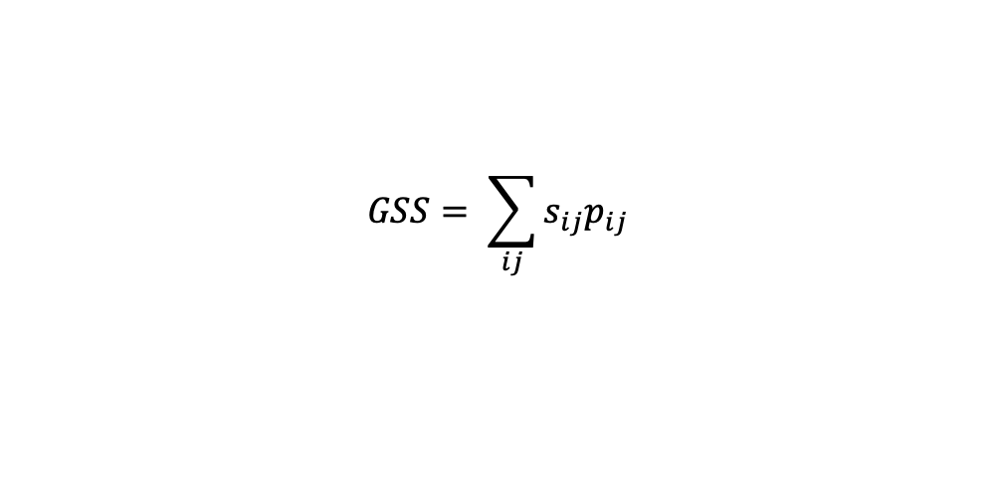
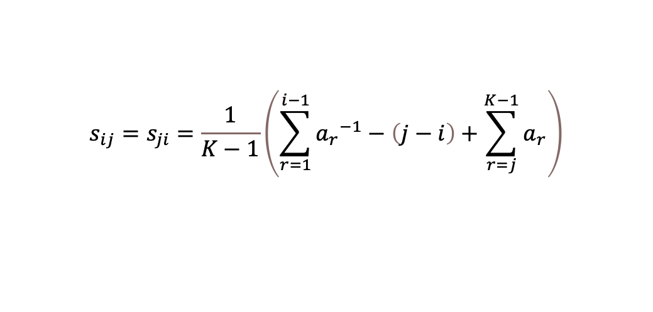
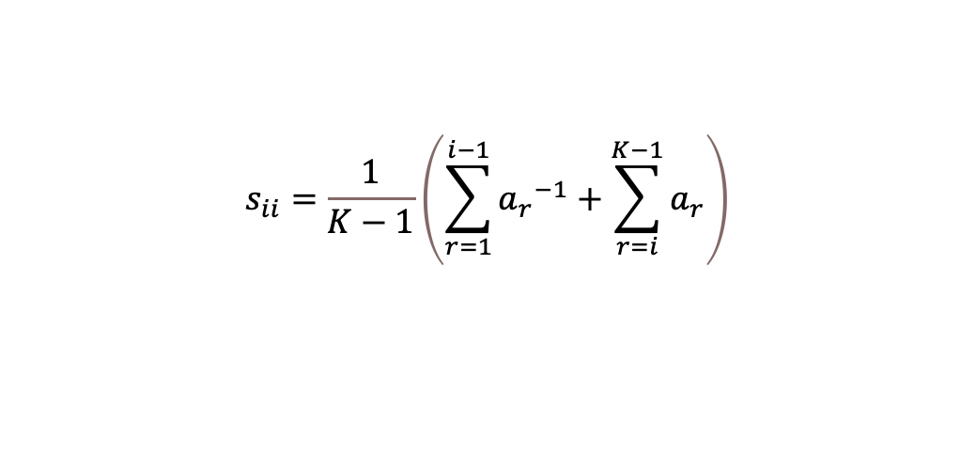
Gerrity Skill Score calculation
Gerrity Skill score is a categorical skill score often used in weather forecasting, but applied to this climate/malaria intercomparison
p = proportion
s = weight
a = coefficient
K = number of categories
i,j and r = index values
Higher GSS = better prediction
GSS = 1: perfect forecast
GSS = 0: random guessing
$$GSS= \sum_{ij}{s_{ij}p_{ij}}$$
$a_{i}=\frac{1−\sum_{r=1}^{i}{p_{r}}}{\sum_{r=1}^{i}{p_{r}}}$
$$s_{ii}=\frac{1}{K−1}\left(\sum_{r=1}^{i−1}{{a_{r}}^{−1}+\sum_{r=i}^{K−1}{a_{r}}}\right)$$
$$s_{ij}=s_{ji}=\frac{1}{K−1}\left(\sum_{r=1}^{i−1}{{a_{r}}^{−1}}−\left(j−i\right)+\sum_{r=j}^{K−1}{a_{r}}\right)$$

Slide 13
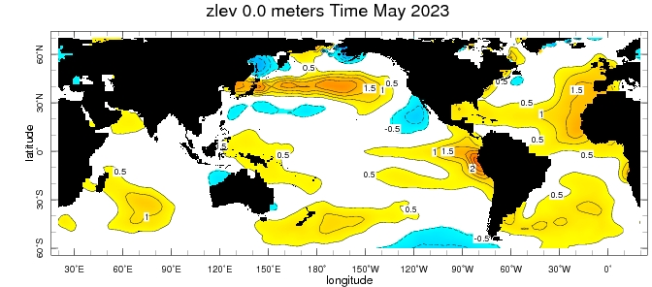
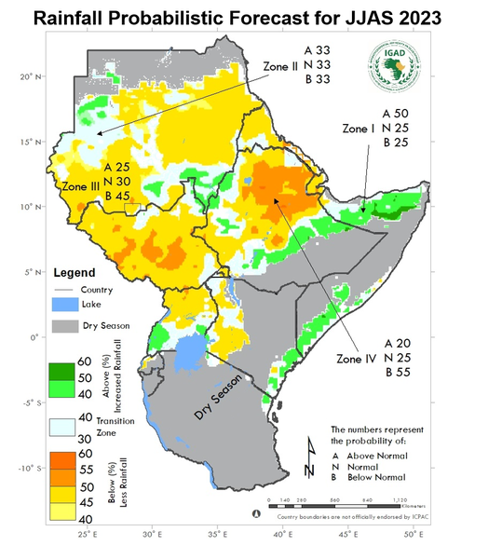
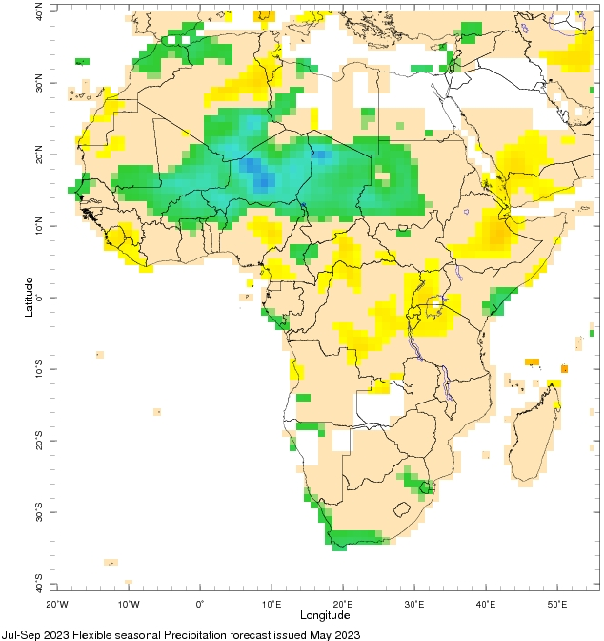
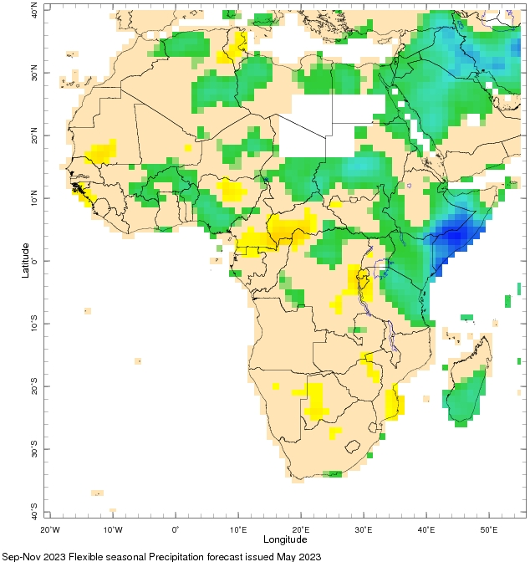
Conclusions, current season, and recommendations
Literature analysis – El Nino, droughts & epidemics
El Nino response and forecast for 2023
  Forecast hot/dry conditions during JJAS
  Enhanced rains in SE
Amhara -> tropical Atlantic SST and local rainfall
Malaria risk may be heightened in 2023
Climate change -> expansion of anopheles habitat
Need for climate & health partnership and EWS
ICPAC JJAS 2023 forecast from May
JAS IRI precip forecast
SON IRI precip forecast

