Slide 1
Addressing Evolving Climate Risks in New Jersey and in a Changing World
Asher Siebert, PhD; Applied Climate Scientist
asherb.siebert@gmail.com,
LinkedIn, Google Scholar, ORCID, ResearchGate
Candidate: Assistant Extension Specialist in Climate Services
Department of Environmental Sciences (DES)/
School of Environmental and Biological Sciences (SEBS)
Rutgers Cooperative Extension
Rutgers University

Slide 2
Seminar Outline
Position
  Research
  Outreach and Extension
  Funding and Collaboration
  Teaching and Advising
  Justice, Equity, Diversity, Inclusion (JEDI)
Work/Education History
  Senior Staff Associate & Postdoc Columbia (IRI) 2016-2022
  Postdoc Princeton Environmental Institute 2015-2016
  PhD Rutgers Geography 2009-2015
  Staff Associate Columbia/IRI 2006-2008
  MA Columbia Climate and Society and NASA-GISS Internship 2005-2006
  Graduate work MIT-WHOI Physical Oceanography 2002-2004
  BA Princeton Geosciences and internship at Ohio State BPRC 1998-2002

Slide 3
Challenges and Research Areas in Climate Services
Challenges
  Science
    Feedback mechanisms, coupled processes, predictability, uncertainty
  Impacts
    Geophysical hazard, vulnerability, exposure
    Severe, prolonged and compound extreme events
  Socioeconomic
    Vulnerability/poverty
    Funding resilience/adaptation
    Interdependence and timing of sectoral adaptations
Research Areas
  Data analysis
  Predictability/projection
  Co-production & tailoring for sector applications
  Adaptation/mitigation synergies
  Policy & Outreach/Extension

Slide 4
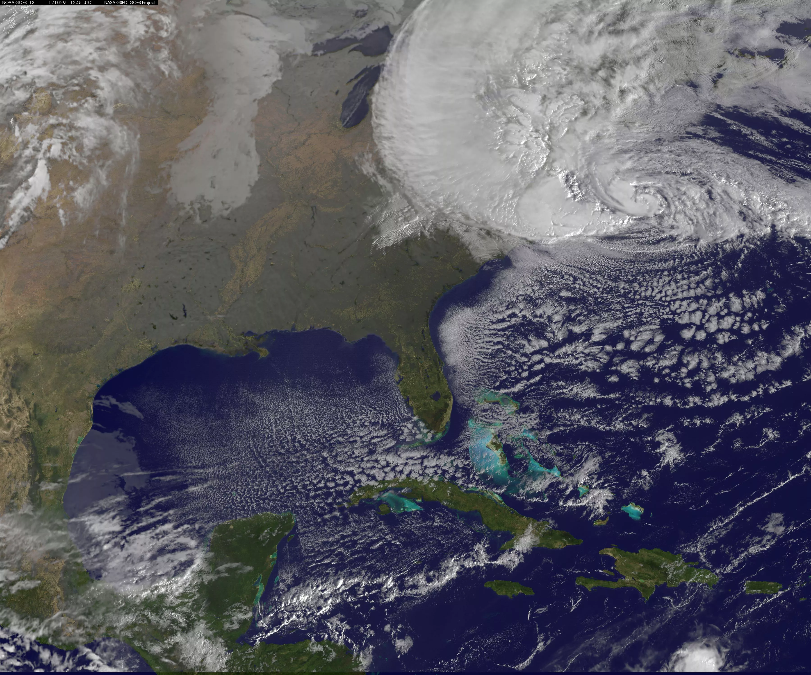
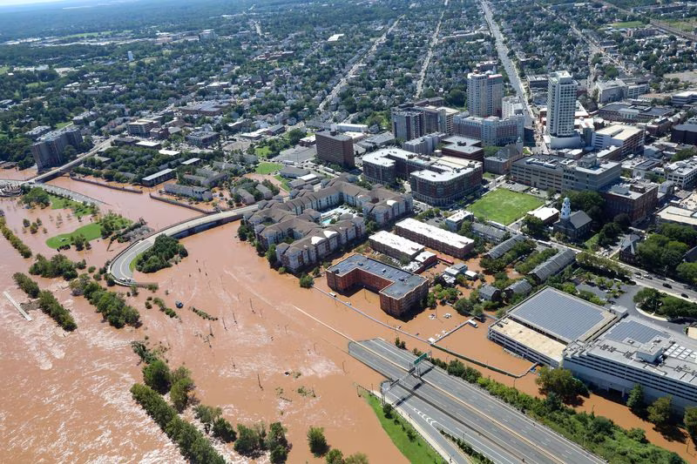
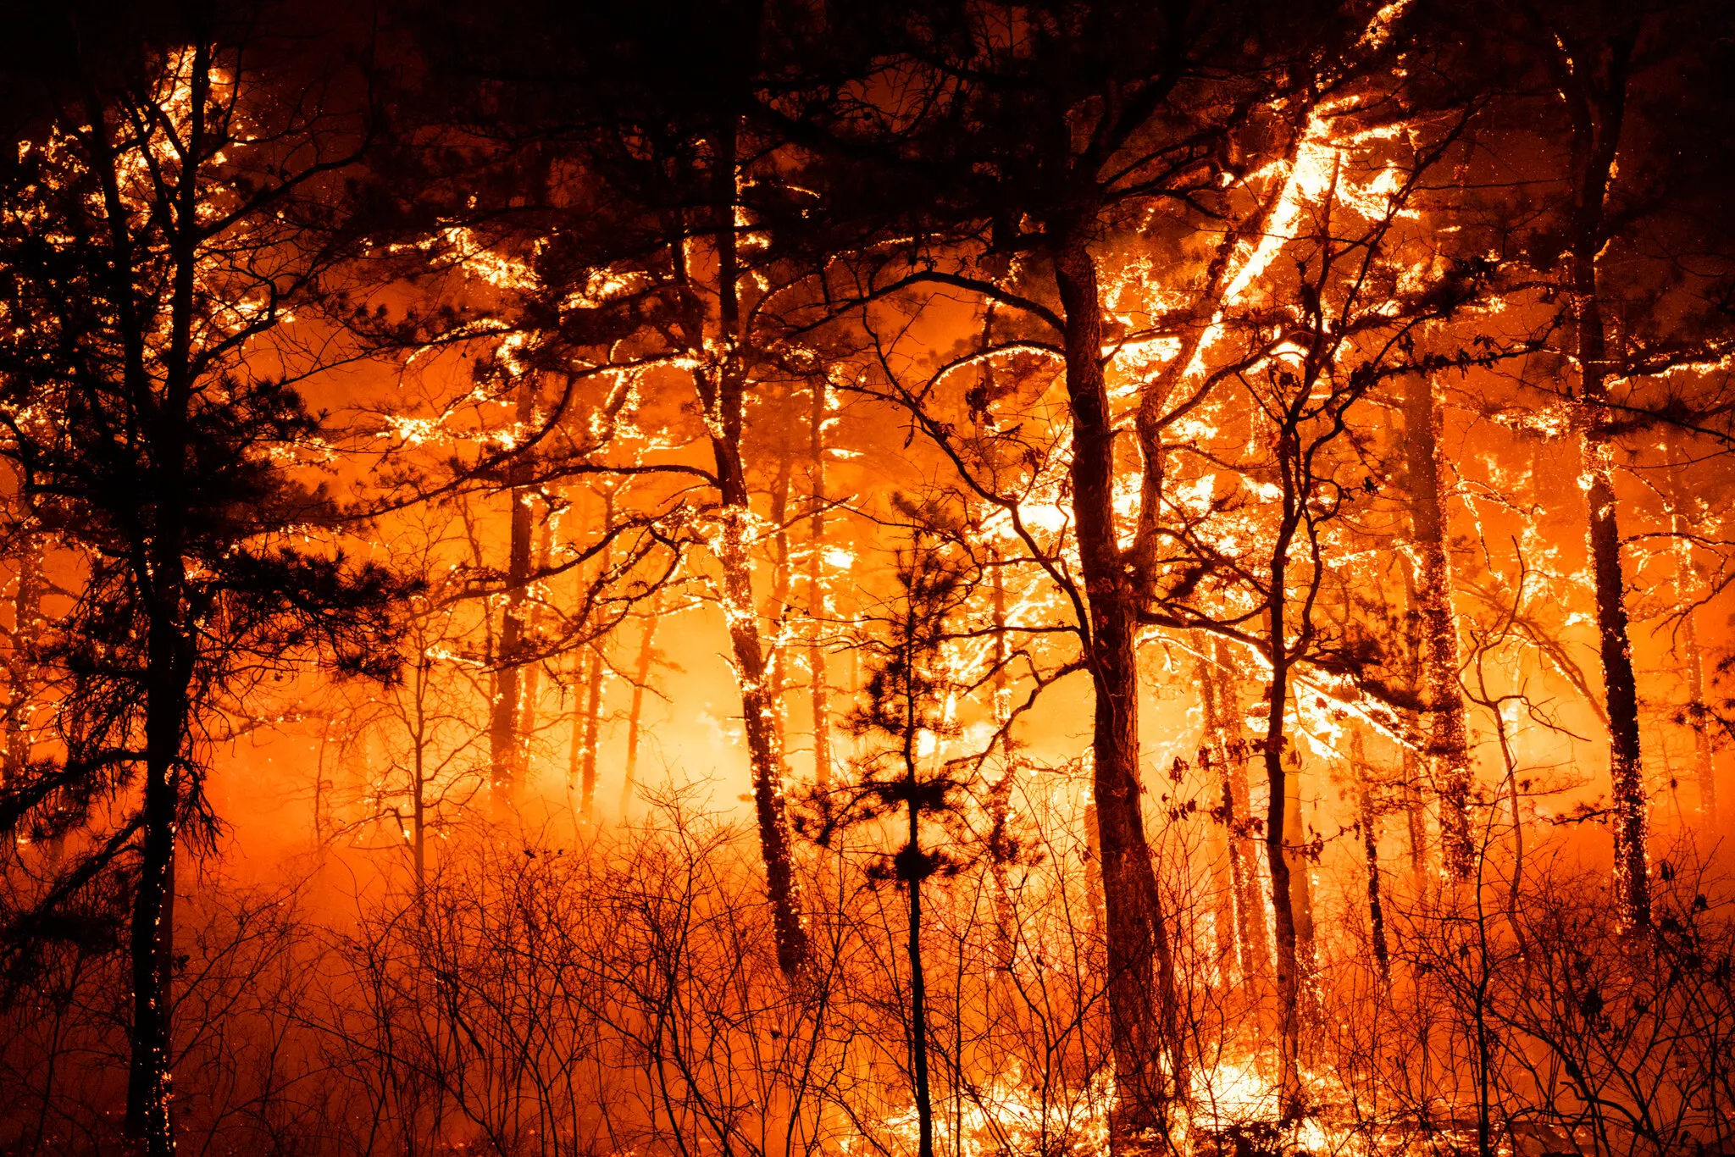
Extreme Events under Climate Change
Hurricane Sandy 2012
  Statistical methods
    Monte Carlo and autoregression
    Conditional/Markov analysis
    Distribution analysis – tail behavior and skew
  Dynamical and/or blended methods
    Weather types
    Analogue studies
    Modeling compound events
  Sector impact modeling (statistical & dynamical methods)
    Combining climate science with sector impacts
    Interrelationships of sectoral impacts
    Tailoring outputs to user needs
Flooding in New Brunswick after Hurricane Ida, 2021
Wildfire in Manchester, NJ April 2023

Slide 5
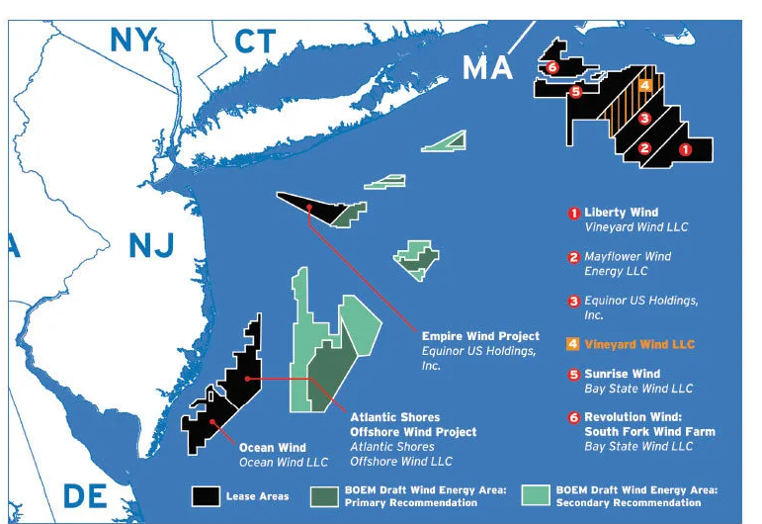
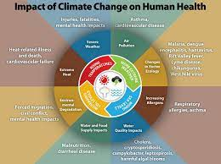
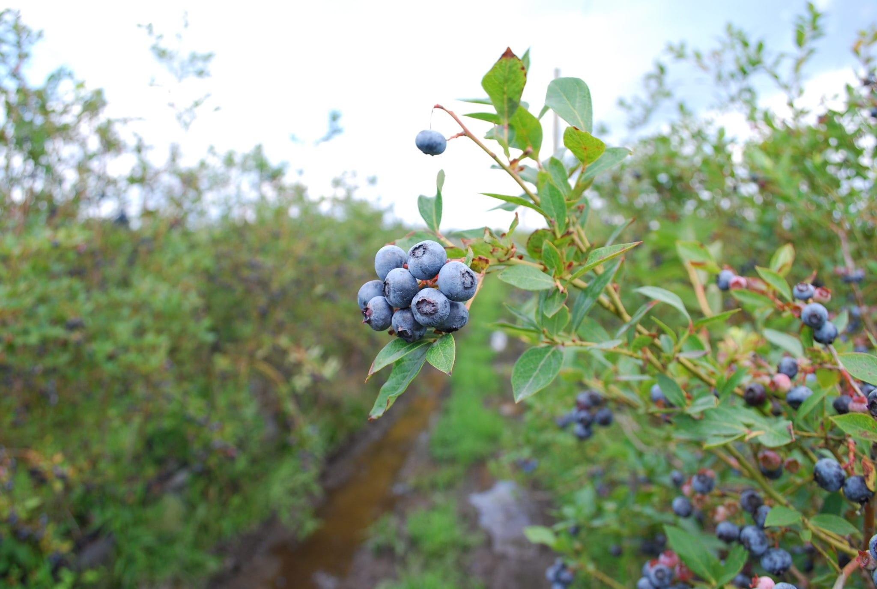
Seasonal/Sub-seasonal Forecasting for Sector Applications
Forecasts need to be understandable, flexible and applicable for the user
Research interest areas include:
  Urban adaptation/public health
  Agriculture/Fisheries
  Coastal Resilience
  Energy & Water
  Disaster Management & Emergency Response
  Time dependence and interrelationship of sector responses
Lake Mead, NV after
decades of drought

Slide 6
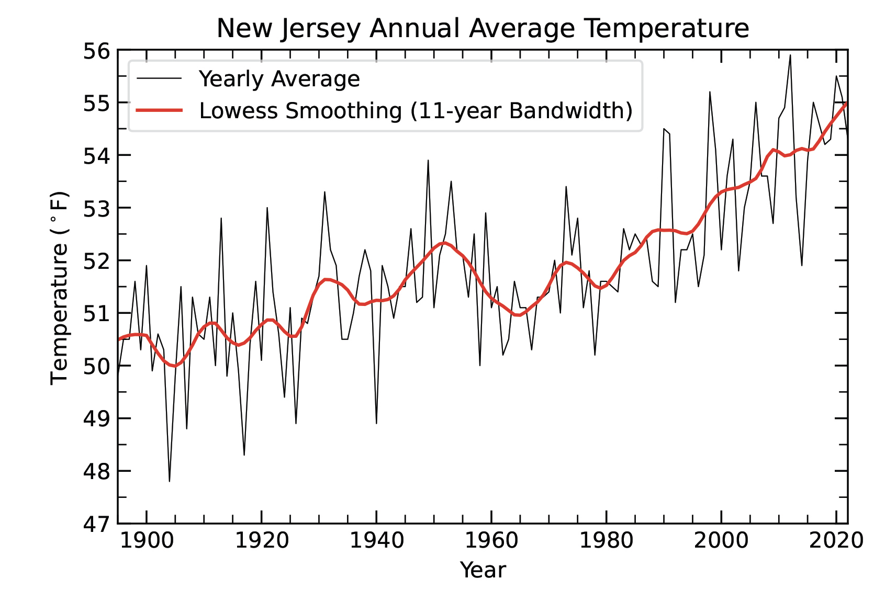
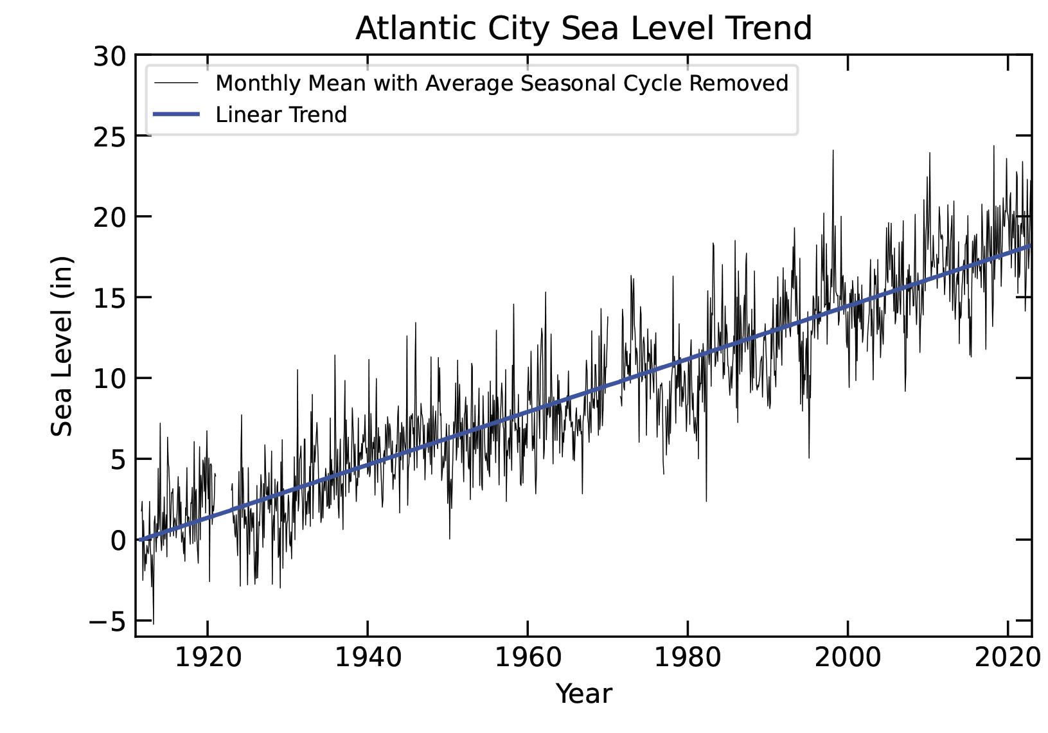
2022 NJ State of Climate Report Highlights
NJ among the fastest rates of temperature increase in the US
NJ experiencing fast rates of sea level rise
Strong trend towards wetter conditions
Both ends of the hydroclimate spectrum amplified
ONJSC 2022
ONJSC 2022

Slide 7
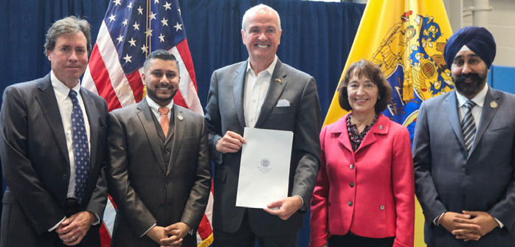
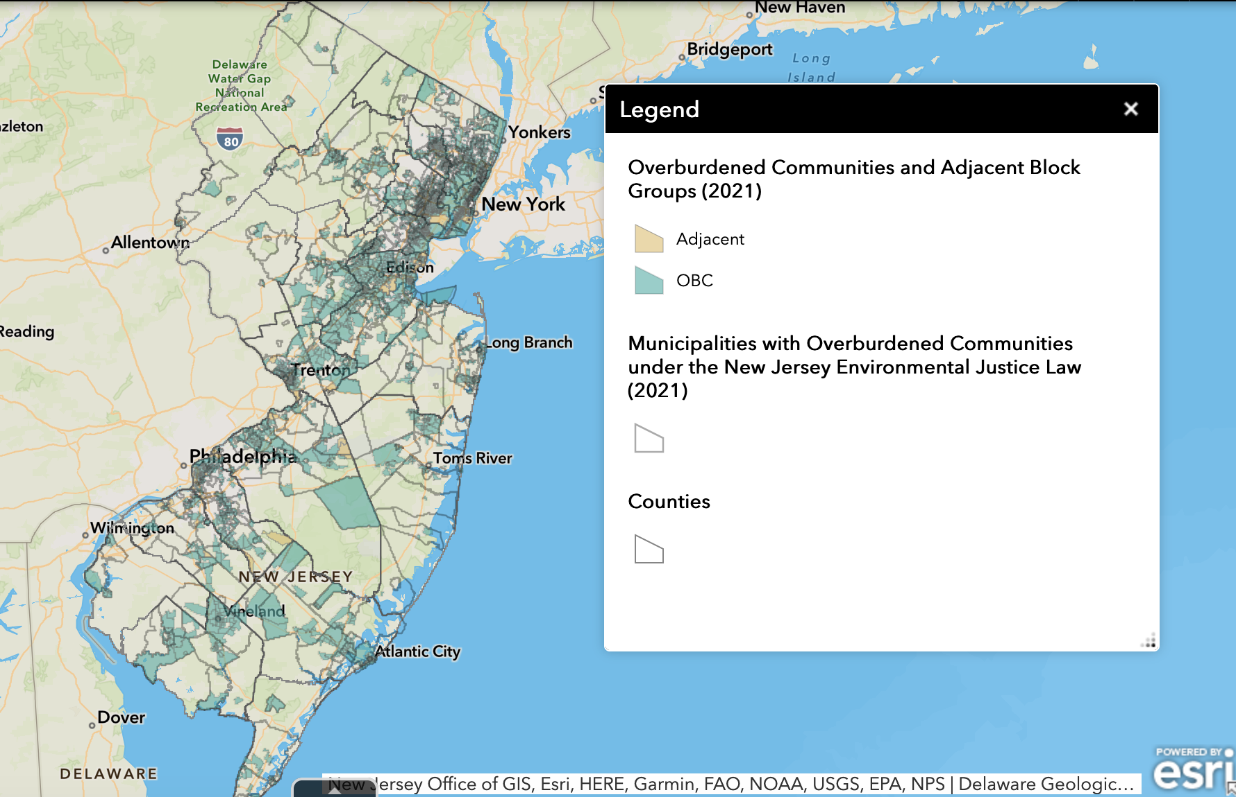
2021 NJ Climate Resilience Strategy
Resilient communities
Strengthened ecosystems
Coordinated governance
Public awareness and education
Climate informed investment and financing
Coastal resilience plan
Governor Murphy and other signatories of 2021 plan
NJ Environmental Justice communities DEP

Slide 8
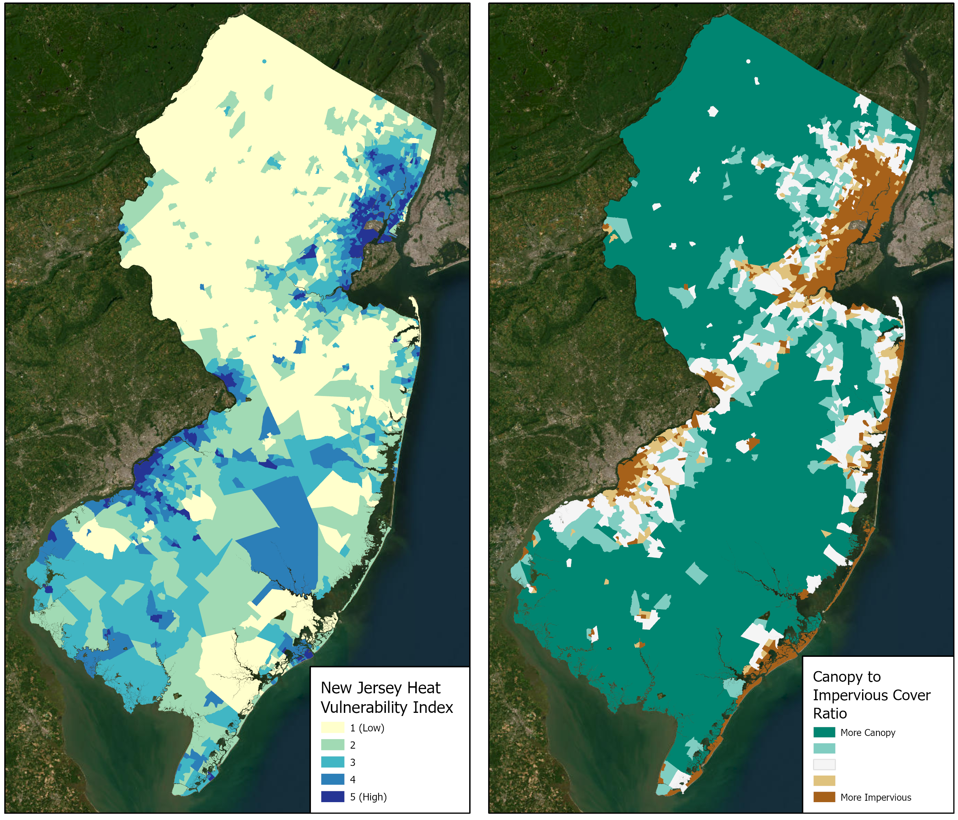
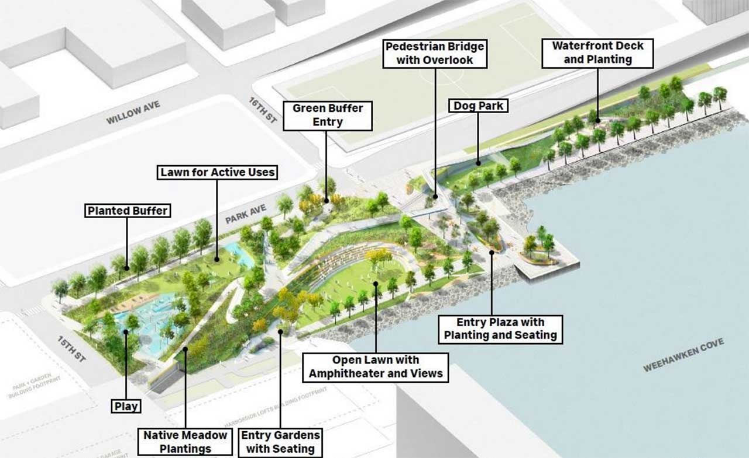
Urban Adaptation, Resilience and Justice
Heat & Health
  Urban heat island
  Vulnerable populations
  NJ Future and NJDEP initiatives
Infrastructure vulnerability
  Roads, public transit, water/wastewater treatment, hospitals, airport
  Financial, policy and outreach
Adaptation Initiative Examples
  CDC – Climate Ready States and Cities Initiative (CRSCI)
  NIHHIS/NOAA – National Integrated Heat Health Information System
  Rebuild by Design projects supported by HUD
ONJSC 2022
Rebuild by Design Schematic, Hoboken

Slide 9
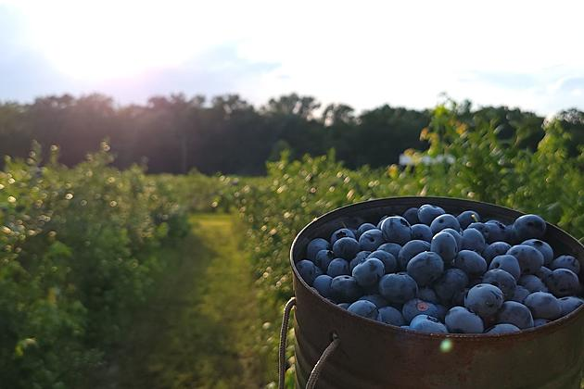
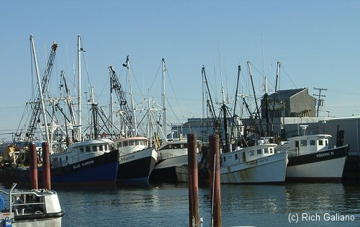
Agriculture/Fisheries
Farming impacts
  Floods/Storms
  Heat waves/Droughts/Fires
  Expanded range of pests
  Shifting seasons
Fisheries impacts
  Marine heat waves
  Acidification
  Storms
Adaptations
  Low or no till agriculture
  Rotational grazing
  Heat tolerant crop varieties
  Fire weather forecasting and controlled burns
  Early warning systems for pest invasions
  Marine heat wave forecasts
  Seasonal storm forecasts
Pemberton blueberry farm
Docks at Pt. Pleasant

Slide 10
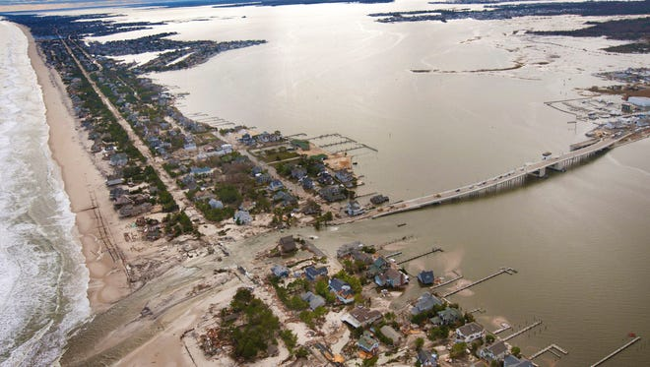
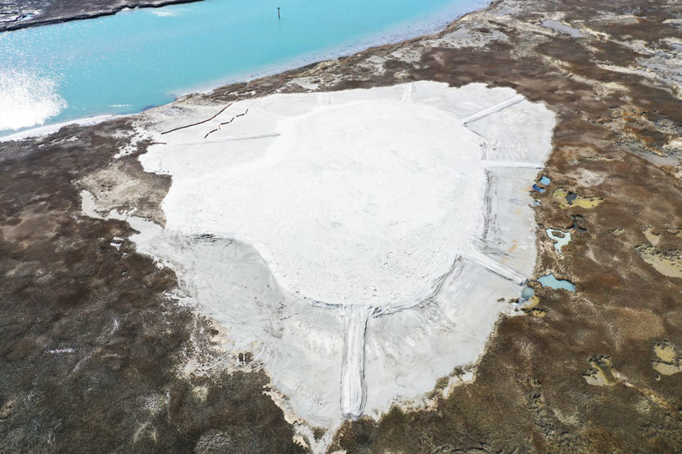
Coastal Vulnerability and Adaptation
Natural Vulnerabilities
  Major storms/erosion
  Sea level rise
  Saline intrusion
  Wetlands loss/degradation
Socioeconomic Vulnerabilities
  Insurance failures
  Competing demands
Adaptive Responses
  New FEMA building codes post-Sandy
  Blue Acres for adaptation to flood risk
  Bureau of Climate Resilience Planning
  Wetlands restoration
  Dune protection/beach replenishment
  Integration of hard and natural infrastructure
  Managed relocation/retreat
Mantaloking, after Sandy 2012
Seven Mile Island Innovation Lab,
NJ Climate Resilience Strategy 2021

Slide 11
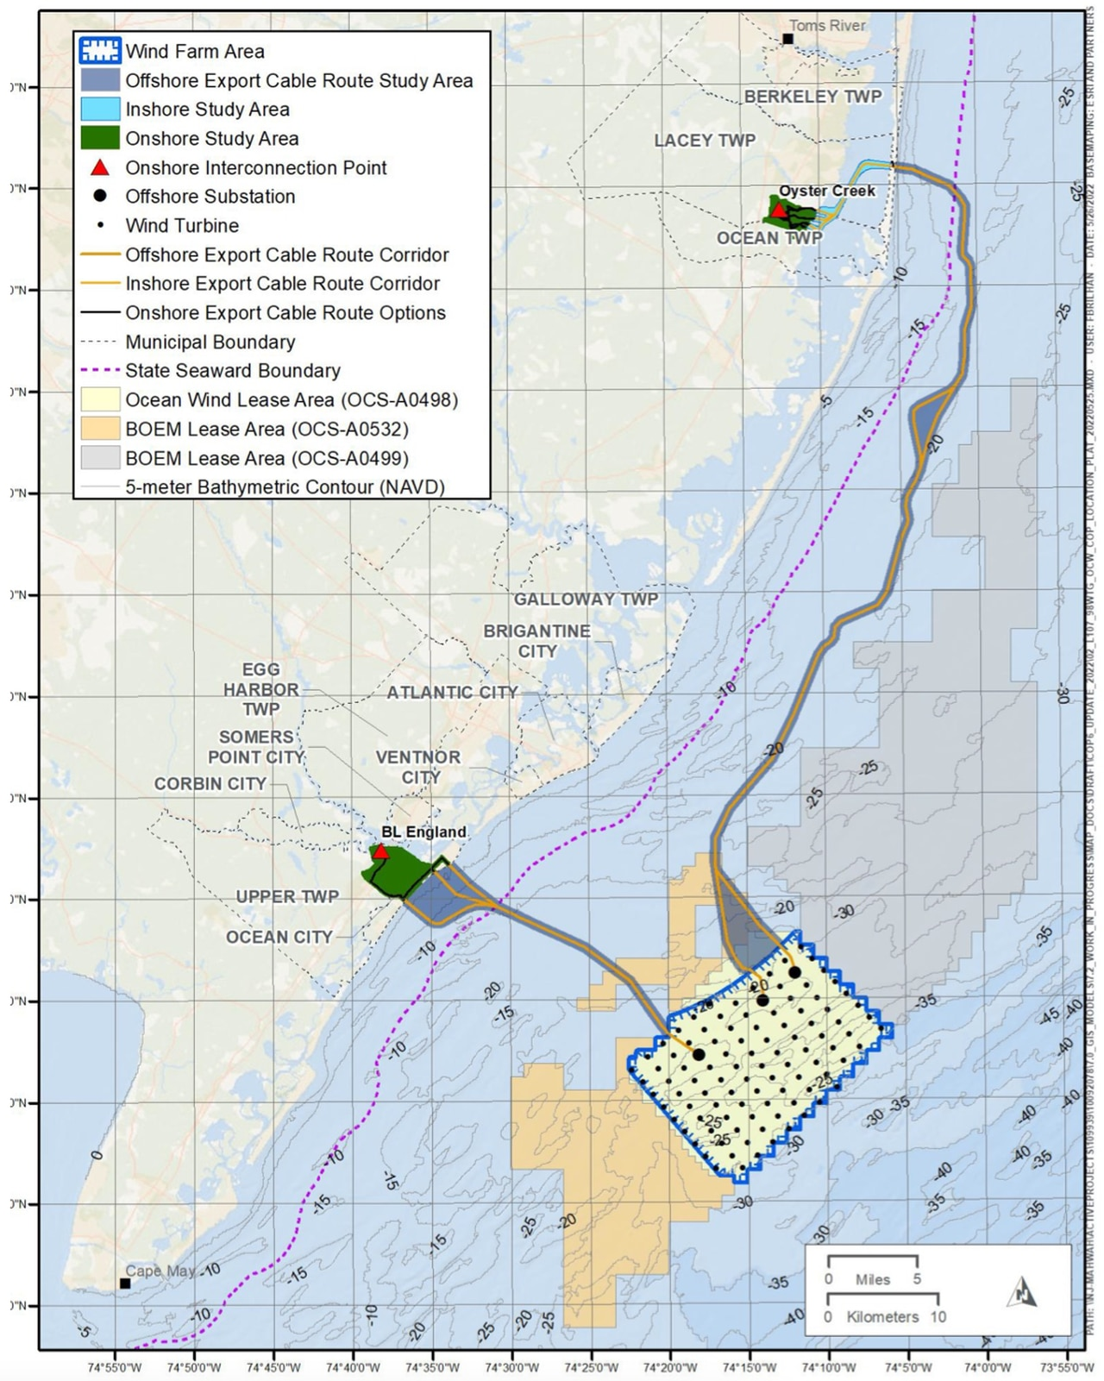
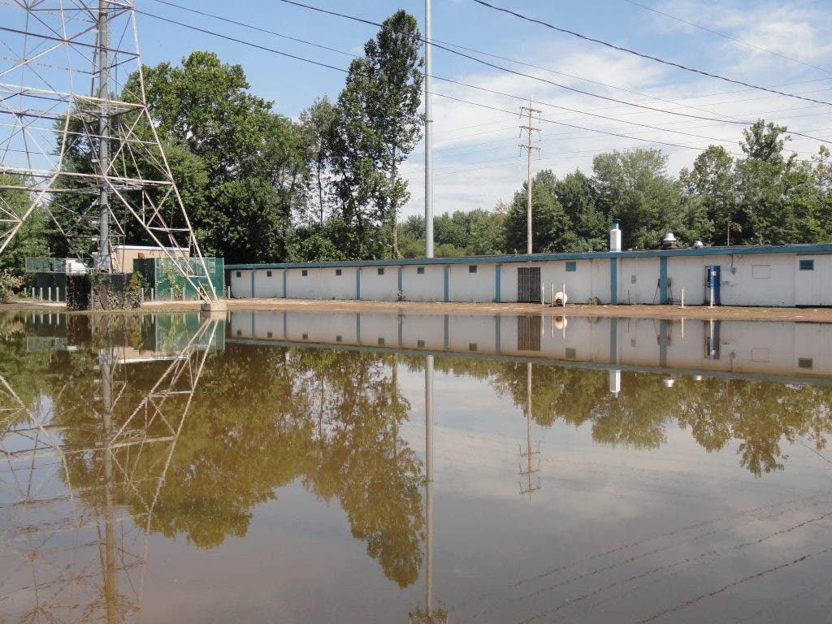
Utilities
Offshore Wind
  Forecasting wind anomalies for construction and operation
Fossil Fuels/Electricity operations
  Blackout risk
  Adaptive forecasting/management
Water Infrastructure
  NJDEP – forecasting for adaptive reservoir management
    heat and drought
    water quality degradation
    storm surge and flooding
    increased demand
  Sensitive aquifers – Highlands, Pinelands
Ocean Wind 1 proposal
Lowering of Boonton reservoir levels
in advance of Sandy 2012

Slide 12
Funding/Collaboration
Funding
  Federal Scientific Agencies: NSF, NOAA, NASA, DOE, NIH, USGS, USDA capacity funding, NOAA CAP/RISA, CDC
  Inflation Reduction Act
  Extension and State level: NJAES, NJDEP, state appropriations
  Rutgers affiliated: Climate and Health, NJAdapt, C2R2
Collaboration
  Meteorology/Atmospheric Science/EnvSci, Geography, Bloustein, Rutgers Climate Institute (RCI), Rutgers Energy Institute (REI), Office of the NJ State Climatologist (ONJSC), Columbia Climate School
  Communities throughout the state, utilities, agriculture and fisheries collectives

Slide 13
Teaching/Advising/Curriculum
Goals
  Research program: climate science, statistics, modeling, societal impact
  Coping with climate risk, creativity, teamwork
  Love for/curiosity about planet
Courses
  Climate and Society, Sector Impacts, Applied Forecasting, Quantitative Methods, Earth Systems, Climate Change, Natural Disasters
Seminars
  Rutgers, other American universities, other institutions or universities (African)?
Internships, graduate programs, etc.
  Rutgers departments and extension, Columbia, international/African organizations

Slide 14
Justice, Equity, Diversity, and Inclusion (JEDI)
Climate Impacts are Justice and Equity Issue
  IRI work
  Princeton postdoc
  Rutgers PhD
Pipeline issue in Earth/Climate Sciences
  Outreach: other colleges and international organizations
  Outreach: underserved communities, citizen science initiatives
Recruitment, hiring and acceptance
Larger thematic initiatives: AGU, AMS, AAG

Slide 15
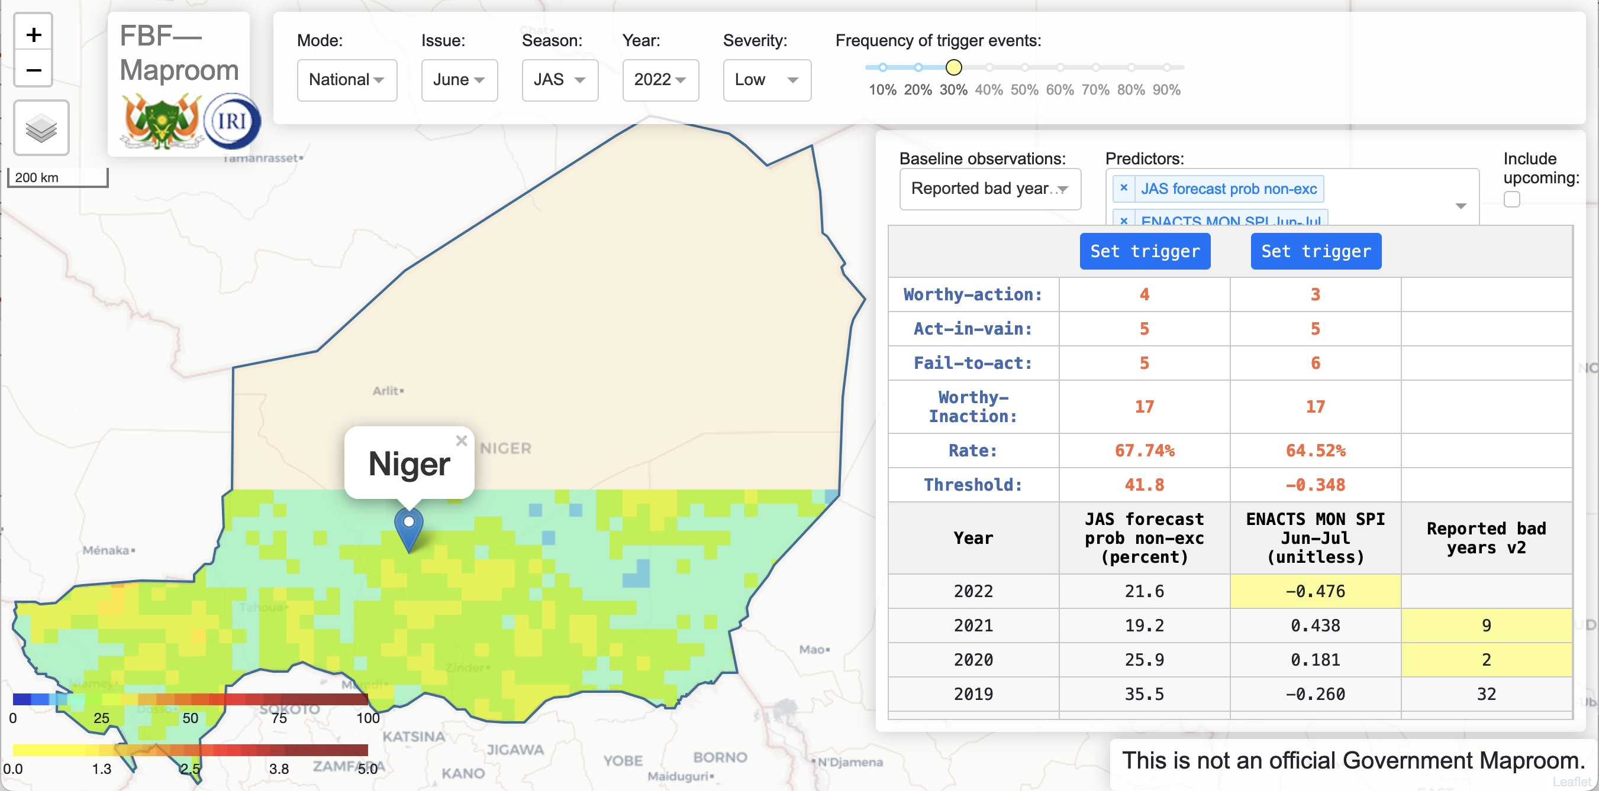
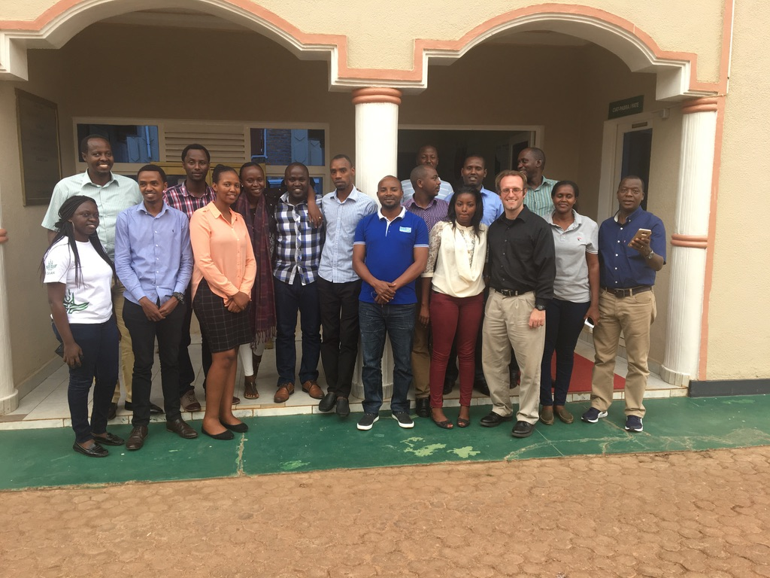
Columbia/IRI (2016-2022)
World Food Programme (WFP) Forecast-based Financing (FbF)
  Niger FbF project: 10 million USD humanitarian payout in 2022
(ACToday) – Columbia World Project
  Forecasting/Training with met services in: Senegal, Ethiopia, Bangladesh
  Curriculum development (2020-2022): CRMAE – Ethiopia
(CCAFS) Rwanda (USAID) (2016-2019): 2018 Africa Climate Smart Project of the year
  Forecasting/Training/Collaboration with staff at MeteoRwanda, (RAB) CIAT-Rwanda
USAID/ UKDfID (CCAFS/WISER) (2016-2019)
  with regional African partners (ICPAC, AGRHYMET)
Conferences - AGU, AMS, ITISE, NOAA CDPW, GHACOF
Papers – Clim Dynamics, Atm Research, Atm and Clim Sci, Int J of Clim, Malaria Journal, Climate Services (in review)
Climate and energy & health interests
Niger FbF maproom tool
Training in Kigali, Rwanda 2017

Slide 16
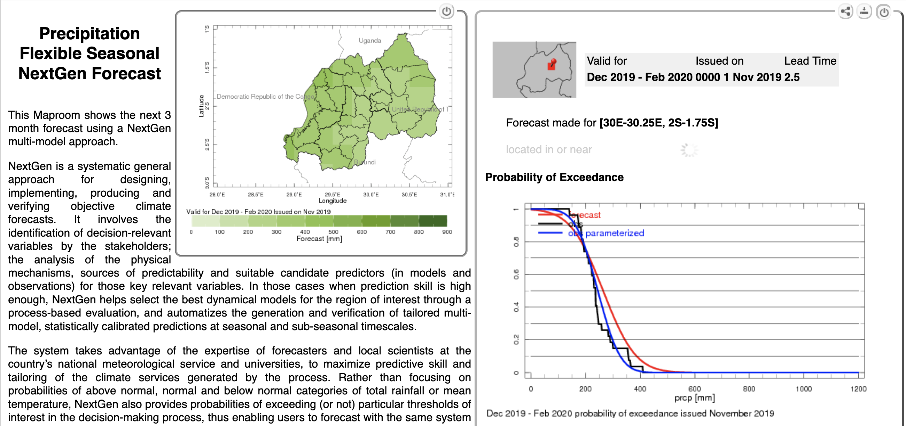
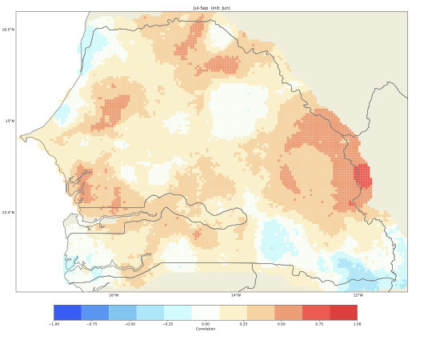
Methods and Tools
Quantitative
  Data types – station, satellite, reanalysis, GCM
  Data fields – climate, vegetation, socioeconomic
  Software – Matlab, R, Python, GIS
  IRI tools – CPT, PyCPT, CDT, ENACTS, IRIDL
  Methods – correlation and regression (forecasting), Monte Carlo
Qualitative and mixed
  Interviews and Surveys
  Vulnerability data
  Stakeholder workshops/User trainings
Future Research
  Data sources/platforms – remote sensing, model output, citizen science/socioeconomic
  Methods – statistical methods, outreach, collaborative tool development
Nov issue DJF 2019/20 rainfall forecast Rwanda
Correlation of NMME JAS rainfall forecast
(from June) with observations for Senegal

Slide 17
Postdoc and Analyst 2015-2016
Princeton Environmental Institute postdoc (Feb 2015-May 2016)
  Interdisciplinary research
  climate-economy IAMs (DICE/RICE)
    Economic damages
    Economic mitigation costs
    Population scenarios
    Health co-benefits and risks
  coauthor papers in Proc Nat Acad Sciences, Clim. Change, WB Econ Rev
NJ Adapt Project (Jan 2015)
  GCM scenario analysis for NJ
From Dennig et al. 2015 PNAS
From Scovronick et al. 2017 PNAS

Slide 18
PhD, Rutgers Geography (2009-2015)
Dissertation (2014-15): index insurance in the Sahel
  Data – station and station rainfall, ENSO, NDVI, streamflow, GCMs from CMIP5
  Statistical methods – climate change and decadal variability
  Research trip to Niger 2010 (ACMAD, AGRHYMET, Niger Basin Authority)
Teaching
  Dissertation Teaching Award (undergrad 2014)
  Rutgers Geography (undergrad 2010-2013)
  Columbia Climate & Society (grad 2009, 2010)
Qualifying Exams (2011)
  Climatology, Hydrology, Adaptation/Insurance, Geography
Conferences - AAG, AMS, (US) WCRP, AMMA (France 2010, 2012)
Lead author papers: Afr. Geog. Review; GeoCompass; Clim. Change; Wea Clim and Soc, J App Met Clim (AAG CSG Award)
From Siebert and Ward 2014 African Geographical Review
From Siebert 2016 Weather, Climate and Society

Slide 19
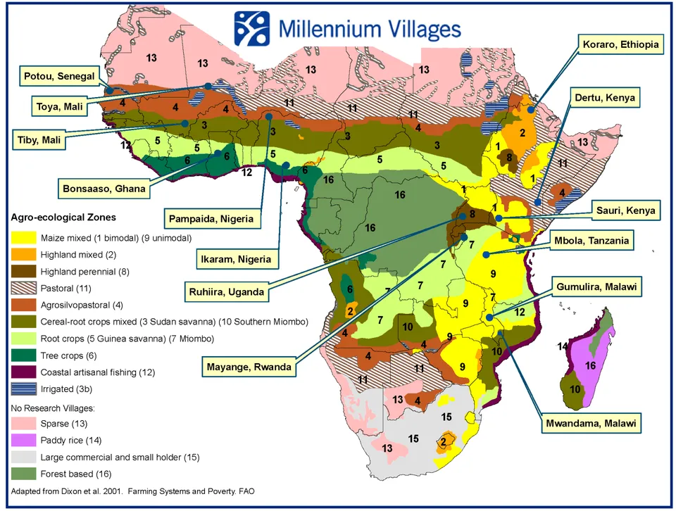
Pre-PhD (before 2009)
Staff Associate Columbia/IRI (2006-2008)
  Developed drought index insurance contracts for 12 locations across Africa (Millennium Villages Project)
  Work funded by Swiss Reinsurance
  Conferences - AMS
MA, Climate and Society (2005-2006)
  Internship at NASA-GISS CCSR working with NYCDEP
Grad student, MIT-WHOI (2002-2004)
  Physical oceanography
BA, Princeton Geosciences (1998-2002)
  Internship at Ohio State Byrd Polar Center, senior thesis on analysis of ENSO record from Andean ice core
NYC DEP 2008 Climate Change Report
From Siebert and Ward 2011 JAMC

Slide 20
Summary
Research & Extension
  Extreme events
  Seasonal forecasting for sectoral applications
  Urban adaptation/climate justice
  Agriculture/fisheries
  Coastal vulnerability
  Utilities
Funding & Collaboration
  Federal scientific and adaptation, extension resources, utilities, local governance
  Department, extension, communities, other departments and initiatives
Teaching/Advising/Curriculum Development
  Teaching: climate and societal impact, applied forecasting, quantitative methods
  Research program: science and societal impact
  Outreach for joint seminars/classes
  Internship & grad programs - Rutgers, extension services, Columbia, and other
Justice, Equity, Diversity, Inclusion (JEDI)
  climate impacts as a justice and equity issue, pipeline issue, community outreach

Slide 21
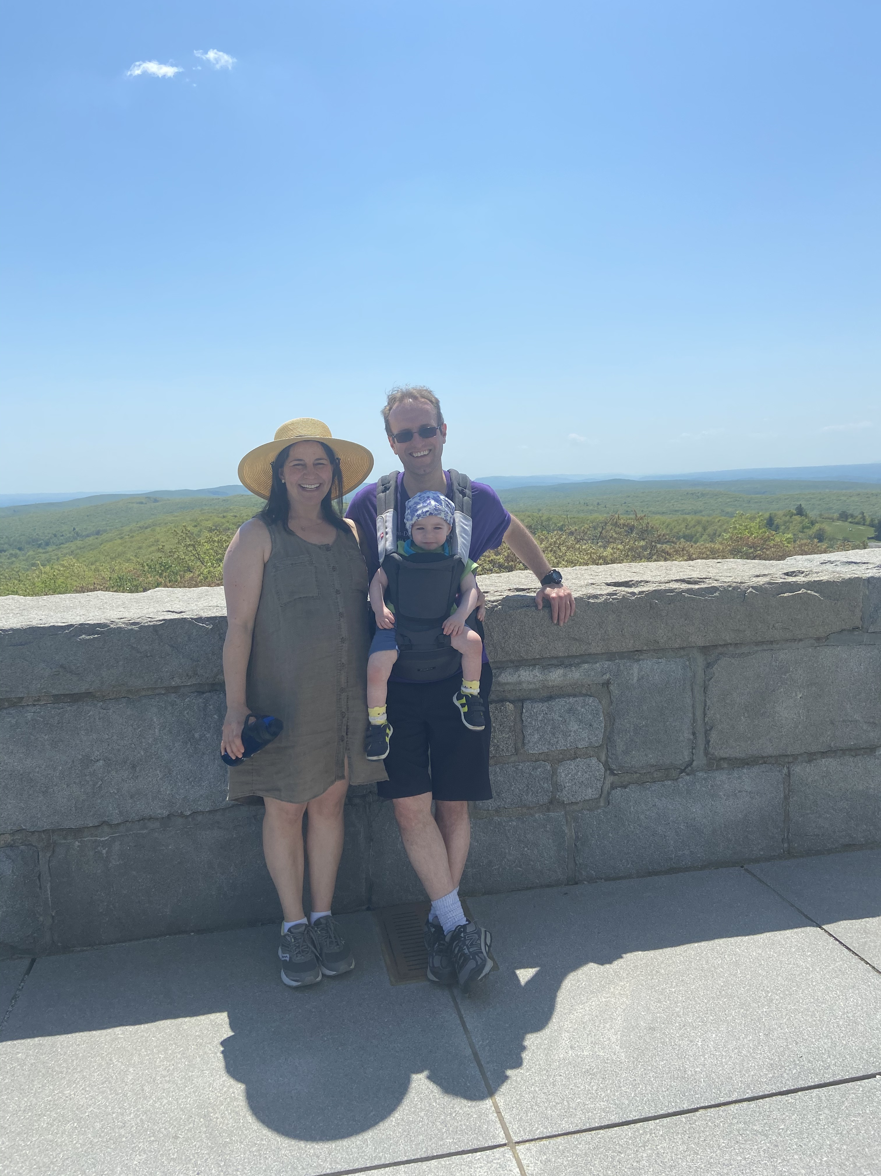
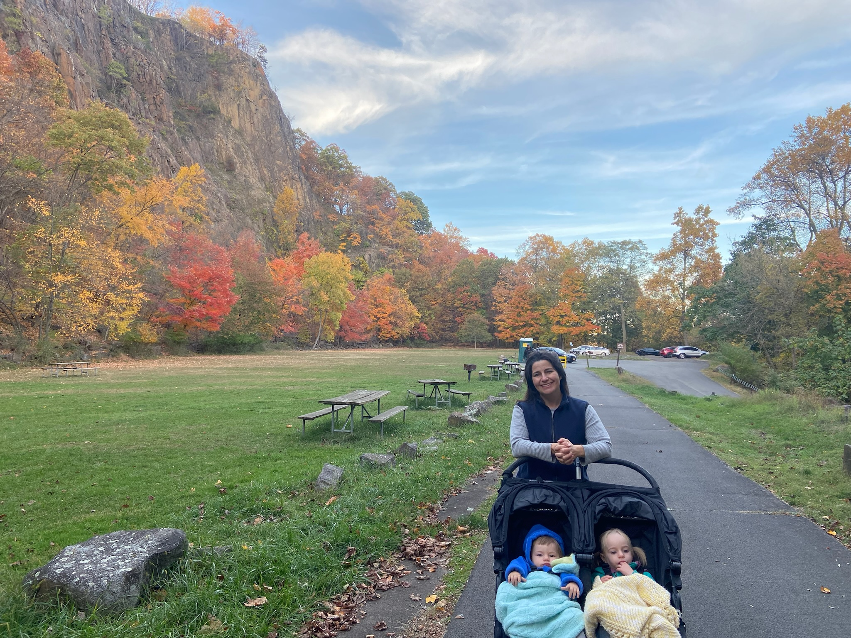
Thanks and Personal
Rutgers Search and Interview Committee
  Professors Mark Miller, Donna Fennell, Amy Rowe, Anthony Broccoli, Alan Robock, Extension Director Brian Schilling, Chris Obropta, David Robinson, Mary Whelan, Dean Laura Lawson, Troy Roepke, Dean Wendy Cohick
IRI Colleagues
  Andrew Robertson, Daniel Osgood, James Hansen, Tufa Dinku, Simon Mason, John Furlow, Remi Cousin, Sylwia Trzaska
  Funding organizations: USAID, WFP, WMO, UKDfID, CWP, Swiss Re
Rutgers PhD Committee
  David Robinson, Neil Ward, Robin Leichenko, Asa Rennermalm, Kenneth Mitchell
Other Mentors
  Princeton: Robert Socolow, Marc Fleurbaey (postdoc), George Philander, Jorge Sarmiento (undergrad)
  Columbia: Mark Cane, Tony Barnston, Mingfang Ting, Upmanu Lall, Lisa Goddard
  NJ Adapt: Marjorie Kaplan, Jeanne Herb
  Internships: Cynthia Rosenzweig (NASA-GISS), Lonnie Thompson (OSU BPRC)
  Africa: Desire Kagabo (CIAT-Rwanda), Ousmane Ndiaye (ANACIM), Zewdu Segele (ICPAC), Mohammed Kadi (ACMAD), Dawit Solomon (EIAR -Ethiopia)
Friends, family – parents, extended family, Melissa, Maya and Jacob
High Point, NJ
Hook Mountain Plateau, Nyack, NY

Slide 22
Acronyms and Links
AAG – Association of American Geographers
ACMAD – African Center for Meteorological Application to Development (Niamey, Niger)
ACToday – Adapting Agriculture to Climate Today for Tomorrow (CWP)
AGRHYMET –Center for Agriculture, Hydrology and Meteorology (Niamey, Niger)
AGU – American Geophysical Union
AMMA – African Monsoon Multidisciplinary Analysis
AMS – American Meteorological Service
ANACIM – Agence Nationale de l’Aviation Civile et de la Météorologie (Senegal)
BPRC – Byrd Polar Research Center (Ohio State)
CCAFS – Climate Change, Agriculture and Food Security
CCSR – Center for Climate Systems Research
CDPW - Climate Diagnostics and Prediction Workshop (NOAA)
CDT – Climate Data Tools
CGIAR – Consultative Group for International Agricultural Research
CIAT – International Center for Tropical Agriculture
CMIP – Coupled Model Intercomparison Project
CPT – Climate Predictability Tool
CRMAE – Climate Risk Management for Agricultural Extension
CRSCI – CDC’s Climate Ready States and Cities Initiative
CWP – Columbia World Projects
EIAR – Ethiopian Institute of Agricultural Research
ENACTS – Enhancing National Climate Services
ENSO – El Nino Southern Oscillation
FbF – Forecast Based Financing
GCM – Global Climate Model
GHACOF – Greater Horn of Africa Climate Outlook Forum
IAM – Integrated Assessment Model
ICPAC – Intergovernmental Authority on Development (IGAD) Climate Prediction and Applications Centre (Nairobi, Kenya)
IRI – International Research Institute for Climate and Society (Palisades, NY)
IRIDL – IRI Data Library
ITISE – International Conference on Time Series and Forecasting
JEDI – Justice, Equity, Diversity, and Inclusion
NASA-GISS – NASA-Goddard Institute for Space Studies (New York)
NDVI – Normalized Difference Vegetation Index
NESDIS – National Environmental Satellite Data Information Service
NIHHIS – National Integrated Heat Health Information System
NJAdapt – NJ Adapt Project
NJAES – NJ Agricultural Experiment Station
NMME – North American Multi-Model Ensemble
NOAA CAP/RISA – Climate Adaptation Partnerships (regional within US)
NOAA-CESSRST - Center for Earth System Sciences and Remote Sensing Technologies
NOAA-CREST - Cooperative Remote Sensing and Technology Center
NJDEP – Department of Environmental Protection
ONJSC – Office of the NJ State Climatologist
RAB – Rwanda Agriculture Board
RCI – Rutgers Climate Institute
REI – Rutgers Energy Institute
RICE – Regional Integrated Climate-Economy Model
PyCPT – Python based CPT
UCCRN – Urban Climate Change Research Network
UKDfID – UK Department for International Development
UNOCHA – Organization for the Coordination of Humanitarian Affairs
USAID – US Agency for International Development
USDA – US Department of Agriculture
WCRP – World Climate Research Program
WHO – World Health Organization
WHOI – Woods Hole Oceanographic Institute
WISER – UK Met Office Weather and Climate Information Services
WFP – World Food Programme
WMO – World Meteorological Organization

