Slide 1

Seasonal Forecasting and Innovative Financing for Food Security in a Changing Climate
Loyola University Climate Change Conference
March 2024
Asher Siebert
asherb.siebert@gmail.com
https://asclimateservices.org/
https://www.linkedin.com/in/asher-siebert-7016065/

Slide 2
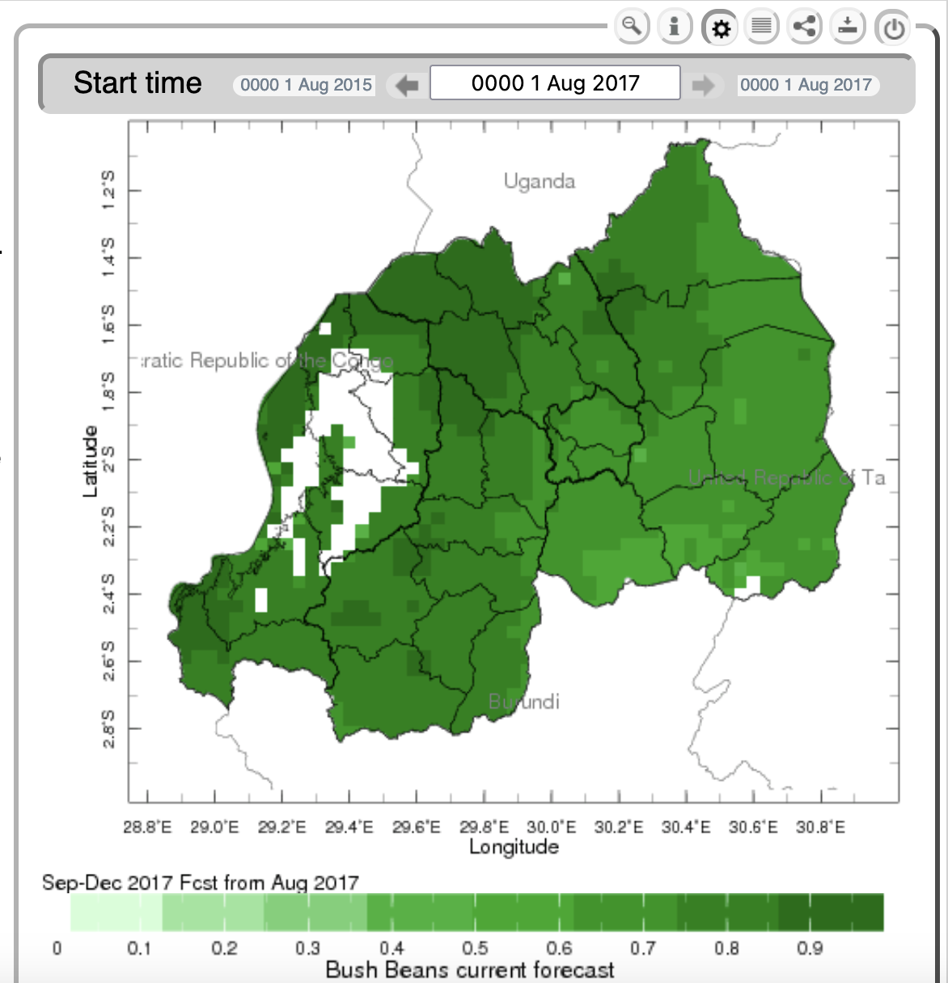
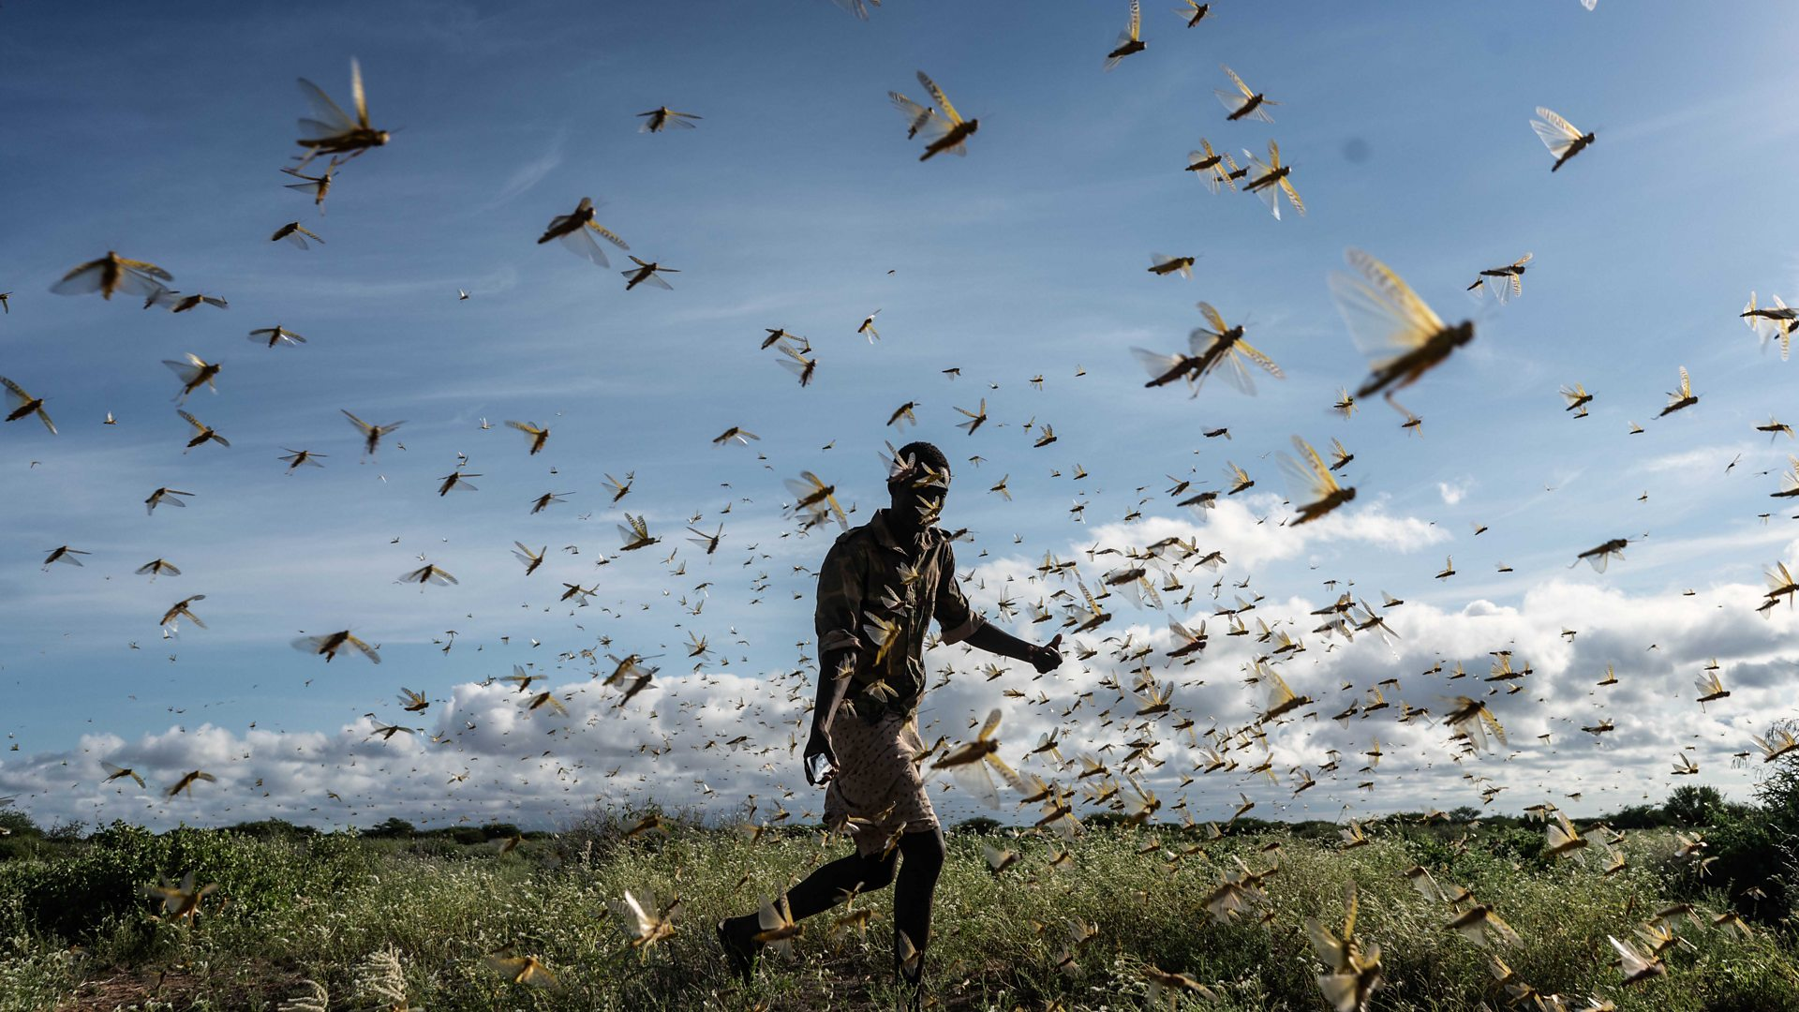
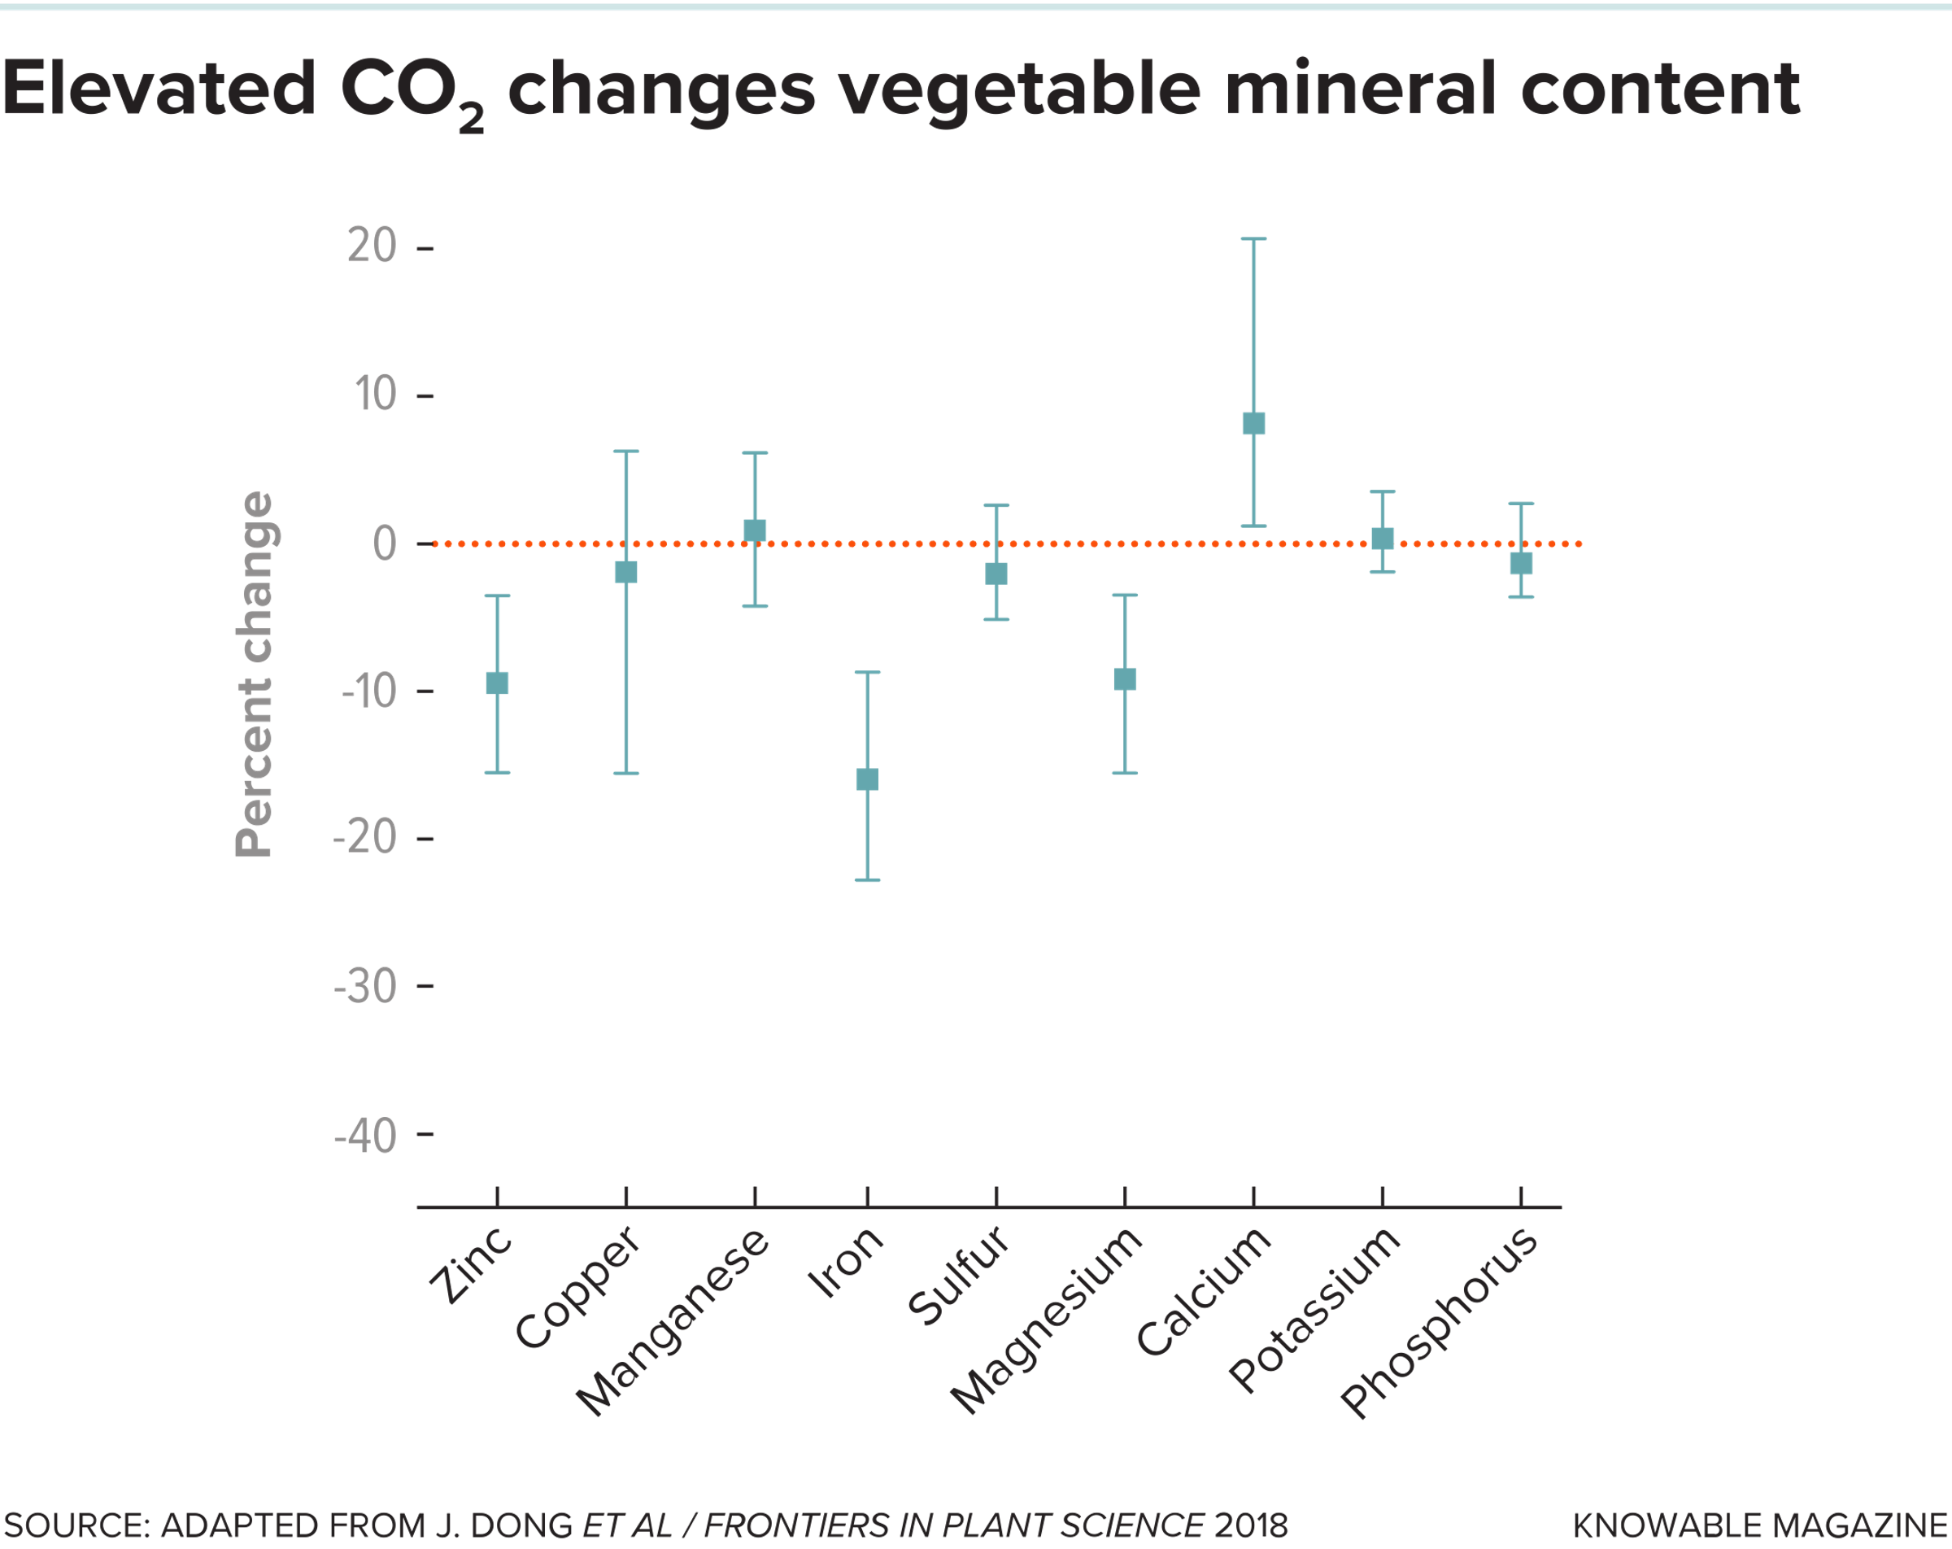
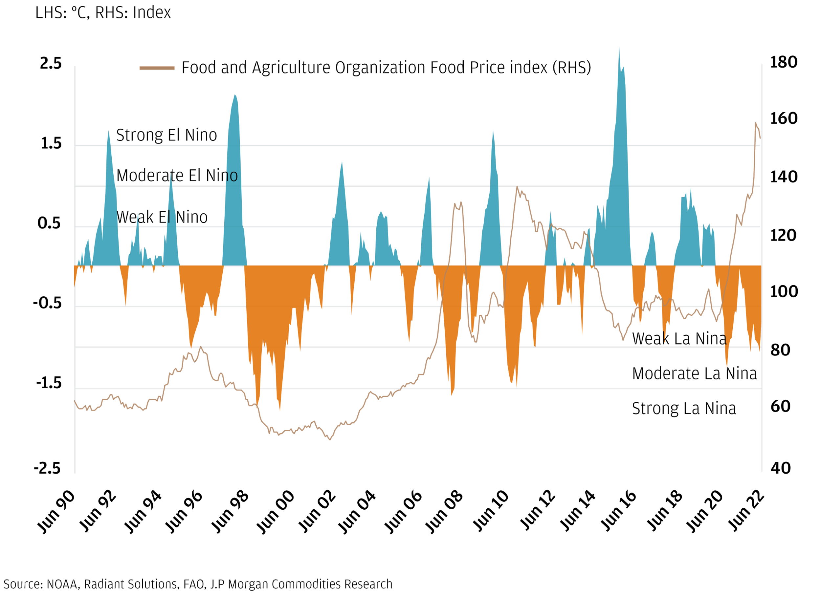
Climate Change and Agriculture Overview
Impacts through Extremes
  Changing seasons
  Heat and water stress (droughts)
  Heavy rainfall – erosion and soil nutrient loss
  Fire risk – heat and drought triggers
Impacts on Harvests
  Accumulated water stress – WRSI (Rwanda example)
  Pest invasions (locust invasion Horn of Africa 2020)
  Changes in nutrient composition
Impacts on Markets and other elements of food security
  Double exposure narrative
  Supply issues - price spikes
2020 locust plague, Kenya, BBC
Bush Beans WRSI forecast, MeteoRwanda
Notes:
Rainfall seasons changing because of erratic onset
Heat stress causing drought conditions to develop faster
Significant increase in heavy rainfall events – hydrological intensification
Fire risk partially a fuel and development issue, but largely about climate
Impacts of climate change depend on the crop, but broad decrease in minerals and protein content
Double exposure narrative: outcomes, exposure and context

Slide 3
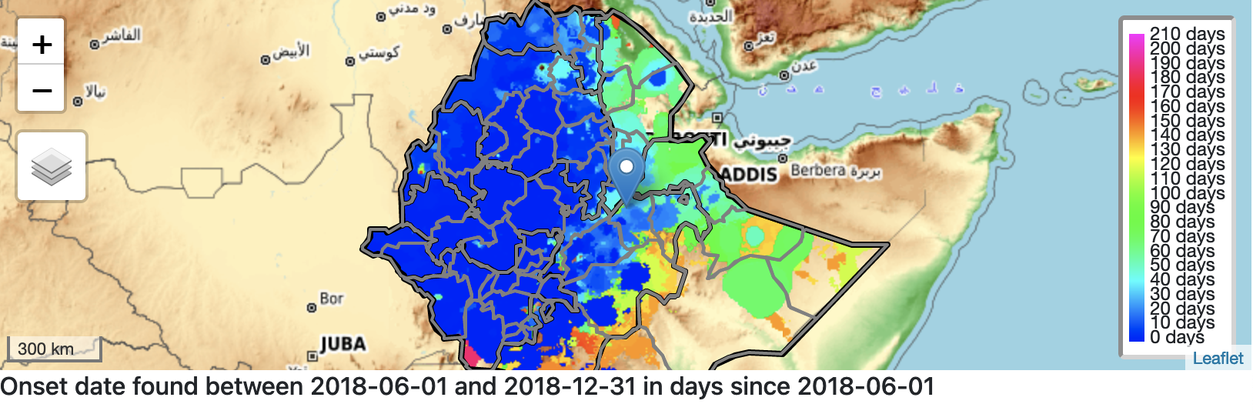
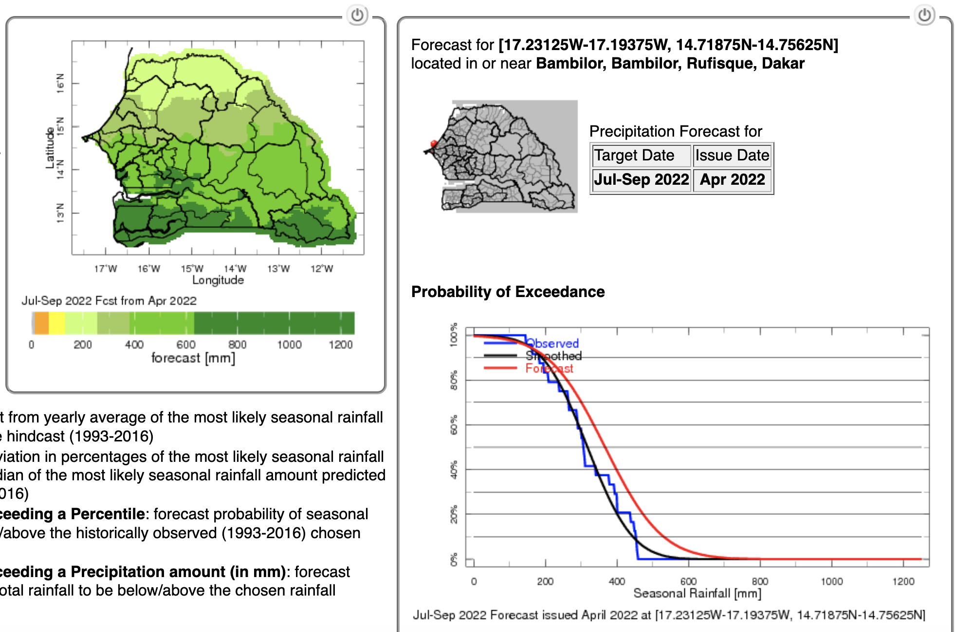
The Role of Seasonal Forecasting
Seasonal forecasts can inform agricultural sector on expectations and advise adaptation decisions
  What crop varieties to plant
  When to plant
  What inputs to buy
  How to approach financing
Challenges in seasonal forecasting
  Spectrum of climate time scales
  Data limitations
  Dissemination challenges
  MME statistical approach
  Agriculturally relevant parameters – dry spell risk, onset date, pest invasions
Examples
  ICPAC
  Rwanda
  Senegal
  Ethiopia
Notes:
Higher predictability of total rainy days
Challenges to predicting onset date, dry spell risk

Slide 4
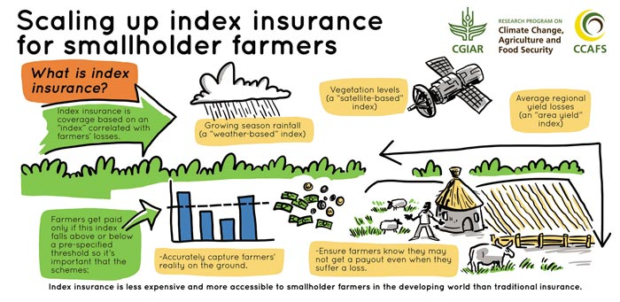
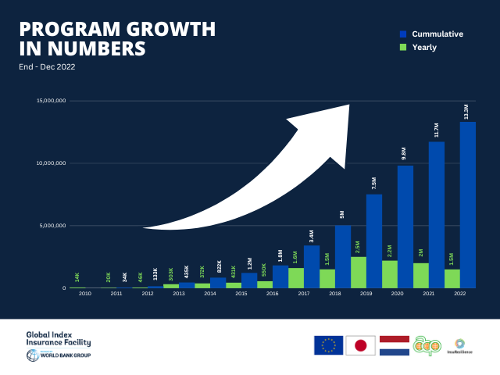
Index Insurance
Potential Advantages
  Low cost, speedy payouts, moral hazard reduction, reduce poverty trap
Potential Disadvantages
  Basis risk, data limitations, institutional and regulatory limitations, need for raising awareness and trust
Experience
  World Bank GIIF – 13 million contracts, 65 million beneficiaries and 2 billion USD insured amount
  Re Insurance companies – Swiss Re and Munich Re
  Pilot projects and national scale projects – largely in global South
Climate Change Context
  Climate change - implied shifts in price and coverage
  Resilience improvement - bundling index insurance with climate smart ag tech and/or loans
Notes:
Data limitations
Trust limitations
Need to engage wide spectrum of users
Reticence to engage in multi-year contracts to adopt price varying framework
Larger scale insurance narrative about retreat from climate risk
Need for government financing backstops?

Slide 5
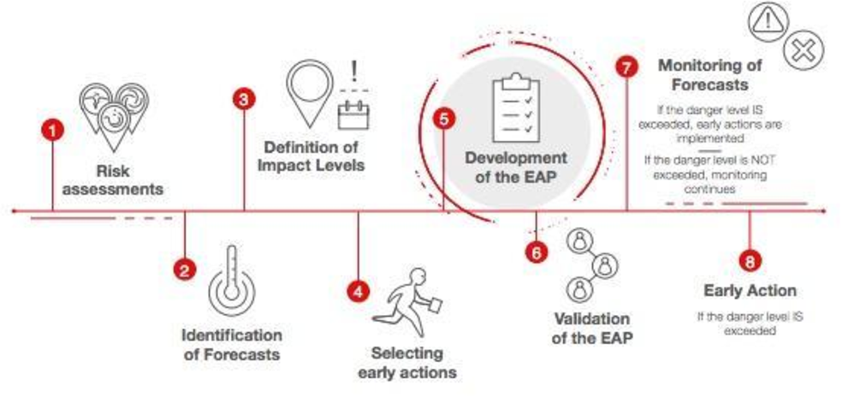
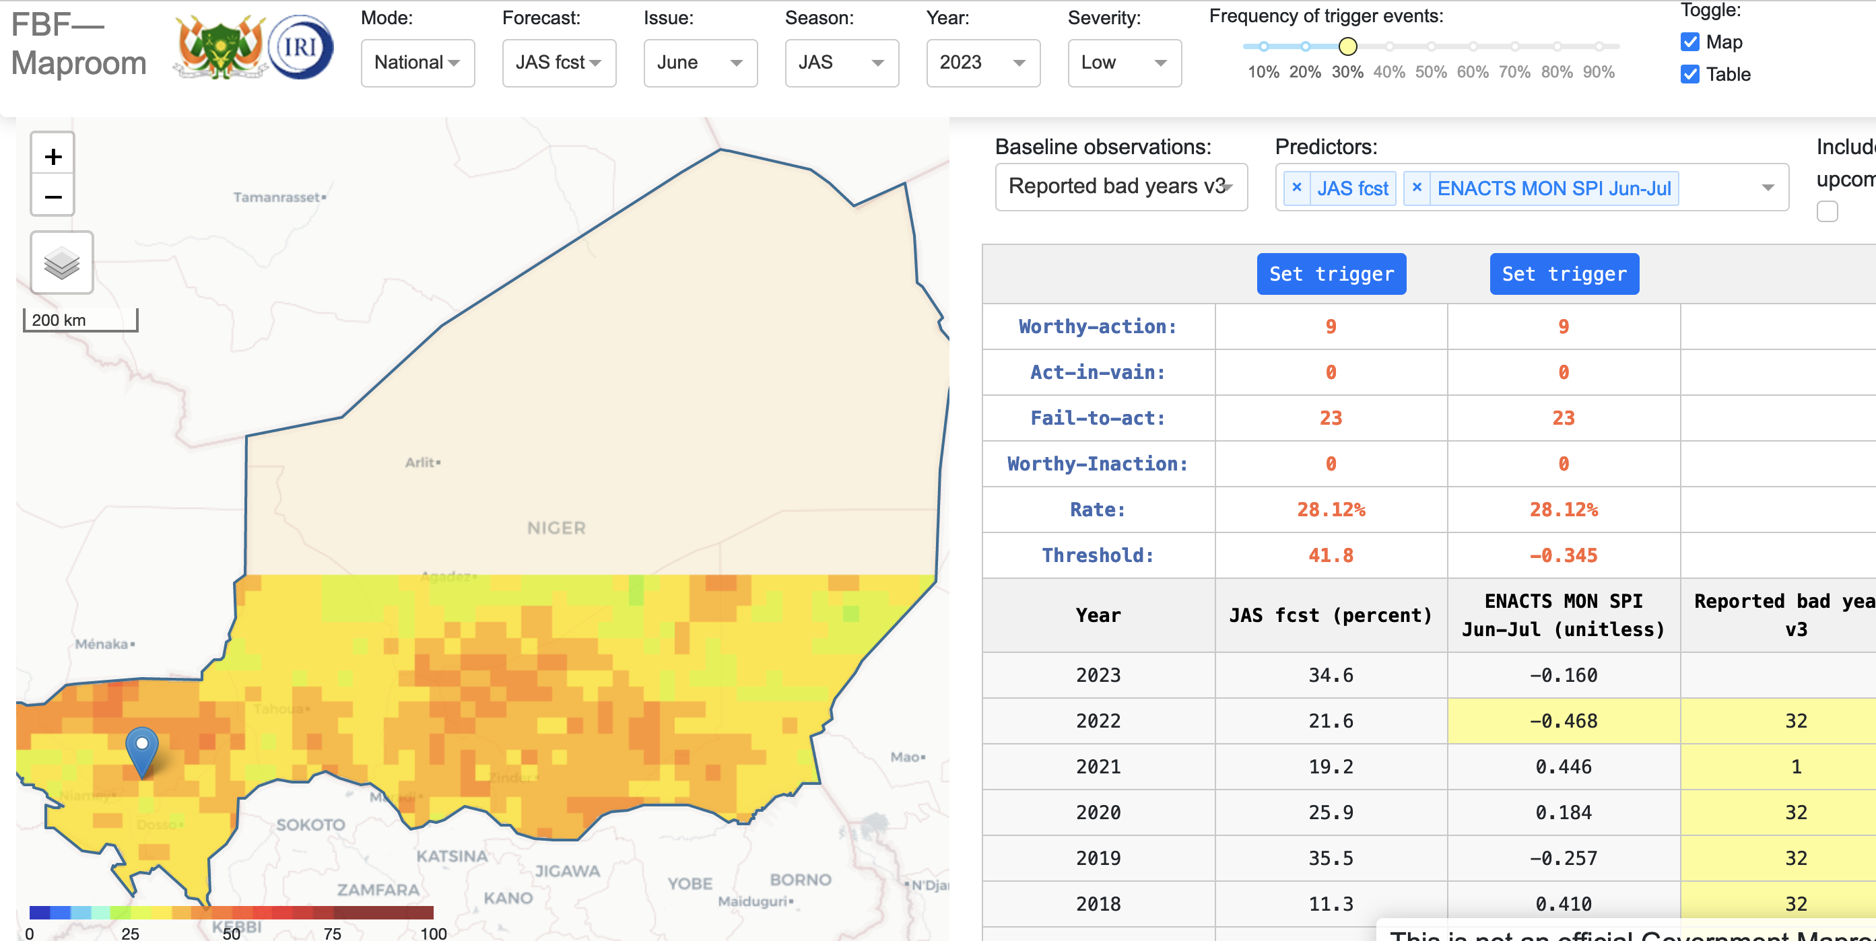
Forecast-based Financing for Humanitarian Organizations
Famine – drought linkage
Humanitarian organizations want to take a more anticipatory approach
Climate forecasts that are timely and skillful can help pre-position resources
FbF can improve efficiency and speed of humanitarian response
Niger 9.5 million USD payout in 2022 in response to severe early season drought
Disaster Response Emergency Fund (DREF) has allocated over 500 million USD to disasters around the world
Notes:
Global Dialogue Platform on FbF
Forecast based approach engaged in recent years
Coupling forecast and in-season monitoring
Will be increasingly important as climate risks grow with climate change

Slide 6
Links and Resources
International Research Institute for Climate and Society (IRI) https://iri.columbia.edu/
Climate Change and Nutrition: https://www.hsph.harvard.edu/c-change/subtopics/climate-change-nutrition/
Maprooms for countries
  ICPAC - https://www.icpac.net/
  Rwanda - http://maproom.meteorwanda.gov.rw/maproom/
  Senegal - http://213.154.77.59/maproom/
  Ethiopia - http://213.55.84.78:8082/maproom/index.html
Global Index Insurance Facility (GIIF) - https://www.indexinsuranceforum.org/
Swiss Re - https://corporatesolutions.swissre.com/innovative-risk-solutions/weather-solutions.html
Munich Re - https://www.munichre.com/en/solutions/for-industry-clients/parametric-solutions.html
World Food Programme Forecast-based Financing (FBF) for Anticipatory Actions - https://www.wfp.org/publications/2023-anticipatory-action-activations
IRI FBF pages
  http://iridl.ldeo.columbia.edu/fbfmaproom2/madagascar
  http://iridl.ldeo.columbia.edu/fbfmaproom2/ethiopia
  http://iridl.ldeo.columbia.edu/fbfmaproom2/djibouti
  http://iridl.ldeo.columbia.edu/fbfmaproom2/niger
Anticipation Hub for Forecast-based Anticipatory Humanitarian Action - https://events.anticipation-hub.org/
Disaster Response Emergency Fund - https://www.ifrc.org/happening-now/emergency-appeals/disaster-response-emergency-fund-dref

