Slide 1
Climate Related Loss and Damage
Asher Siebert, PhD
Senior Scientist on Loss and Damage, Climate Analytics
asher.siebert@climateanalytics.org
University of Colorado, Denver
November 4, 2025

Slide 2

Who we are
Climate Analytics is a global climate science and policy institute engaged around the world in driving and supporting climate action aligned to the 1.5°C warming limit.
We connect science and policy to empower vulnerable countries in international climate negotiations and inform national planning with targeted research, analysis and support.
Our vision
We want a climate-safe, sustainable and just future for all.
Our mission
We deliver cutting-edge science, analysis and support to accelerate climate action to limit warming below 1.5°C.
Our work empowers countries, communities and peoples on the frontlines of the climate crisis.

Slide 3
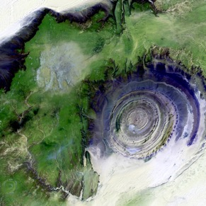
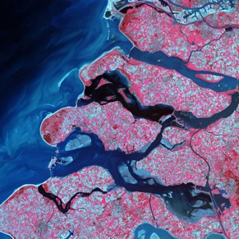
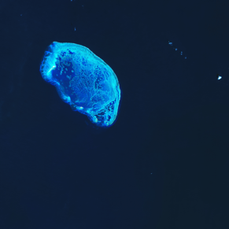
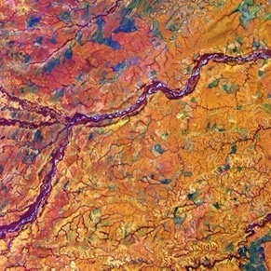
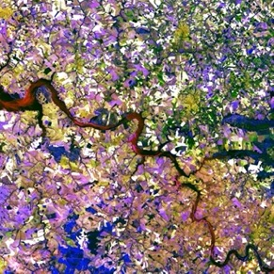
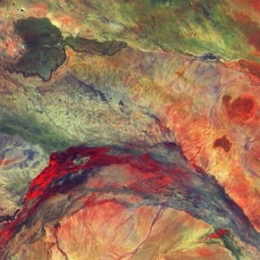
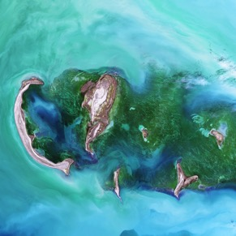
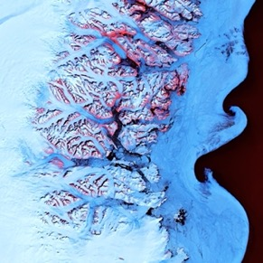
Our work
We produce policy-relevant science and analysis, highlighting options to accelerate progress in line with the Paris Agreement.
We also provide technical support to climate vulnerable countries for their national implementation work, and in the international climate negotiations.
Climate impacts and risks
Adaptation
Loss and damage
Decarbonisation targets and 1.5°C pathways
Climate finance
Climate diplomacy
Climate justice
The 1.5°C limit

Slide 4
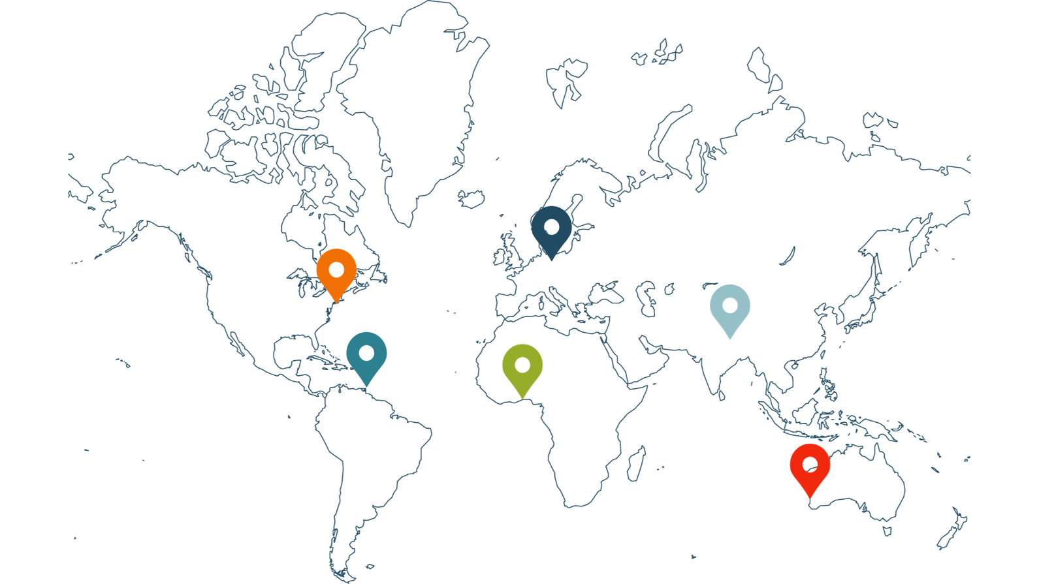

Where we work
Our international team of 130 experts and support staff work from our headquarters in Berlin and our regional offices in Africa, Australia and the Pacific, the Caribbean, North America and South Asia.

Slide 5
My background
BA Geosciences, Princeton (1998-2002)
Physical oceanography grad student MIT/WHOI (2002-2004)
Intern NASA-GISS (2005-2006): worked on NYCDEP report under Bloomberg admin
MA in Climate and Society, Columbia (2005-2006) – fellow student with Prof. Ivan Ramirez
Staff Associate IRI/Columbia (2006-2008): developed drought index insurance contracts for Millennium Villages project
PhD Geography, Rutgers (2009-2015): index insurance in the West African Sahel in a changing climate context
Postdoctoral Associate, Princeton Environmental Institute (2015-2016): interdisciplinary integrated assessment model research to explore issues of equity and health in mitigation scenarios
Postdoctoral Scientist, IRI/Columbia (2016-2019): seasonal forecasting in Africa for food security applications, trained meteorologists on IRI tools
Senior Staff Associate, IRI/Columbia (2019-2022): seasonal forecasting and forecast-based financing in Africa (primarily focused on food security), some work on climate & public health, trained meteorologists on IRI tools
Senior Scientist, Loss and Damage, Climate Analytics (Nov 2024-present): develop multi-sector loss and damage strategies for SIDS and LDCs, contribute to scientific reports, explore intersection of loss and damage and climate justice/equity

Slide 6
Outline
Loss and Damage Definition
Impacts and Costs of Delayed Action
Ongoing Loss and Damage Work at Climate Analytics
The Intersection of Climate Science and Loss and Damage

Slide 7
Loss and Damage Framework

Slide 8
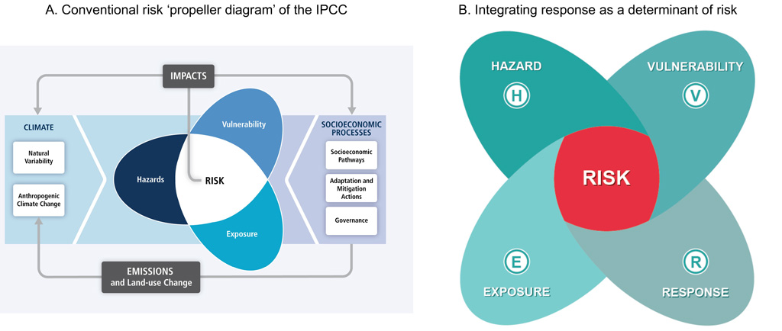
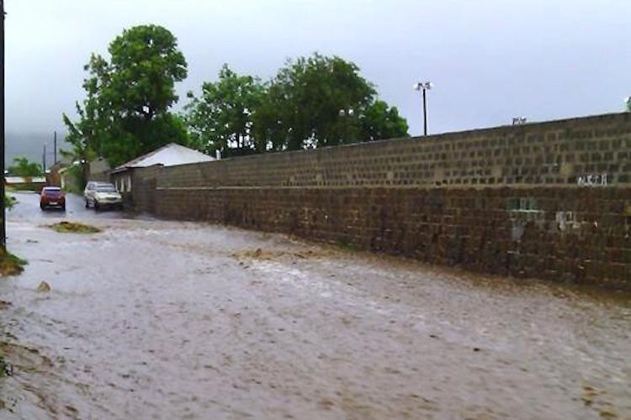
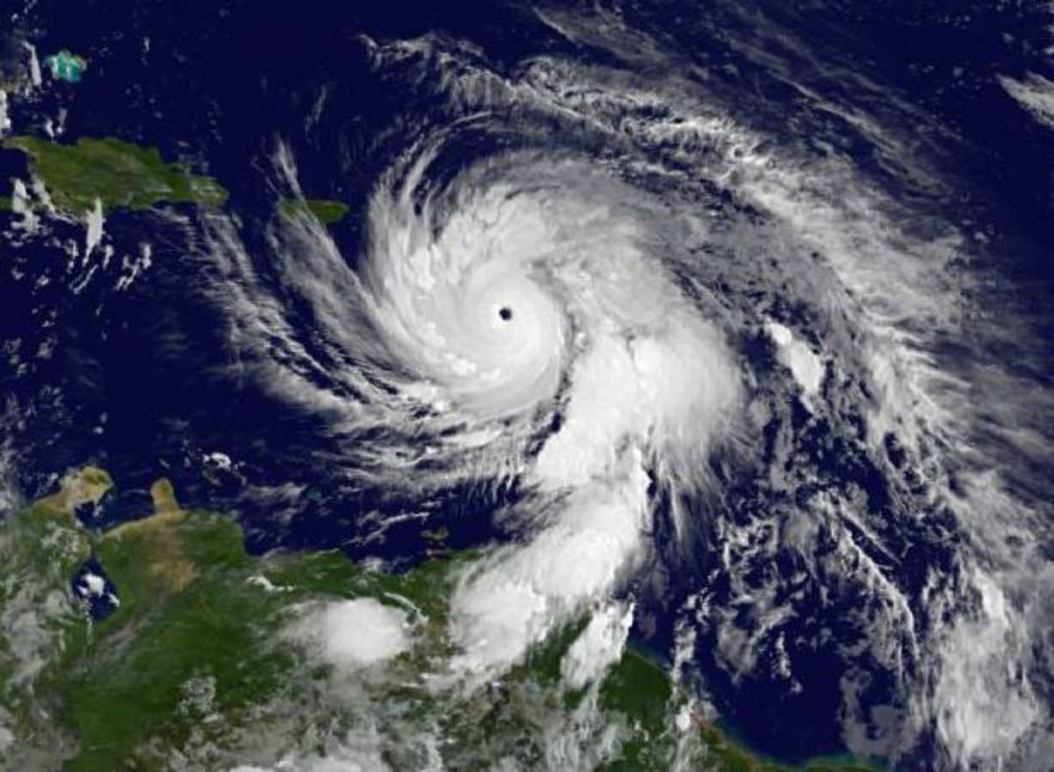
Loss and Damage overview
What is climate-related loss and damage?
  Human, health, economic, ecological, cultural and resilience related adverse impacts incurred from climate extremes and change
Drivers of loss and damage?
  Hazard: hydrometeorological, temperature and sea level rise
  Exposure: people and assets at risk
  Vulnerability: likelihood of adverse impact in exposed communities
Why is it important for SIDS?
  High hazard (eg. hurricane, SLR)
  High exposure (eg. large coastal populations)
  Varying vulnerability
  Reporting L&D -> funding -> pressure on emitters and wealthy countries

Slide 9
Framing Loss and Damage
Resilience
Disaster response
Socioeconomic vulnerability
(Im)Mobility
Environmental damage
Ecosystem services
Livelihoods and Culture
Economic growth and inequality
Health
Deaths
Injuries
New illnesses (eg. vector borne)
Exacerbated pre-existing conditions (eg. cardiovascular and respiratory)
Indirect impacts: food insecurity, energy and water disruptions, mental health
Economic
Property damage
Supply chain feedbacks
Disaster Response/Recovery
Productivity Losses
Impacts on Tourism
Investment and insurability
Growth and inequality
Sectors
Physical infrastructure and built environment
Transport system
Food systems: agriculture/fisheries
Energy
Water system
Tourism

Slide 10
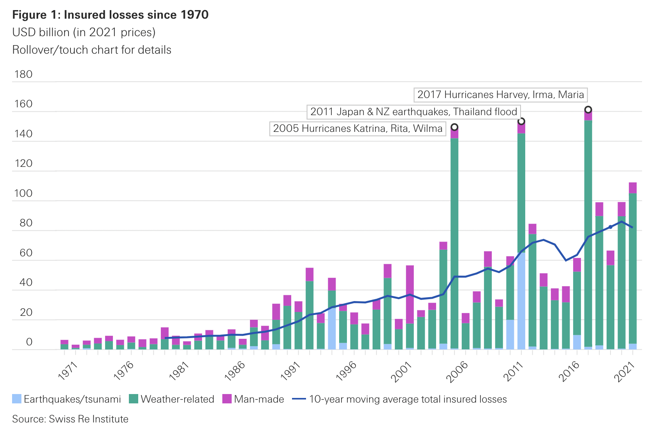
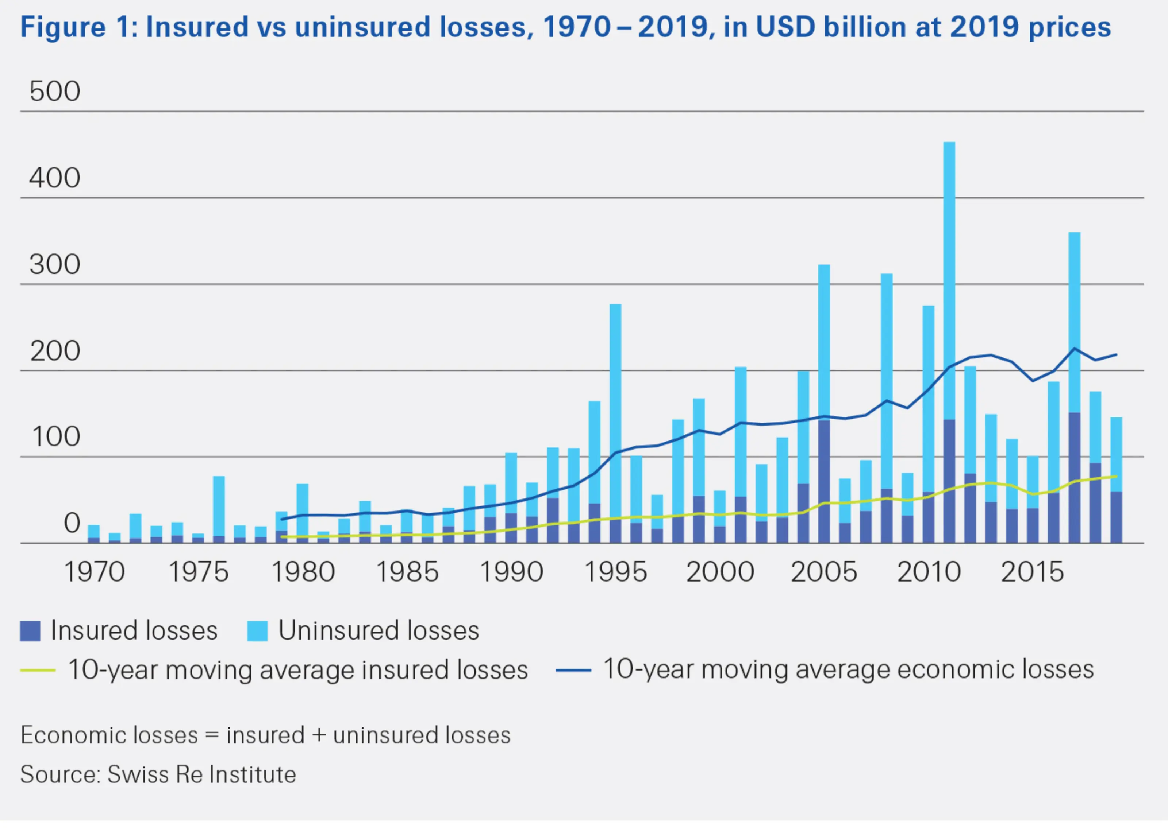
Short Term Impacts, Loss and Damage
Deaths
  Hundreds of thousands of deaths per year from climate change already (multiple sources)
  Loss of life dominant source of economic loss from extreme events attributable to climate change (Newman and Noy 2023)
  Estimates of at least 250,000 deaths/year already from all climate related causes in period from present to 2030 (WHO)
Displacements
  Majority of climate related displacements are internally displaced people - IDPs (IDMC)
  Over 30 million IDPs in 2022 from climate/weather disasters (IDMC and UNHCR) - ~40% increase from 2008
Health impacts (WHO)
  Heat: heat stroke, cardiovascular complications, respiratory impairments
  Storms: injuries, disease from floodwaters, mold, food insecurity, water borne diseases
  Vector-borne diseases: changes in ranges and suitability of pathogens
Water disruptions (WMO)
  Supply impacts – long term changes and variability/reliability
  Quality impacts – turbidity, increased temperature
  Saline intrusion – of particular concern to SIDS
Risks to food systems (AGMIP)
  Adverse impacts on yields – particularly in dryland regions
  Changes in nutrient composition
  Pest invasions
  Some agricultural benefits in high latitude regions

Slide 11
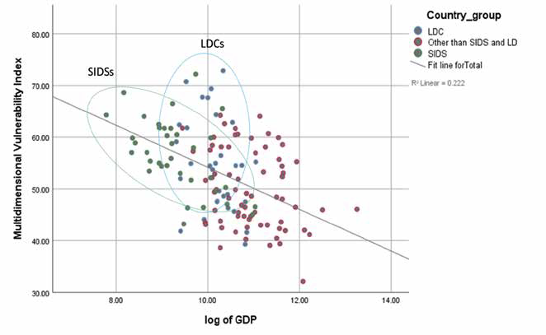
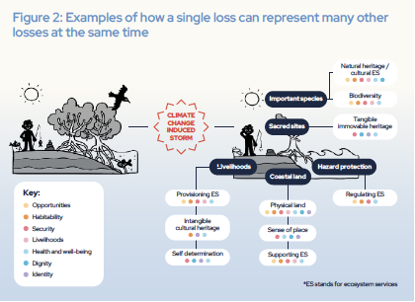
Long Term Impacts, Loss and Damage
Vulnerability and adaptability
  Risk of being trapped in disaster response cycle
  Climate impacts historically have larger proportional economic impacts on LDCs (sometimes more than 10% of GDP over time and individual events can be much higher)
Economic growth
  Economic cost of climate change has been at least hundreds of billions USD/year with the total cost in the 21st century well in the trillions (World Economic Forum)
  Unabated climate change may cost the world on the order of 7% of GDP by 2100 (Kahn et al. 2019) and may exceed 10% of GDP for warming beyond 3C (IIASA)
  Long-term downward pressure on economic growth on most impacted societies
Ability repay loans (Bharadwaj, R. et al. 2023)
  Many LDCs and SIDS have very high debt/GDP ratios
  Loan repayment schemes (especially with high interest rates) will lead to increased financial vulnerability, inability to pay and default risk
Culture and Lifestyle (UNFCCC Report on Non-Economic Losses 2024)
  Changes of landscapes, relationship between human population and flora/fauna, connection to ancestral practices, food and water security
Ecosystems Services and Biodiversity
  Habitability
  Health
  Food and water security
correlation of vulnerability with GDP
Bharadwaj, R. et al. 2023
Linkage between one loss and many others
UNFCCC Report on Non-Economic Losses 2024

Slide 12
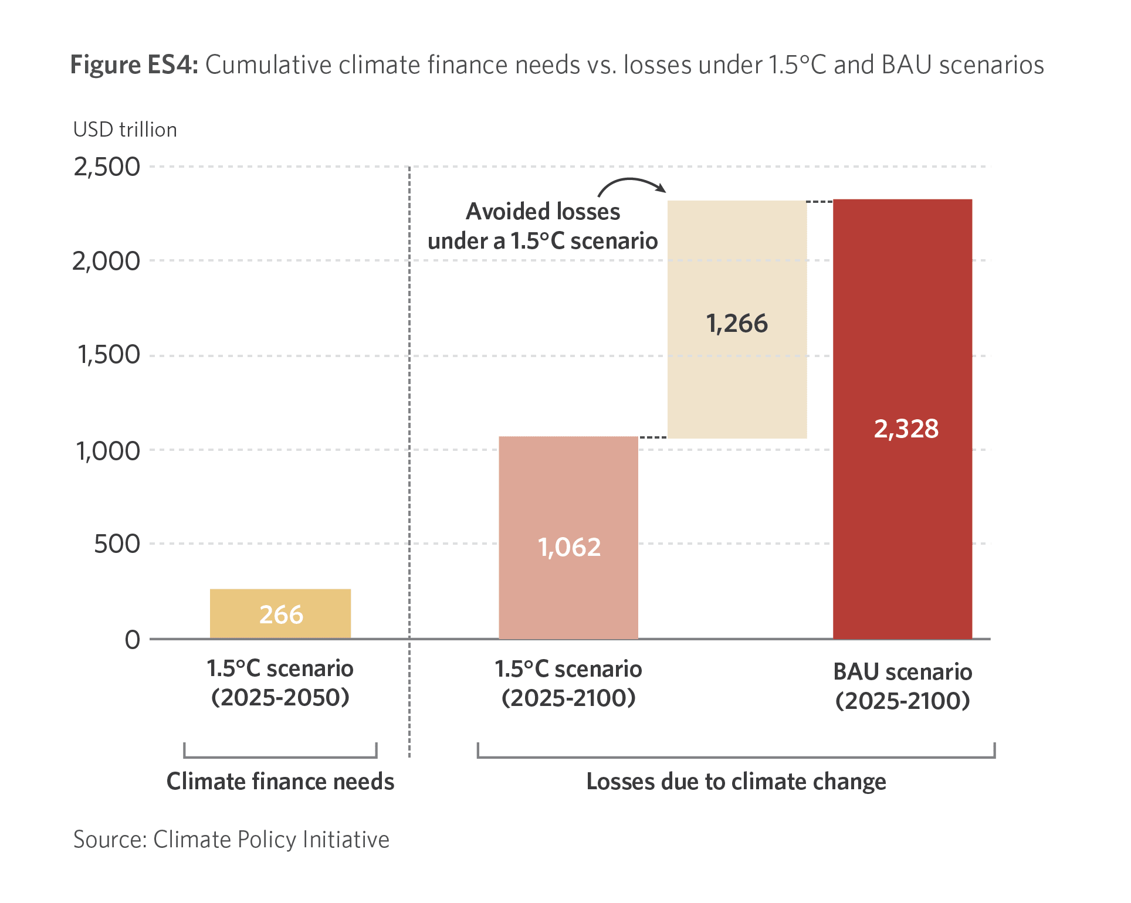
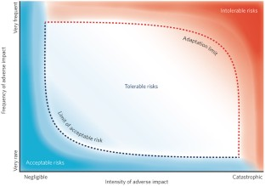
Cost of Inaction or Delayed Action
Expected migration – and resource/housing burdens to countries
  Many inhabitants of SIDS countries will have to leave country or move to higher elevations to survive
Expected health burdens
  Heat related impacts
  Water borne and storm related diseases
  Shifts in vector borne disease ranges
Expected resource limitations
  Increasing resource pressure on SIDS as sea level rise advances
  Increasing resource pressure on many regions around the world, but particularly LDCs
Expected geopolitical disruptions
  Climate change a threat multiplier – against a backdrop of other economic and geopolitical challenges
  Convergence of climate risks and violent regimes in many regions (multiple regions in Africa, Central Asia, Latin America)
Possibility of certain adaptations may slip away
  Socio-economic communities and modalities may be disrupted
  Loss of mangroves, coral reefs, protective wetlands and forests
Climate system changes beyond human ability to adapt
  Irreversible changes to landscape with sea level rise
  Extreme wildfire and flood risk
  Increasing frequency of days at very high wet bulb temperature – physiological limit
Figure on framework for limits to adaptability, Dow, K. et al. 2013

Slide 13

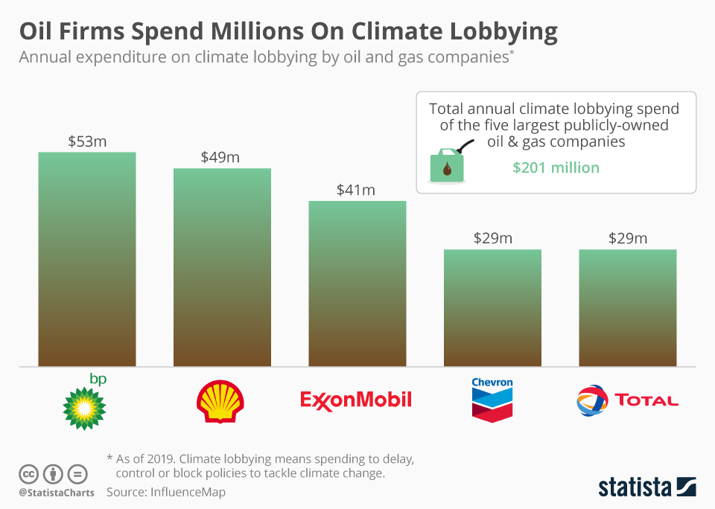
Barriers to Action
Conference of Parties (COP) to UNFCCC
  Most COPs dominated by national rather than global interests
  Agreement at COP29 for 300 billion USD/year by 2030 mostly in the form of loans to Fund for Responding to Loss and Damage Fund (FRLD)
  Over 1 trillion/year needed (and needed mostly as grants)
Global Geopolitics
  Election of Trump and implications for backsliding for global ambition
  Ongoing wars creating geopolitical unrest and volatility in energy markets
  Limited legal/financial accountability for major polluters despite historic responsibility and potential to still make profit (Schleussner et al. 2023)
  Limited legal recourse for SIDS/LDCs through existing frameworks
Observed Emissions and Climate Ambition
  Significant growth of renewable energy
  Some reduction in emissions from affluent countries
  Continued increases in fossil fuel emissions in middle income countries and LDCs leading to increased global emissions
Putting Intention into Practice
  Mobilizing and sustaining funds
  Data availability and analysis for targeted responses
  Coordination of climate responses across geography, scale and sector
  Political pressures and timelines, versus need for sustained funding/engagement
  Feelings of disempowerment at the personal level

Slide 14
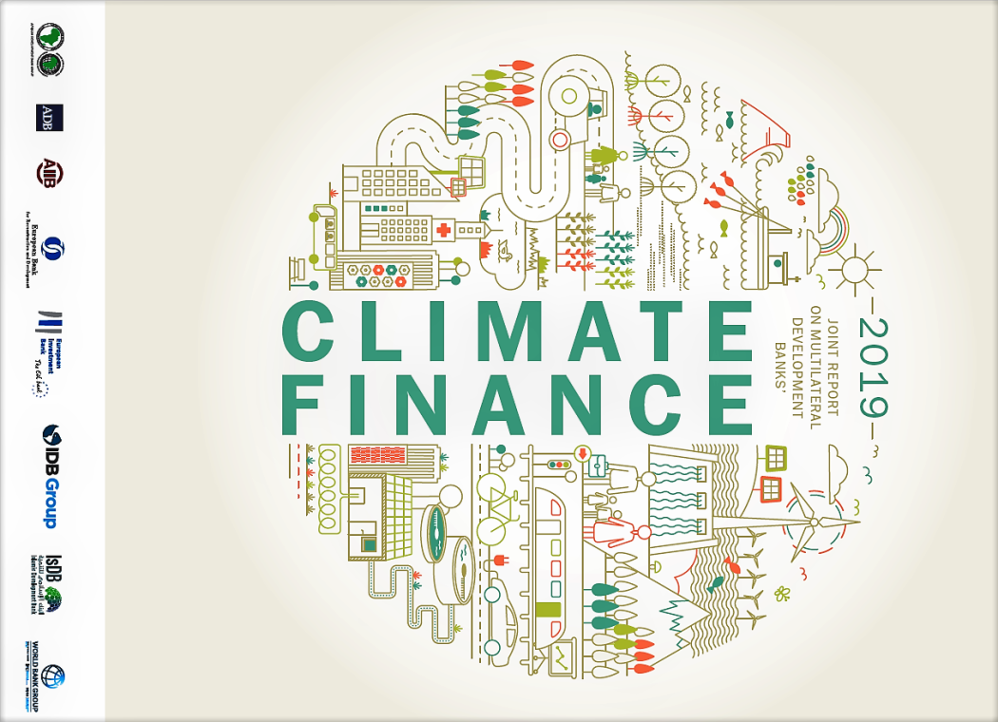
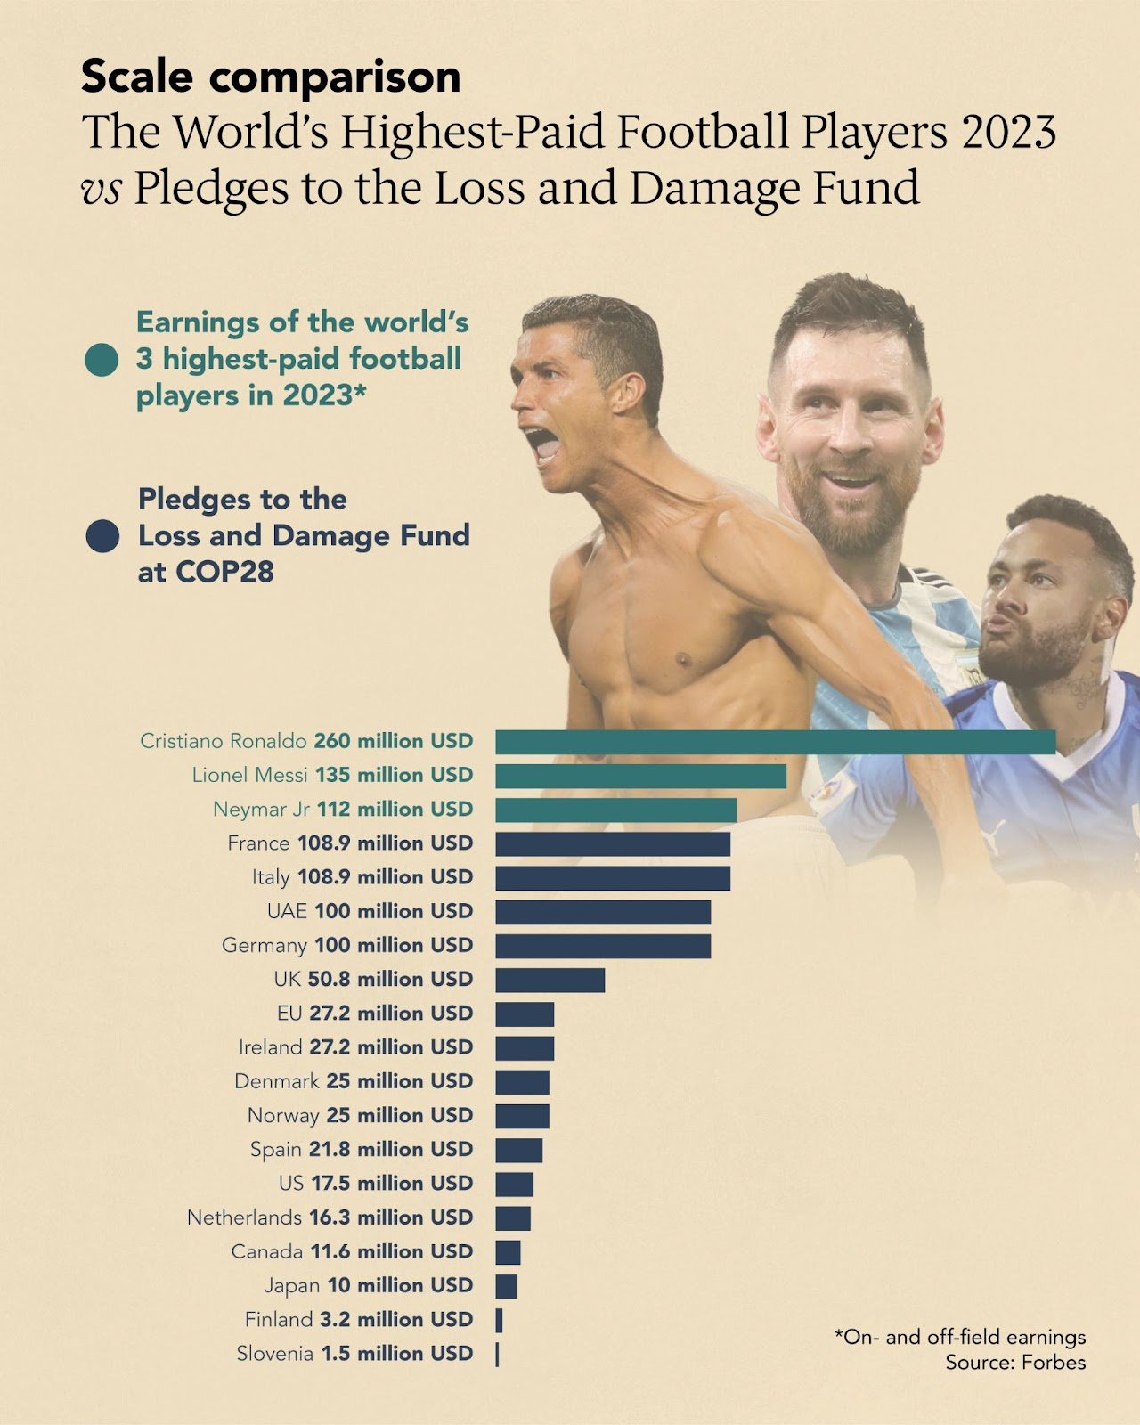
What can we do?
Global Climate Finance
  Fund for Responding to Loss and Damage (FRLD) – 700 million USD
  Green Climate Fund (GCF) – 16 billion USD
  Adaptation Fund – 1.2 billion USD
  Push for more grant financing (even outside of COP) – highlighting long-term savings
  Argue to funders that heavily loan-based system is not sustainable and will likely be more costly
  Expand climate (index) insurance: eg. Global Index Insurance Facility (GIIF), Caribbean Climate Risk Insurance Facility (CCRIF)
  Microfinance: eg. Climate Investment Funds (CIF)
Policy
  Develop, fund and support robust National Adaptation Plans
  Revise NDCs towards greater ambition, and integration with L&D
  Encourage inter-sectoral cooperation and coordination within vulnerable countries
  Pressure major polluting governments from the grassroots community level
  Engage with climate-friendly sub-national governments in large polluting countries
  Legal Action and Frameworks
Public-private partnerships across a wide range of sectors
Targeted Responses
  Targeted habitat restoration projects – some have proven very successful
  Engage with corporate ESG: both adaptation/disaster finance and mitigation/decarbonization
  Forecast-based Financing for Humanitarian Agencies in Disaster Relief

Slide 15
Ongoing Loss and Damage Work

Slide 16
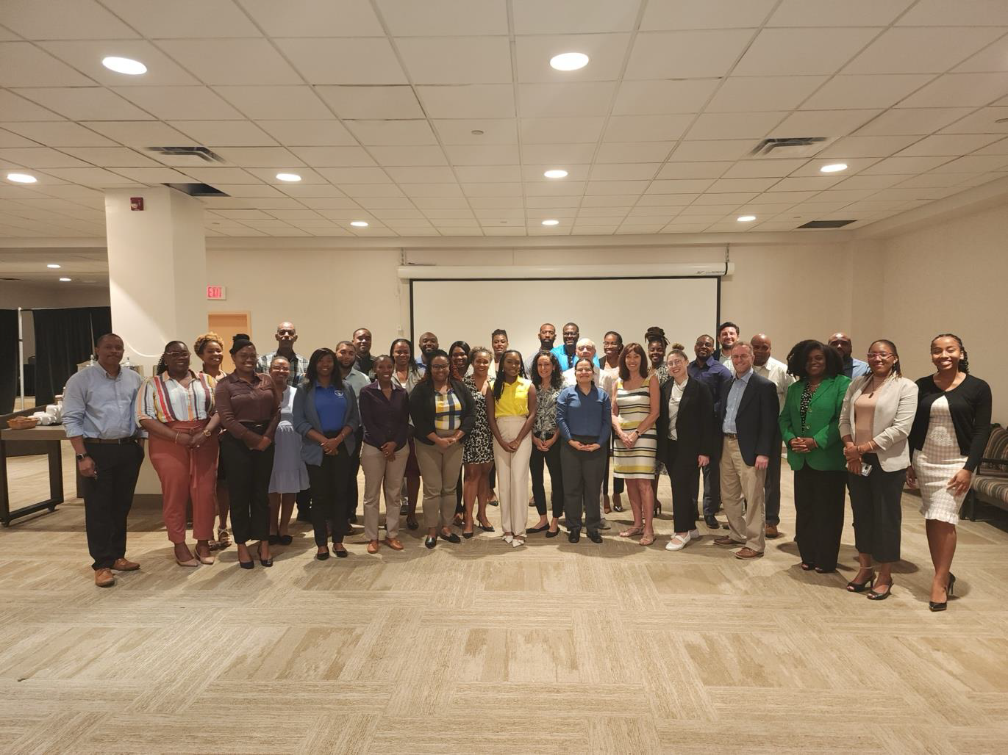
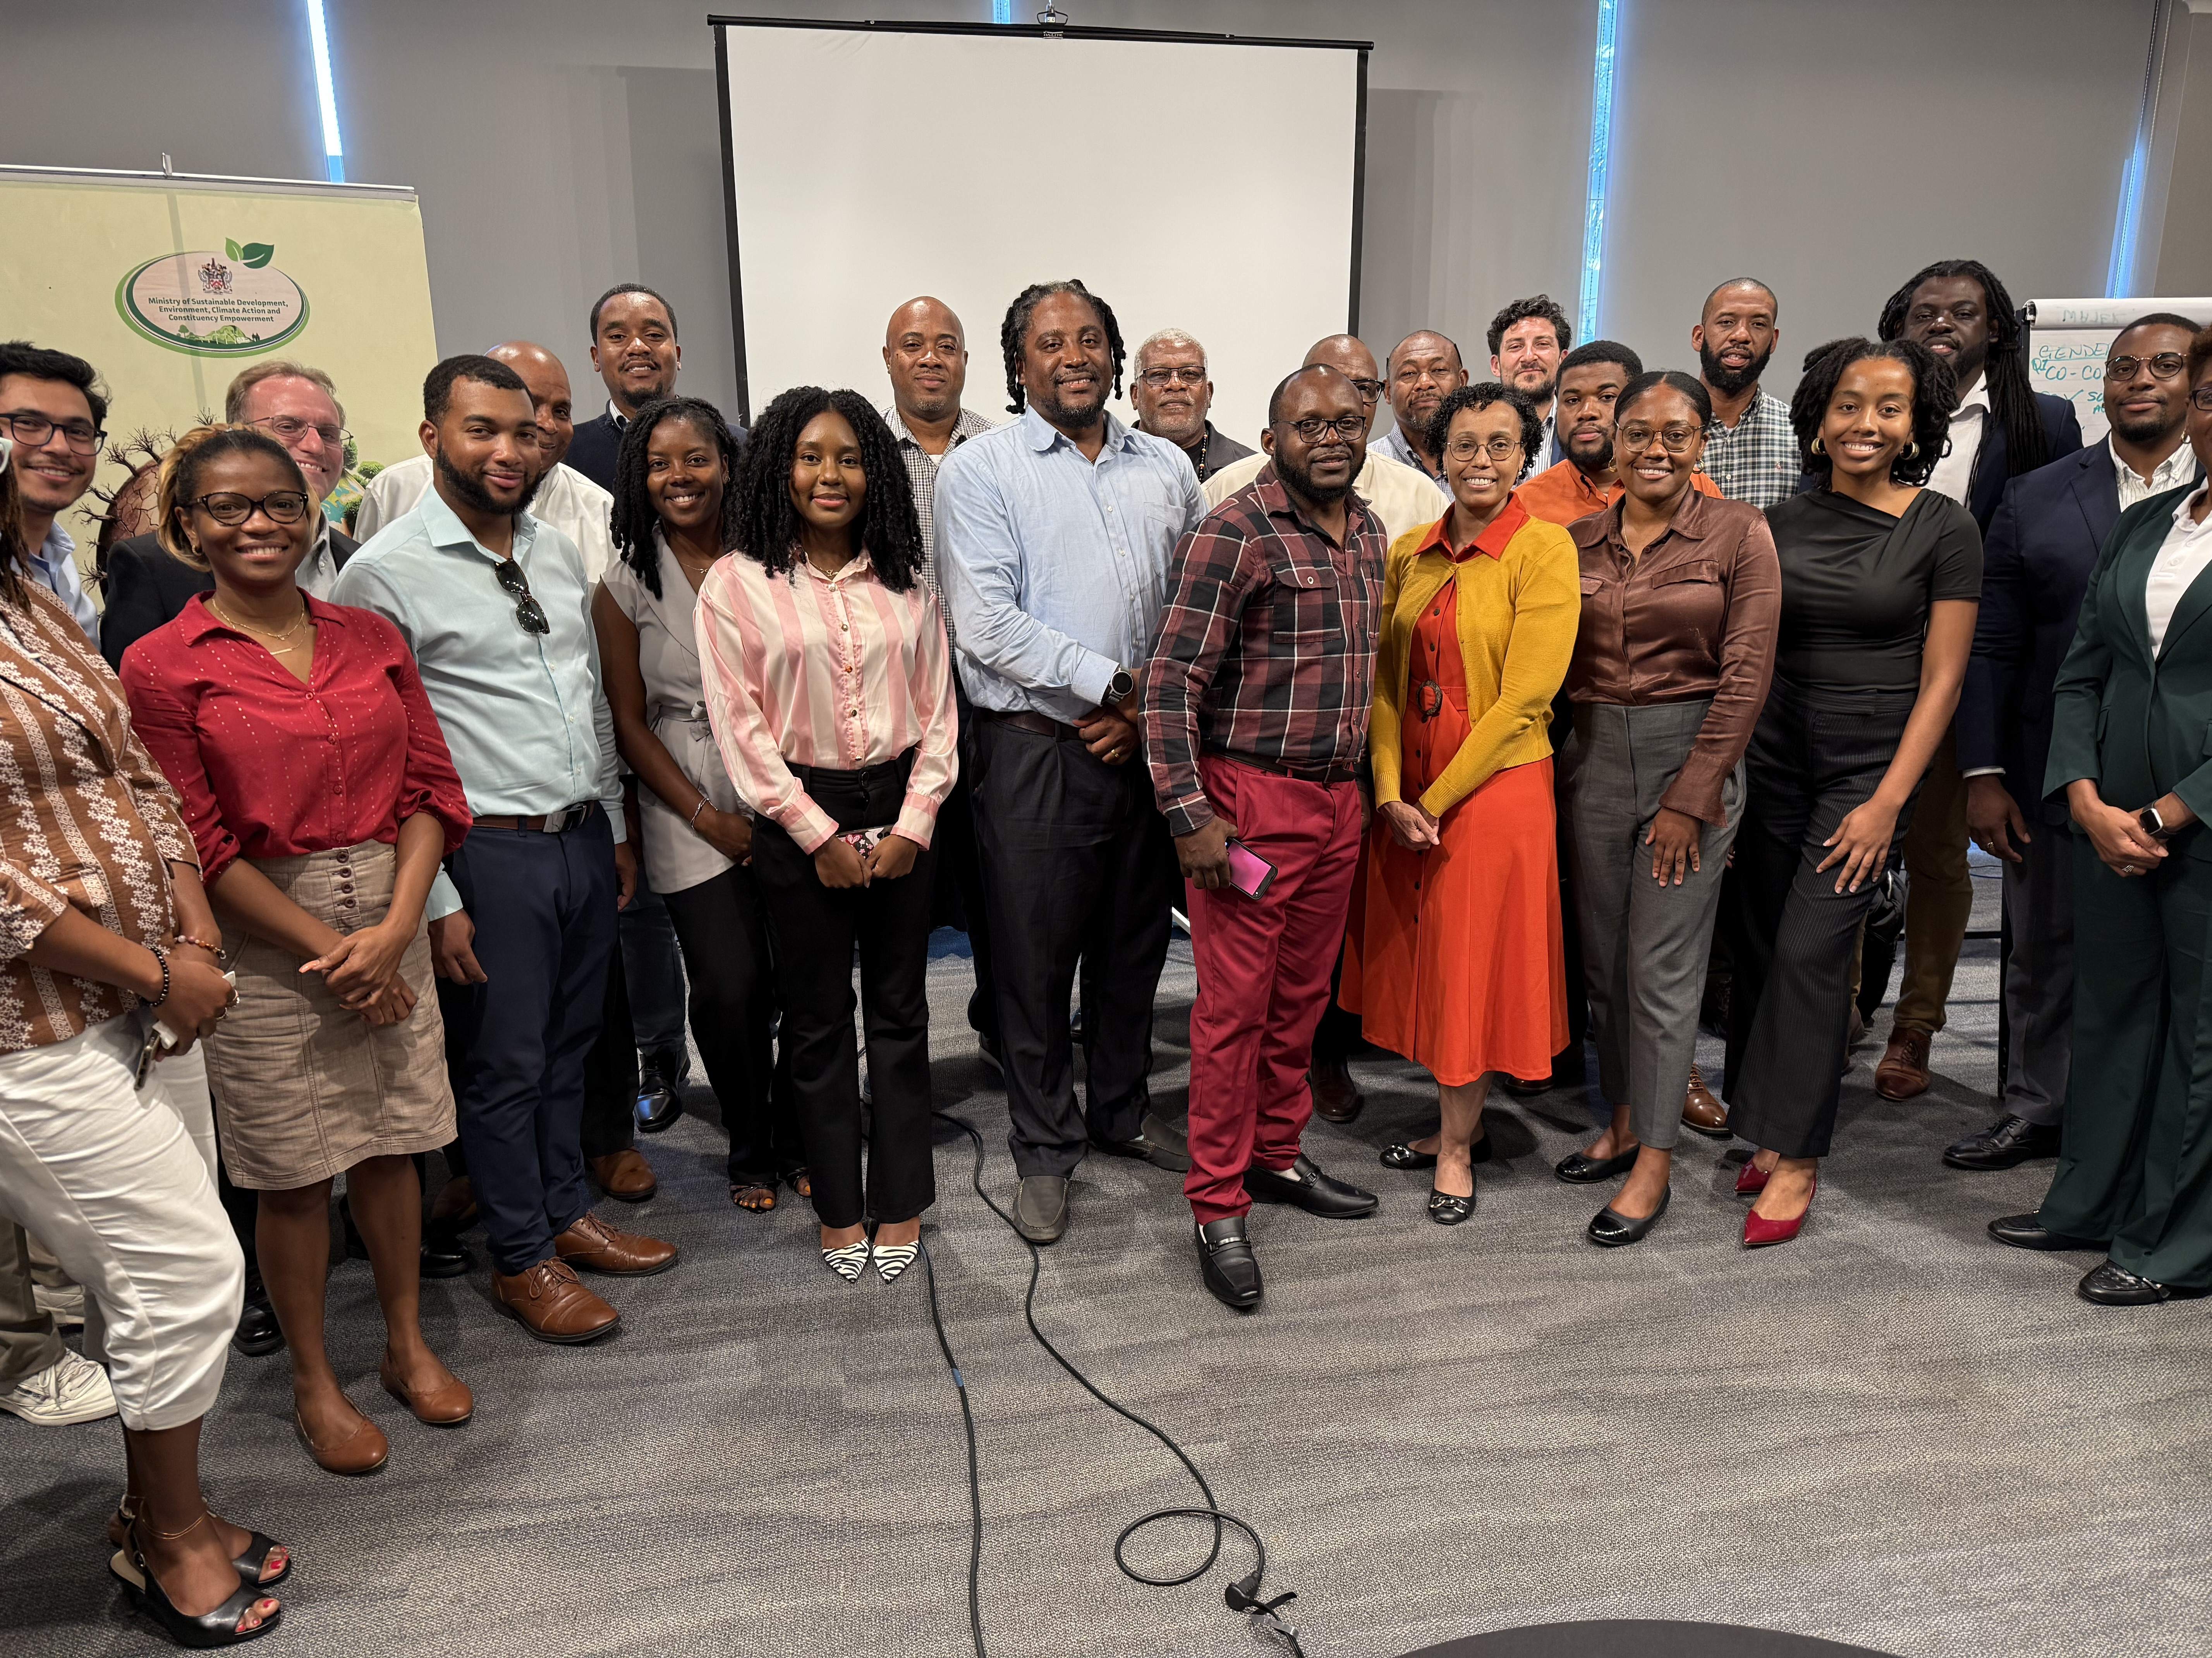
Saint Kitts and Nevis Nationally Determined Contribution Partnership Action Fund NDC PAF project
Four Components
  National Loss and Damage Strategy (2-year timeline)
  National Integrated Water Policy and Plan (1-year timeline)
  Updated National Climate Change Policy (1-year timeline)
  NDC Investment Plan (1-year timeline)
Ongoing Work and Next Steps
  Engage multiple domestic sector stakeholders across government and private sector in defining scope of future potential work
  Work with international partners on funding and disaster relief: CCCCC, OECS, CARICOM, CDEMA, NDCFI
  Work with climate science/meteorological community (CIMH, other Caribbean, US, Europe)
  Work with finance community – towards financial sustainability for L&D
  Work with local community to document non-monetary cultural, ecological and biodiversity related losses and damages
Stakeholder Workshop, Basseterre, Saint Kitts, March 2025
Stakeholder Workshop, Basseterre, Saint Kitts, October 2025

Slide 17
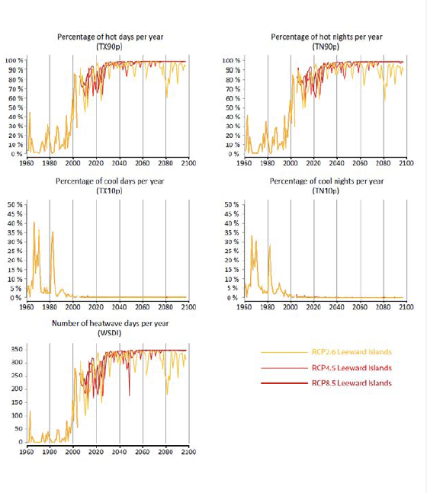
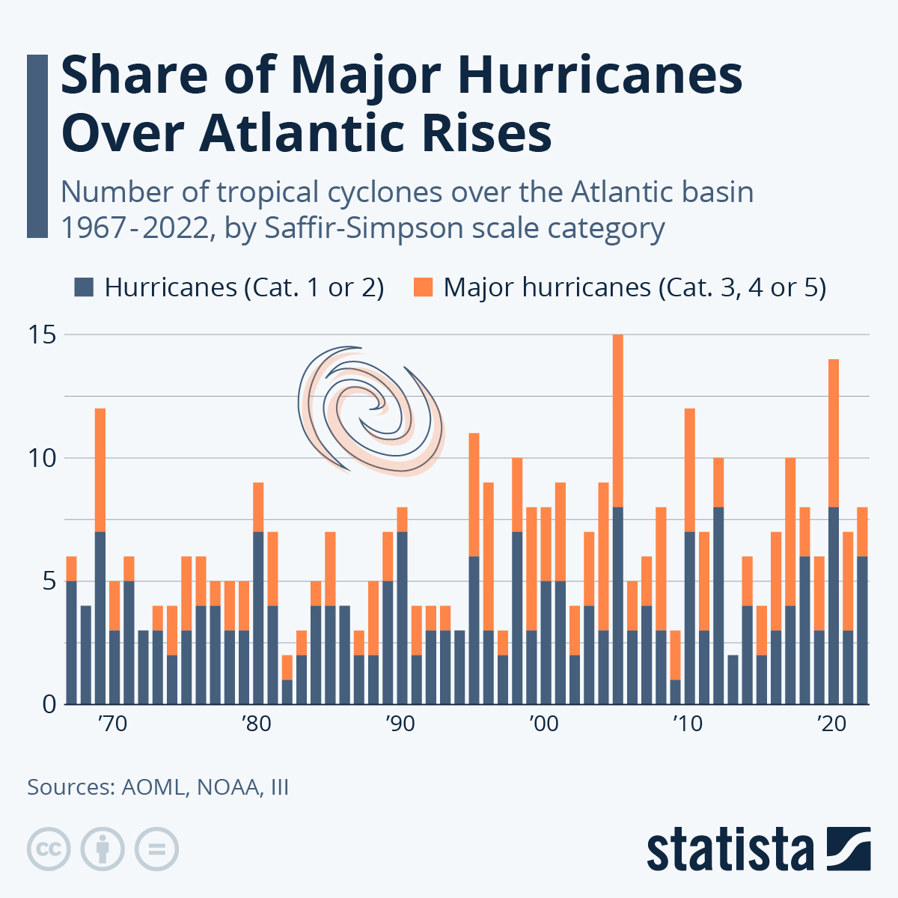
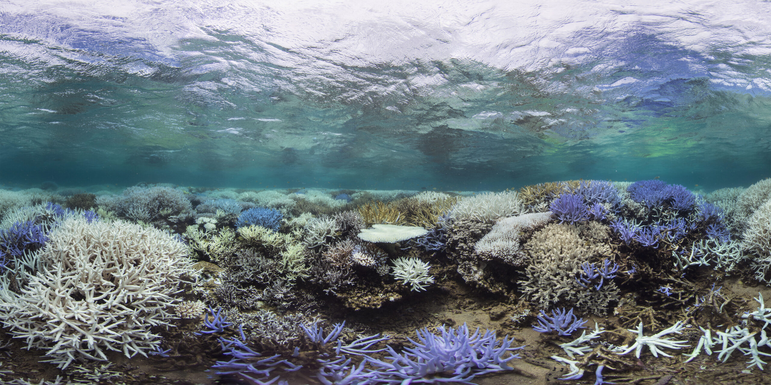
Climate Projections and Concerns for the Caribbean
Science and Impacts
  Heat: Projected increase in heat waves (atmospheric and marine) – impacts on health, fisheries, coral bleaching
  Hydrometeorological
    Projected increase in category 4 and 5 hurricanes (NOAA) – deaths, injuries and illnesses
    Projected increase in drought (particularly before hurricane season) (Song et al. 2018) – food insecurity, increased energy demand, water system issues
  Marine impacts: Sea Level Rise, Storm Surge, Saline Intrusion
  Potential Analysis and service
    Regional Downscaling of model data (UWI)
    Tailor projections for sectors (co-production with stakeholders)
    Engage with CCRIF, development and aid agencies to develop adaptive financial response
    Climate Attribution – connecting specific events to Loss and Damage Finance Coumou et al. 2024
Socioeconomic Impacts
  High cost of adaptation and disaster response (at least 4-5% of GDP for adaptation - UN) despite limited historical responsibility and power
  Dependence on tourism
  Energy and food supply chain issues with dependence on imports (UN)
  High debt/GDP ratios and limited ability to repay loans (Bharadwaj, R. et al. 2023)
  Culture and Lifestyle (UNFCCC Report on Non-Economic Losses 2024)
  Ecosystems Services and Biodiversity: Habitability, Health, Food and water security
OECS report 2021: Projected share of hot and cool days and nights with different climate models, Leeward Islands
Atlantic Ocean and Meteorological Lab, NOAA: historical trends in hurricanes in Atlantic basin

Slide 18
Building our Loss and Damage Response (BOLD)
Broad understanding of loss
  Including non-monetary components (ecosystems, environment, cultural/heritage)
  Including traditional economic and health losses (deaths, property damage, agricultural losses)
Fiji, Samoa, Vanuatu, Tuvalu, Republic of Marshall Islands
Linking Science and Community Voices
Strengthening National and Regional Capacities
Regional Partner - Secretariat of the Pacific Regional Environment Programme (SPREP)

Slide 19
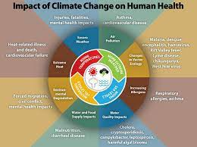
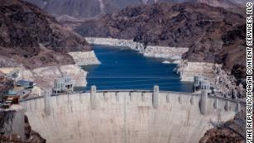
Sectors for applied L&D climate modeling work
Public Health
Food Security/Agriculture
Water Management
Energy Utilities
Infrastructure and Public Works
Disaster Management & Humanitarian Response
Biodiversity and Environment
Cultural, Gender and Social Impacts
Private Sector
Governance
Education
Financial Services (including insurance)
Justice and Legal
Need for Early Warning Systems and Incentives for Proactive Adaptation

Slide 20
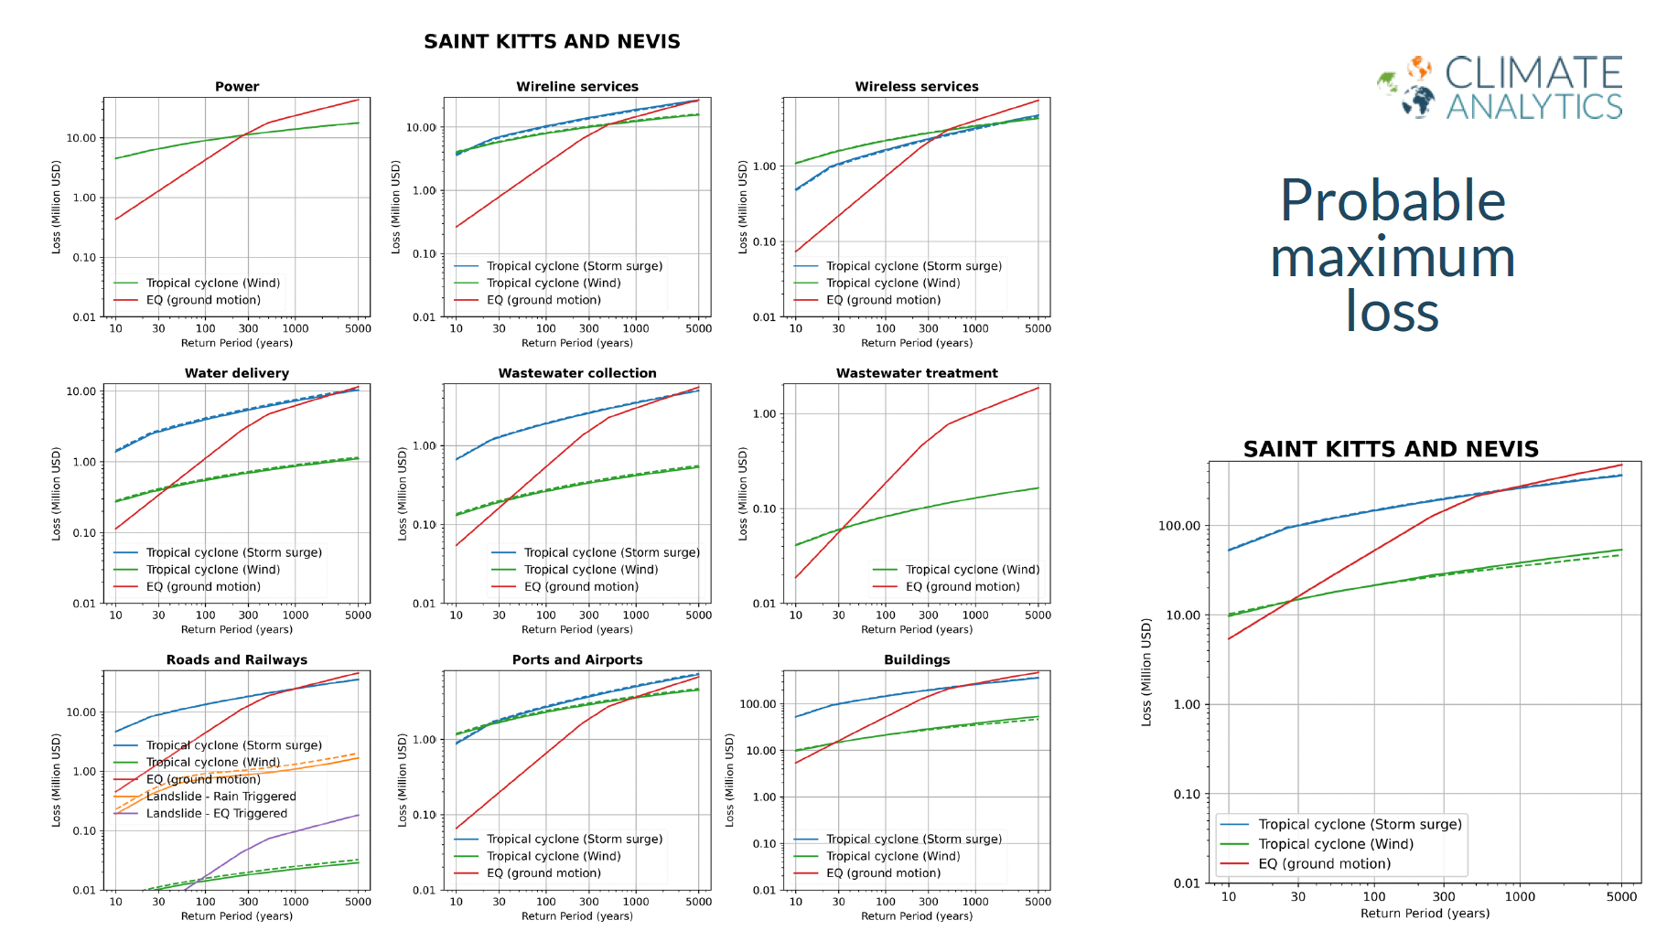
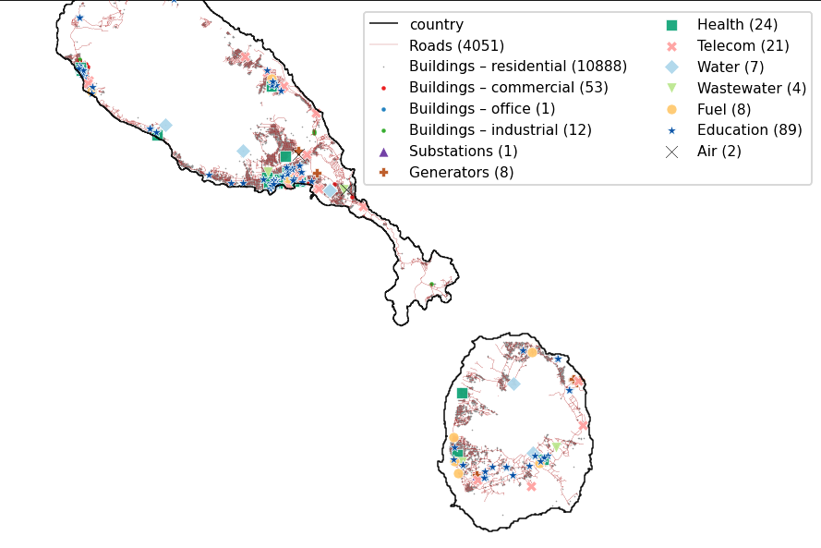

Observational Data/Model Sources and Needs
Data and Model Examples
  International Disaster Database: EMDAT
  LitPop Exposure – population and assets exposed
  Coalition for Disaster Resilient Infrastructure Global Infrastructure Risk Model and Resilience Index (CDRI GIRI)
  International Best Track Archive for Climate Stewardship (IBTrACS)
  Climate Adaptation and Econ Integrated Assessment Model (CLIMADA)
  Integrated Model to Assess the Global Environment (IMAGE)
Needs and challenges
  Climate model and earth observation data
  Socioeconomic data
  Vulnerability and exposure data
  Impacts are local but climate model data is coarser
  Connection between hazard impact and sector specific costs
  Connections between sector costs (interdependency of impacts)
  Appropriate treatment of uncertainty
  Integrated assessment models
Detailed population Exposure (using LitPop and Census)
Detailed infrastructure exposure (using OSM-flex with specific vulnerabilities).

Slide 21
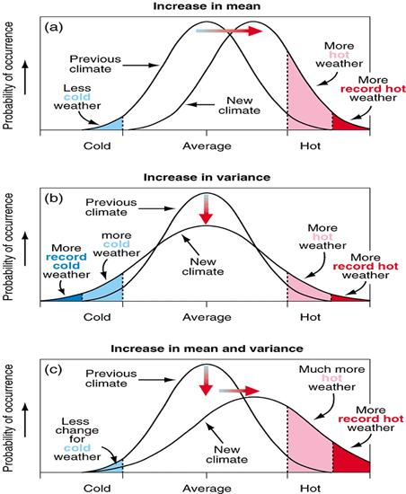
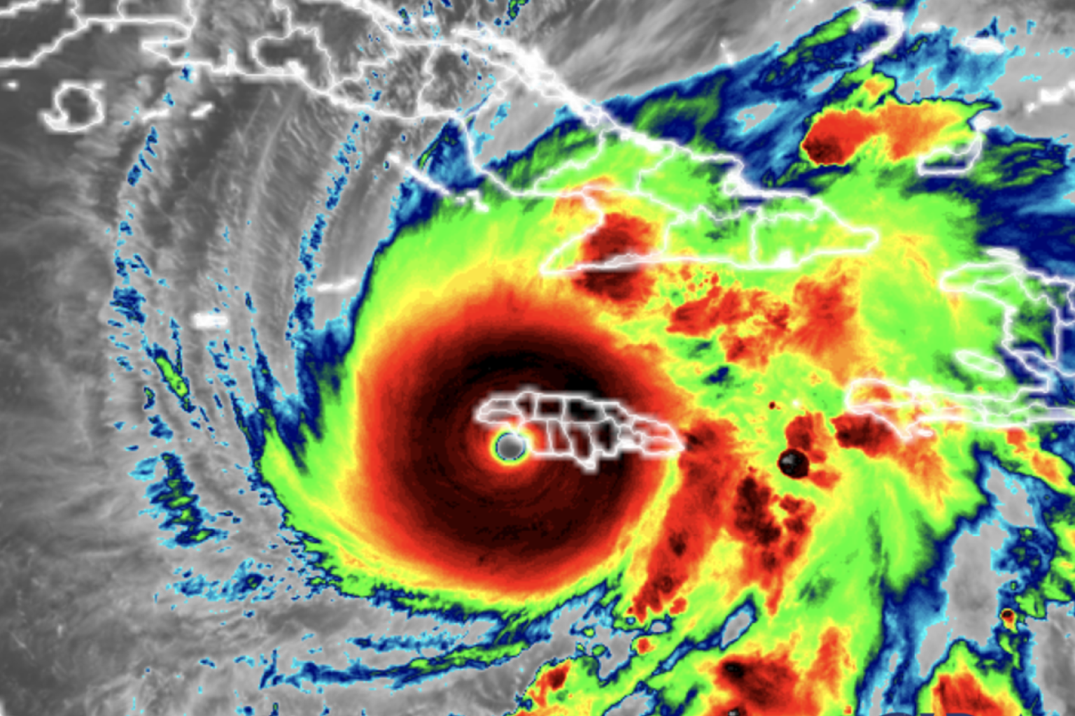
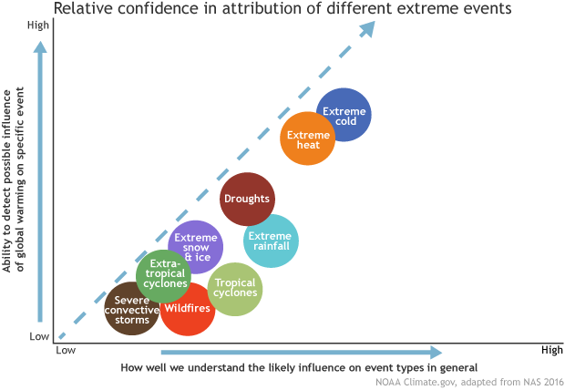
Attribution Science -> Legal Accountability
https://climateattribution.org/
https://www.worldweatherattribution.org/
Coumou et al. 2024 – methodological framework for connecting attribution to Loss and Damage finance using Bayesian framework
Quilcaille et al. 2025 – attribution of heat waves to carbon majors
Climate Central Melissa attribution
Grantham Attribution Study of Melissa
CCRIF payout to Jamaica for Melissa
CNBC coverage of 150M cat bond for Jamaica/Melissa
From Climate Central
CPO NOAA
Hurricane Melissa striking Jamaica Oct 28

Slide 22
Additional Questions?
Feedback?

Slide 23
References, materials and partners
Atlantic Oceanographic and Meteorological Laboratory, (AOML) NOAA
Caribbean Community (CARICOM)
Caribbean Institute for Meteorology and Hydrology (CIMH)
Caribbean Regional Climate Center/Climate Outlook Forum (CariCOF)
Climate Risk Dashboard
Climate Vulnerability Monitor
Global Climate Change Alliance
Green Climate Fund Country Programme for St. Kitts and Nevis 2023
IPCC AR6 WGII, Chapter 15: Impacts on Small Island States
National Climate Change Adaptation Strategy for Saint Christopher and Nevs 2018
NOAA Factsheet on Projected Hurricane Changes 2023
OECS St Kitts and Nevis Country Analysis 2021
St Kitts and Nevis Government
UNFCCC Loss and Damage Fund

Slide 24
References
Bharadwaj, R. et al. 2023, Sinking Islands, Rising Debts, IIED Report
Climate Analytics Annual Report 2023
Coumou et al. 2024, How can event attribution science underpin financial decisions on Loss and Damage?
Dow, K. et al. 2013, Limits to Adaptation, Nature Climate Change
Hare, Friedrich-Schleussner, Nauels and Kloenne, 2022, Is 1.5 Still Alive? Science Update, Climate Analytics
Kahn et al. 2019, Long-Term Macroeconomic Effects of Climate Change: A Cross-Country Study, International Monetary Fund Working Paper 2019/215
New, R. and I. Noy, 2023, The Global Costs of Extreme Weather that Are Attributable to Climate Change, Nature Communications
Powis et al. 2023, Observational and model evidence together support wide-spread exposure to noncompensable heat under continued global warming
Quilcaille et al. 2025, Systematic attribution of heatwaves to the emissions of carbon majors
Schie, D., G. Jackson, O. Serdeczny, and K. van der Geest, Economic and Non-Economic Loss and Damage: A Harmful Dichotomy, Global Sustainability
Schleussner et al. 2023 Carbon majors’ trillion-dollar damages, Climate Analytics
Sircar, Thomas, Serdeczny and Jattansingh 2024, A review of loss and damage in the Caribbean (1994 to 2024), Climate Analytics
Song et al. 2018, Future Changes in Seasonality of the North Pacific and North Atlantic Subtropical Highs
UNFCCC Report on Non-Economic Losses 2024
Vanos et al. 2023, A physiological approach for assessing human survivability and liveability to heat in a changing climate
Vousdoukas et al., 2023, Small Island Developing States under threat by rising seas even in a 1.5 °C warming world, Nature Sustainability

Slide 25
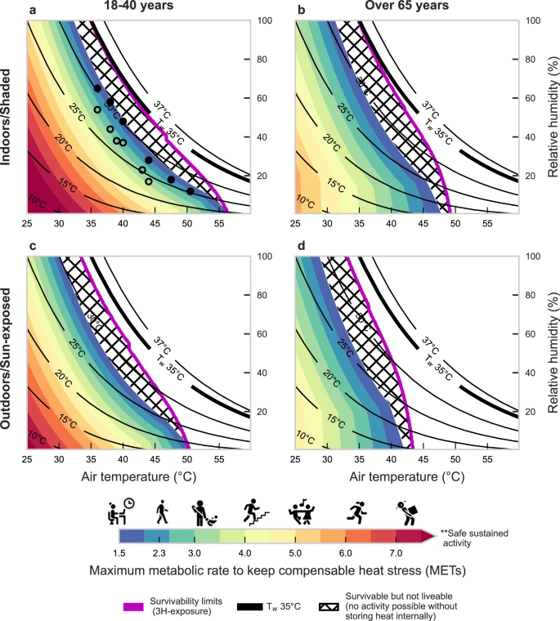
Health and Food Security
Health
  Humid heat risk - Powis et al. 2023 – intersection with other health vulnerabilities (particularly chronic cardiovascular, respiratory issues, esp. among elderly and other vulnerable groups)
  Vector borne disease – dengue outbreaks
  Storm related risks – injuries, deaths, illnesses, disruptions to hospital services
  Develop or refine existing contingency plans (stockpiles of critical medicines, cooling centers, backup power generation for hospitals)
Agriculture
  Adapting planting and cropping decisions to respond to changing climate and yield impacts
  Micro-insurance to hedge against risk of crop failures
  Climate smart practices to limit soil erosion and adapt to drought
Fisheries
  Understand risk to fish stocks from marine heat waves
  Understand risk from sargassum
  aquaculture
Vanos et al. 2023

Slide 26
Utilities, Infrastructure and Transport
Energy
  Identified need for insurance to cover transmission and distribution components of grid
  Additional need for financial support for small scale energy provision (eg. rooftop solar)
Water
  Identified need to increase supply by desalination to address saline intrusion and decreased rainfall
  Identified need to reduce non-revenue water and increase water rates to encourage conservation
  Identified need to make water infrastructure more resilient to climate risks (eg. wind risks for rainwater harvesting tanks)
Transportation
  Need to ensure roads, airports and ports can be resilient to storms and heat stress
  Need to ensure financing for renovation/retrofitting after disasters occur
Public Works
  Need to understand design specifications and expected lifetime of planned structures
  Need for operational financing to cover expected repairs and renovations to public infrastructure
Physical Planning
  Need to address data gaps and coordination/sharing – including socioeconomic vulnerability and exposure
  Need to understand design specifications and expected lifetime of planned structures
Data and Model Examples
  International Disaster Database: EMDAT
  LitPop Exposure – population and assets exposed
  Coalition for Disaster Resilient Infrastructure Global Infrastructure Risk Model and Resilience Index (CDRI GIRI)
  International Best Track Archive for Climate Stewardship (IBTrACS)
  Climate Adaptation and Econ Integrated Assessment Model (CLIMADA)
Detailed population Exposure (using LitPop and Census)
Detailed infrastructure exposure (using OSM-flex with specific vulnerabilities).

Slide 27
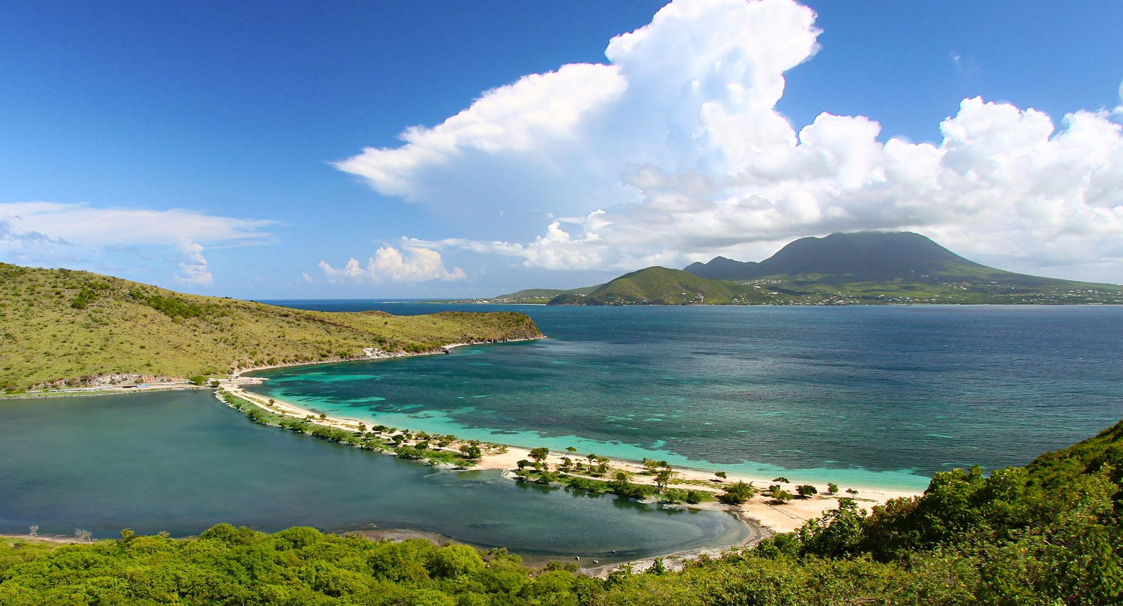
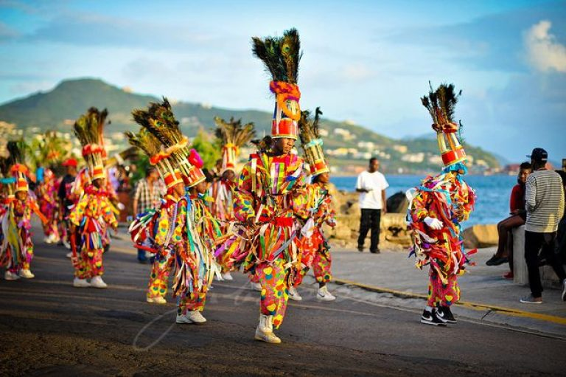
Physical Environment and Social/Cultural Impacts
Physical Environment and Biodiversity
  Risks to forested lands – slow onset climatic changes and extreme events
  Risks to coral reefs and mangroves – storm surge and marine heat waves
  Pest invasions – can impact natural ecosystems, agriculture and marine environments
Social and Cultural Impacts and Responses
  Differentiated vulnerability across society (function of income/wealth, but also geographic and social connectedness)
  Potential risk to cultural practices that depend on ecosystems
  Need to include community organizations in co-development of loss and damage strategy
  Need to make sure that Nevis is adequately represented in national plans

Slide 28
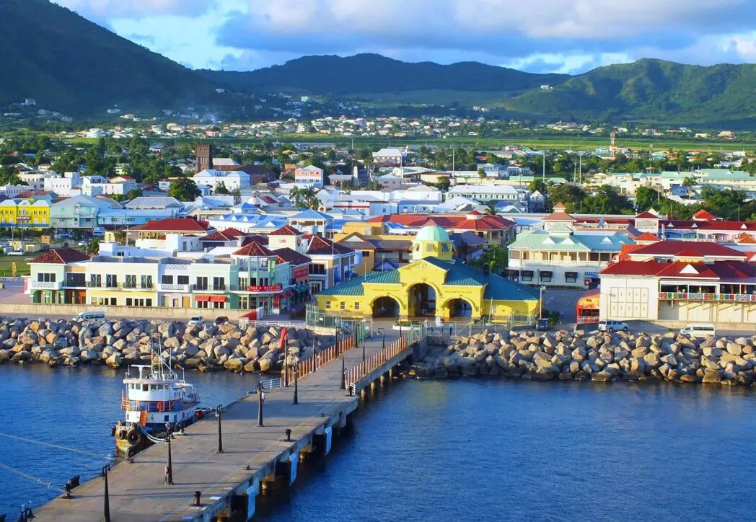
Private Sector and Trade
Industry and Commerce
  Physical risks to manufacturing, construction and shipping industries
  Disruption risks to service industries
Regional Trade
  Extreme events and supply chain disruptions
  Vulnerability to price volatility from imports
  Other trade implications
Economic Affairs and Impacts
  Differentiated vulnerability as both a driver of and consequence of climate risk
  Long term impacts of climate risks on economic growth and inequality

Slide 29


Governance, Finance, Education and Regional Engagement
Governance
  Seek to minimize political and/or funding barriers or silos to implementation
  Engage multiple domestic sector stakeholders across government and private sector in defining scope of work (both during and after completion of PAF project)
  Ensure that Nevis is adequately represented and funded
Finance
  Ensure that the ministry of finance works closely with sectors to develop robust financing strategy for implementation
Education and outreach
  Integrate climate risk awareness into school curricula and public service announcements/adult education to promote climate smart adaptations
Community outreach
  Engage community leaders in both co-production of analysis/monitoring and policy design – particularly regarding non-monetary cultural, ecological and biodiversity impacts
Regional Engagement
  Work closely with international partners on funding and disaster relief: CCCCC, OECS, CARICOM, CDEMA, NDCFI
  Work with regional and international climate science/meteorological community (CIMH, other Caribbean, US, Europe)
  Work with larger finance community – towards financial sustainability for L&D

Slide 30
Resistance and the future
How do we fight back to advance science and the public interest?
Build data redundancies – SEDAC, IRIDL? various NOAA and NASA
Appeal to State and Local Funding and initiatives (C40, ICLEI, ClimateSmartNY, UCCRN etc.)
Seek Public-Private Partnerships (World Bank overview, UK CP3, etc.)
Strengthen Climate Science/User Community Connection/Collaboration and co-production of knowledge and services
Strengthen International Collaboration (WCRP, WMO, WHO, World Bank, UNEP, UNDP, NRDC, GCF, FRLD, Adaptation Fund, etc.)
Social media, protests, lobbying, lawsuits
Your thoughts on resistance?
Areas for collaboration?
Requests from Climate Modelling community regarding Loss and Damage?

Slide 31
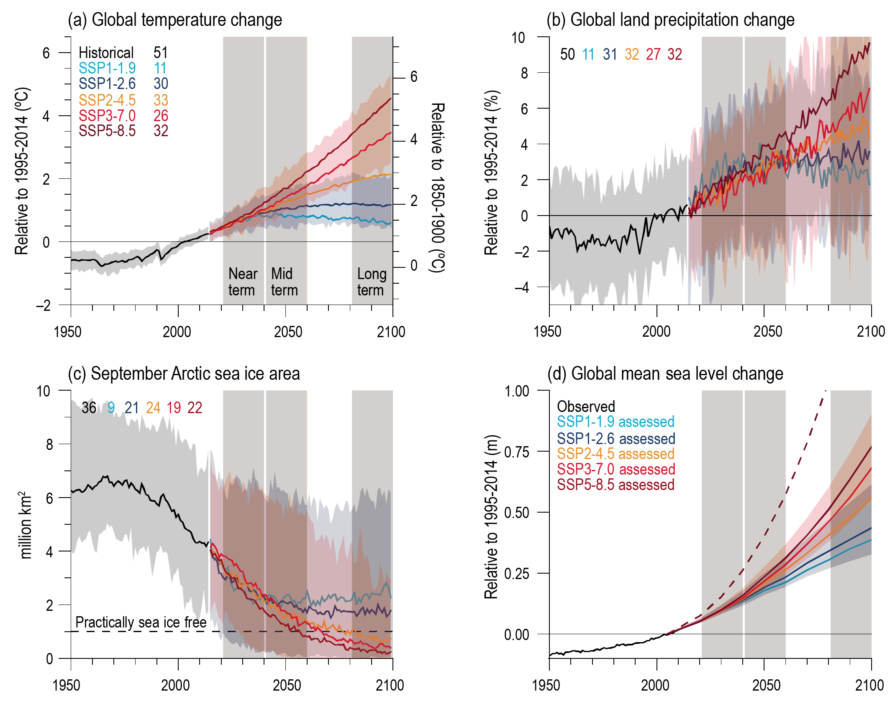
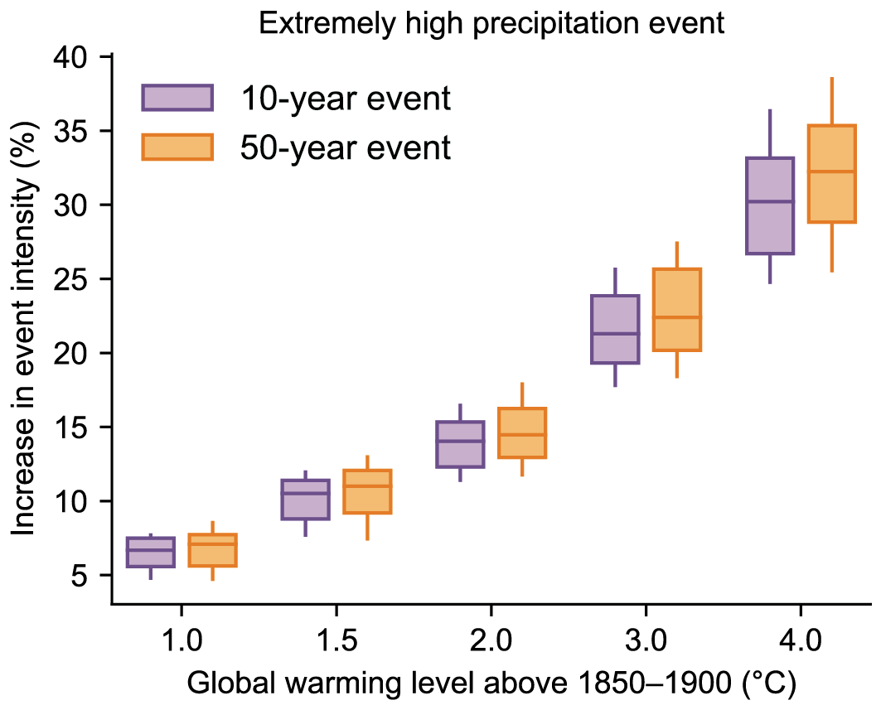
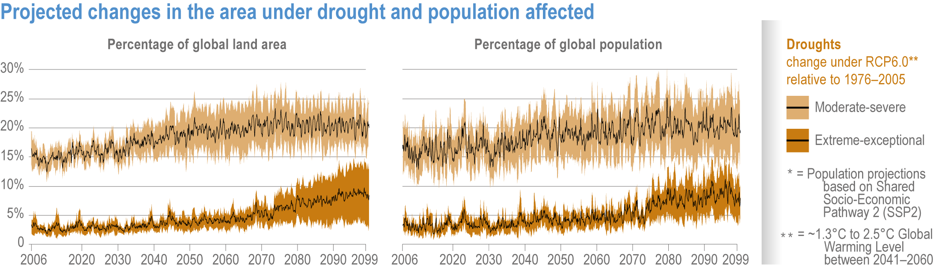
Observed and Projected Changes in the Climate System
Increase in global average temperature 1.5-5 C by 2100
Increase in global sea level 0.3-0.8 m or more by 2100
Ice-free summers in Arctic Ocean by late 21st century
Significant increases in heat extremes: particularly at high latitudes in continental interiors
Increases in area experiencing 35C wet-bulb temperatures
Hydrologic cycle intensifies – severe storms and drought
Increased share of powerful tropical cyclones – likely at least 10% increase in Cat 3+ by mid-late century
Increase in risk for wildfires – burn area may increase by multiple 100s of % in some ecologies
Other effects: ecosystems, ocean acidification (~0.06 pH change in last 35 years), ocean circulation, changes in carbon sequestration potential
IPCC AR6 WGI Figure 4.2: Temperature, Precipitation, Arctic Sea Ice and Sea Level Rise Projections
IPCC AR6 WGI Figure 11.15: Projected changes in extreme rainfall
IPCC AR6 WGI Figure 4.19: Projected changes in area and population under drought

Slide 32
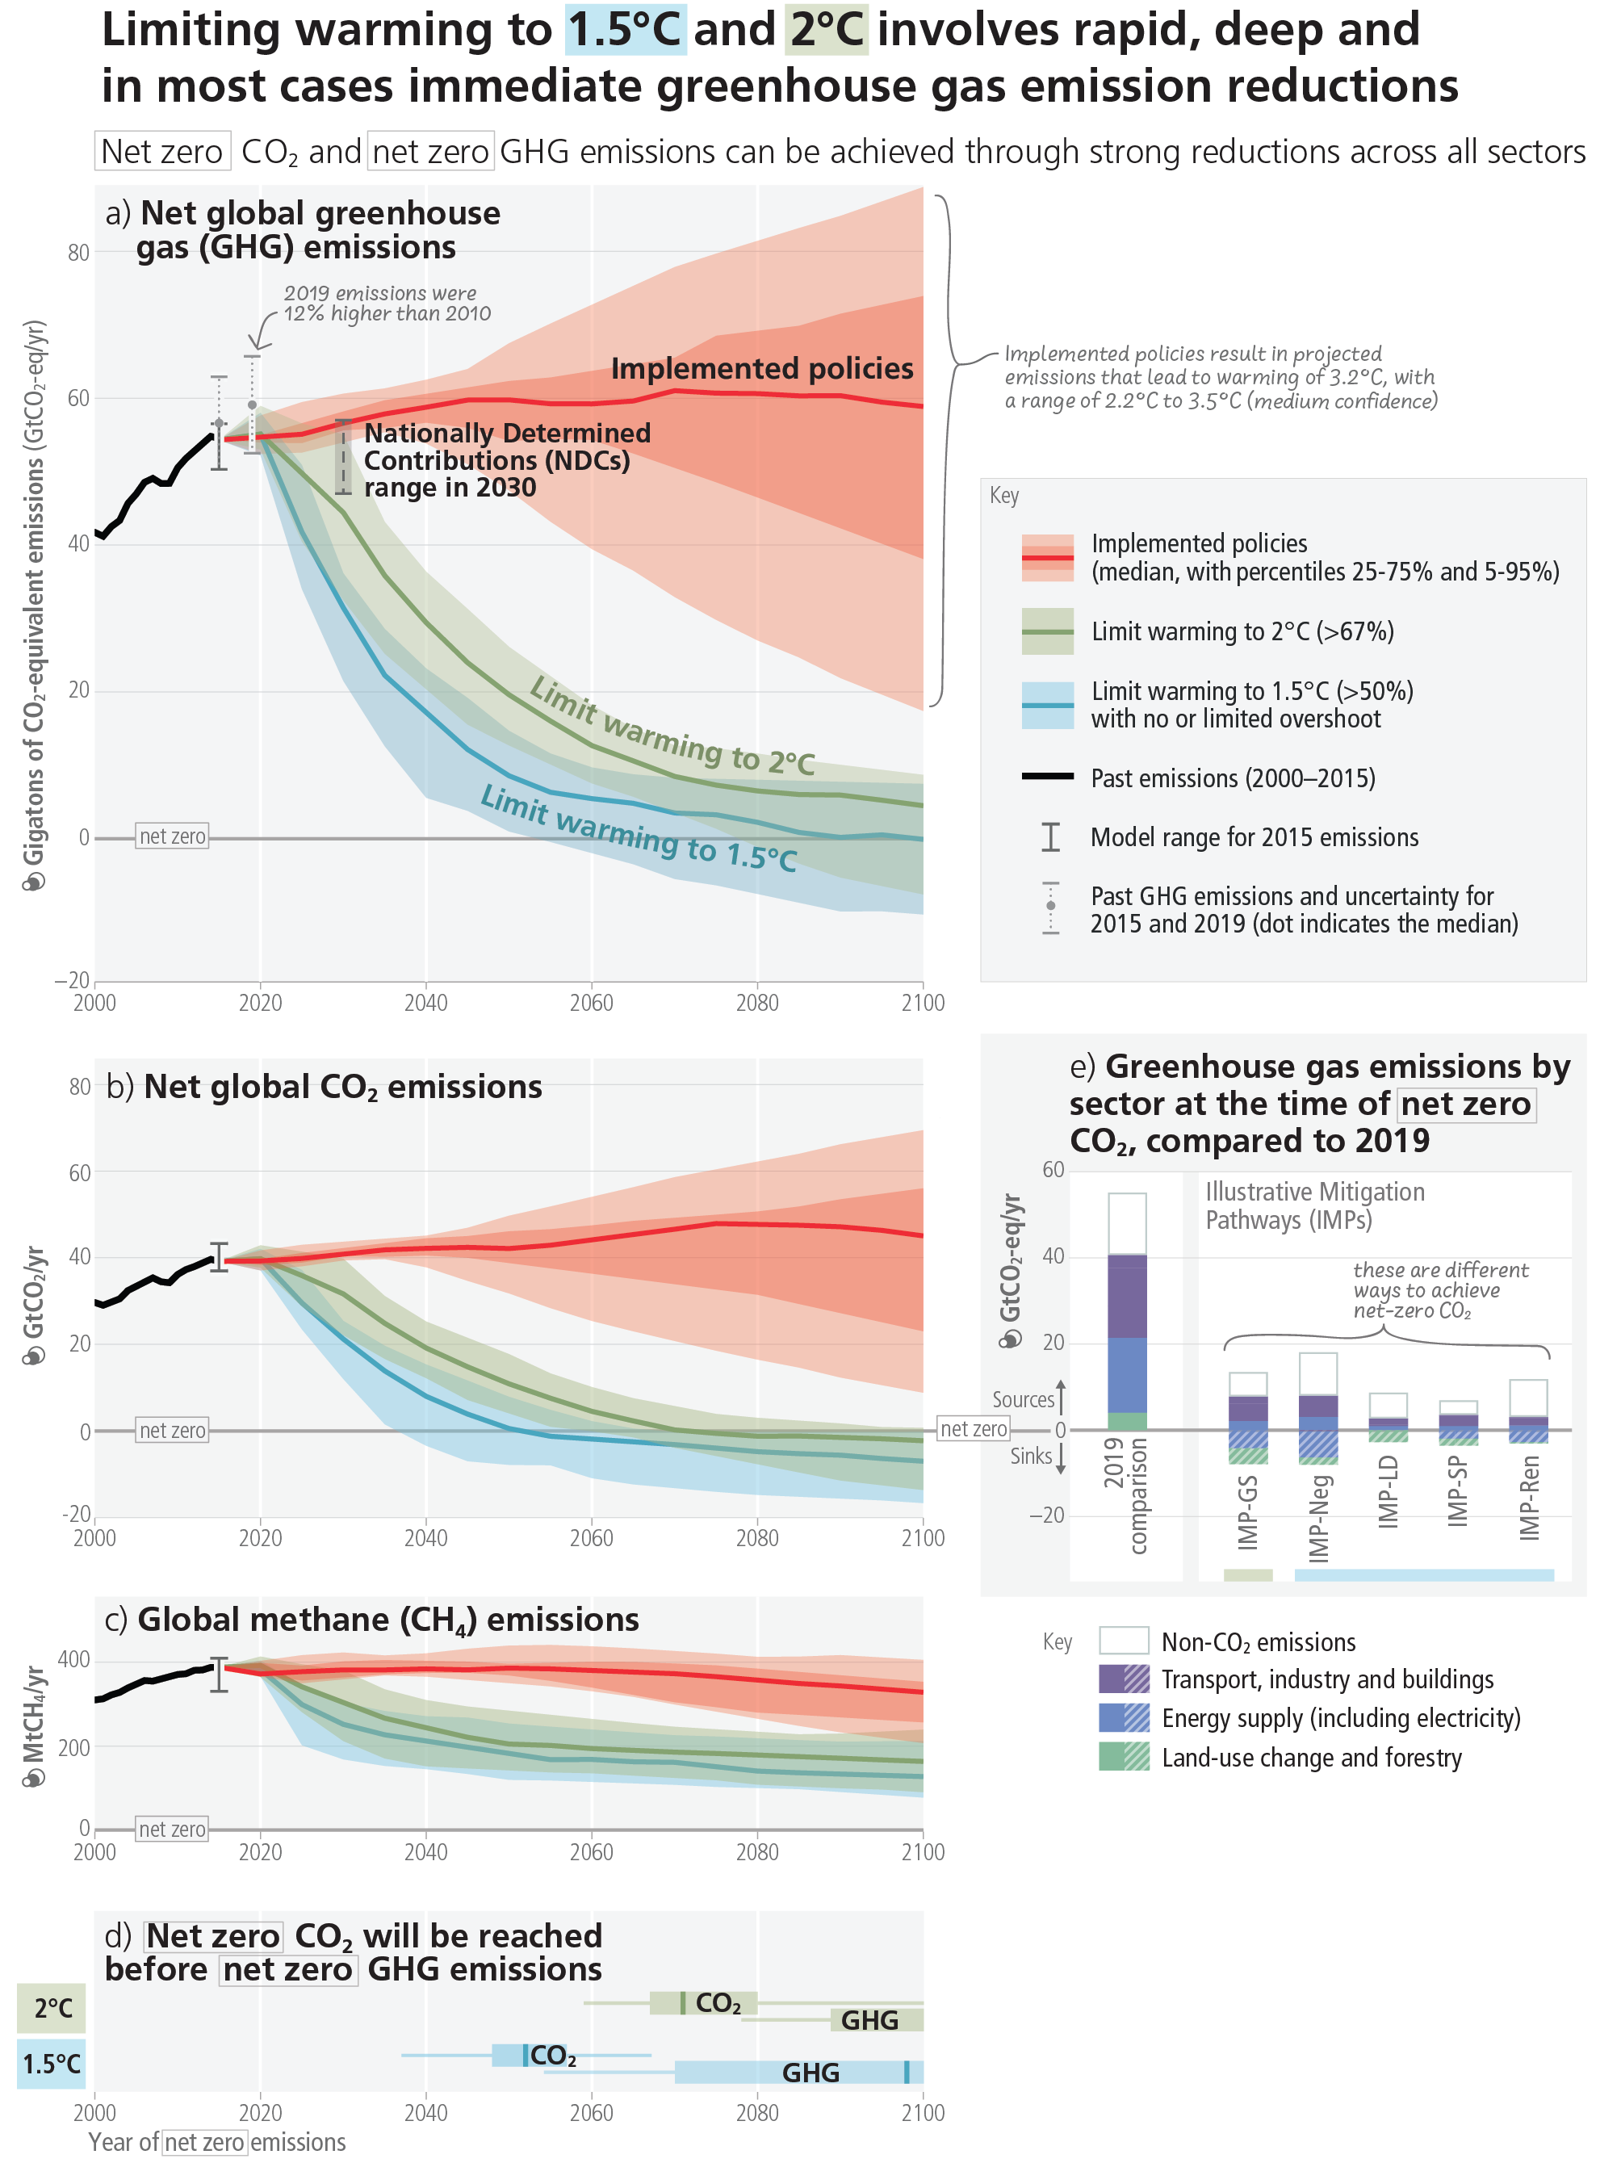
Climate Science – Prospects for Mitigation
Significant impact occurs even at 1.5C
1.5C Paris target is a long-term goal
There is still time to achieve 1.5C – but some degree of overshoot inevitable
High sensitivity to positive feedback loops and tipping points
Powerful natural sinks can stop temperature rise if we stop emitting – but may already be starting to diminish
Progress in alternative and renewable energy sector
Political and economic inertia in changing fossil fuel framework
IPCC AR6 SYR Figure 5: Summary of Paris NDC commitments and needed ambition for 2 and 1.5 C targets

