Slide 1
Climate Modelling, Loss and Damage
Asher Siebert, PhD
Senior Scientist on Loss and Damage, Climate Analytics
Coauthor: Camilo Gomez Zapata
asher.siebert@climateanalytics.org
NASA-GISS
New York, NY
October 8, 2025

Slide 2

Who we are
Climate Analytics is a global climate science and policy institute engaged around the world in driving and supporting climate action aligned to the 1.5°C warming limit.
We connect science and policy to empower vulnerable countries in international climate negotiations and inform national planning with targeted research, analysis and support.
Our vision
We want a climate-safe, sustainable and just future for all.
Our mission
We deliver cutting-edge science, analysis and support to accelerate climate action to limit warming below 1.5°C.
Our work empowers countries, communities and peoples on the frontlines of the climate crisis.

Slide 3
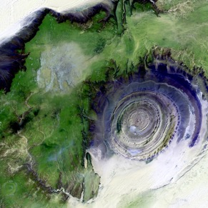
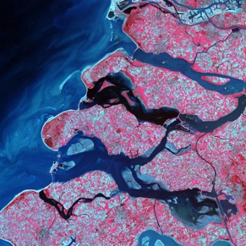
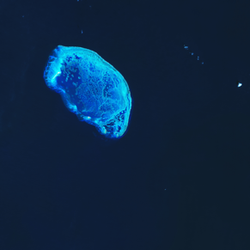
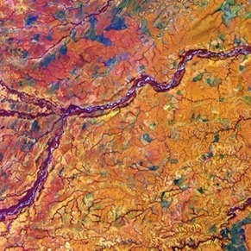
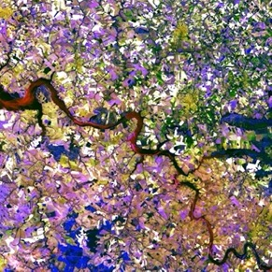
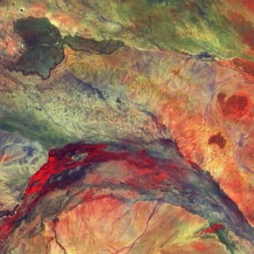
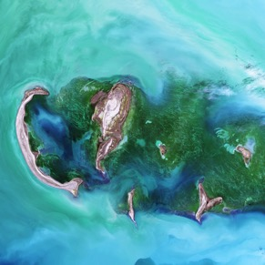
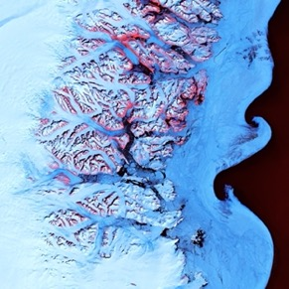
Our work
We produce policy-relevant science and analysis, highlighting options to accelerate progress in line with the Paris Agreement.
We also provide technical support to climate vulnerable countries for their national implementation work, and in the international climate negotiations.
Climate impacts and risks
Adaptation
Loss and damage
Decarbonisation targets and 1.5°C pathways
Climate finance
Climate diplomacy
Climate justice
The 1.5°C limit

Slide 4
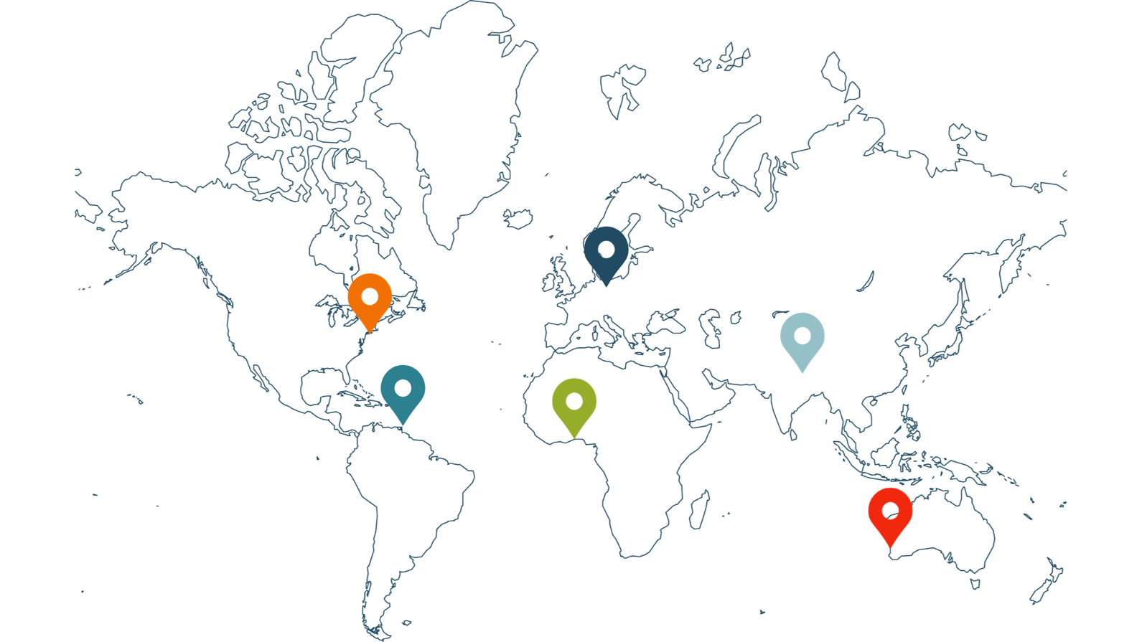

Where we work
Our international team of 130 experts and support staff work from our headquarters in Berlin and our regional offices in Africa, Australia and the Pacific, the Caribbean, North America and South Asia.

Slide 5
My background
BA Geosciences, Princeton (1998-2002)
Physical oceanography grad student MIT/WHOI (2002-2004)
Intern NASA-GISS (2005-2006): worked on NYCDEP report with Cynthia Rosenzweig and Radley Horton
MA in Climate and Society, Columbia (2005-2006)
Staff Associate IRI/Columbia (2006-2008): developed drought index insurance contracts for Millennium Villages project
PhD Geography, Rutgers (2009-2015): index insurance in the West African Sahel in a changing climate context
Postdoctoral Associate, Princeton Environmental Institute (2015-2016): interdisciplinary integrated assessment model research to explore issues of equity and health in mitigation scenarios
Postdoctoral Scientist, IRI/Columbia (2016-2019): seasonal forecasting in Africa for food security applications, trained meteorologists on IRI tools
Senior Staff Associate, IRI/Columbia (2019-2022): seasonal forecasting and forecast-based financing in Africa (primarily focused on food security), some work on climate & public health, trained meteorologists on IRI tools
Senior Scientist, Loss and Damage, Climate Analytics (Nov 2024-present): develop multi-sector loss and damage strategies for SIDS and LDCs, contribute to scientific reports, explore intersection of loss and damage and climate justice/equity

Slide 6
Outline
Loss and Damage Definition
Impacts and Costs of Delayed Action
Ongoing Loss and Damage Work at Climate Analytics
The Intersection of Climate Modelling and Loss and Damage
Resistance and Adaptation to the Present Reality

Slide 7
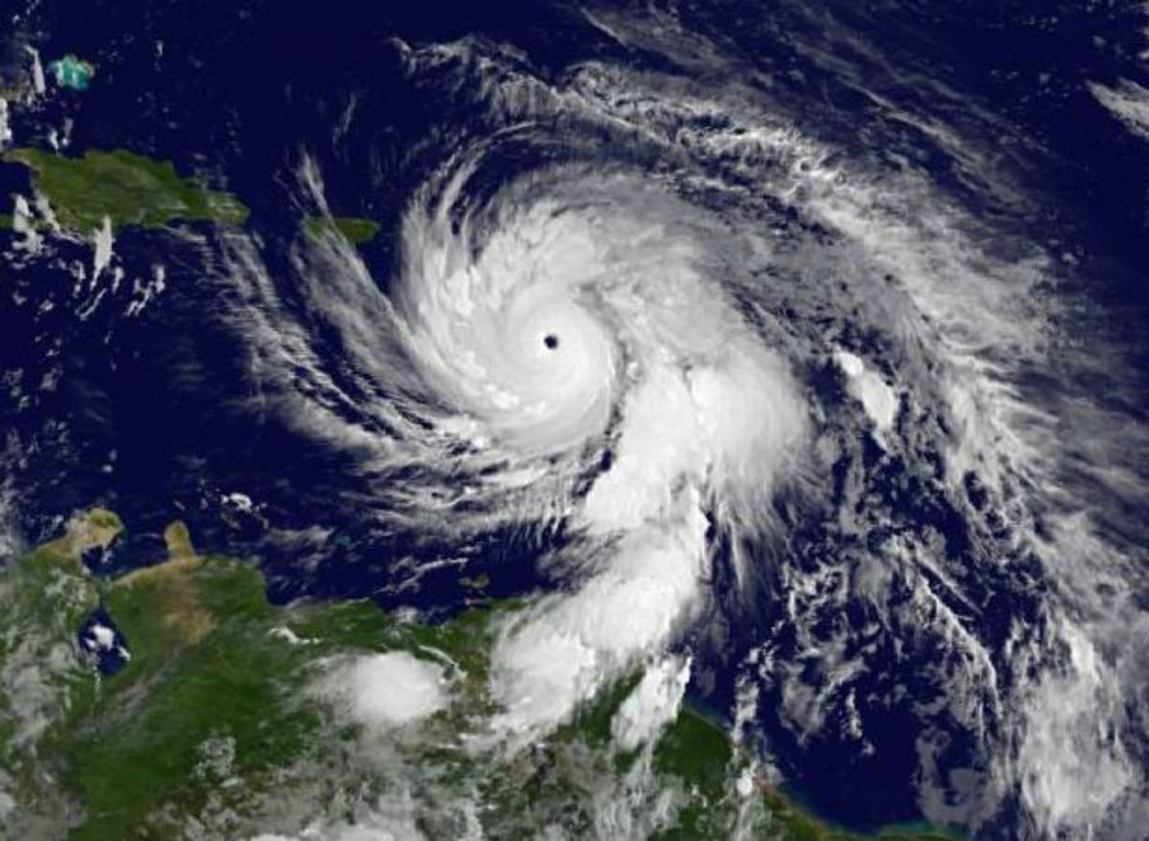
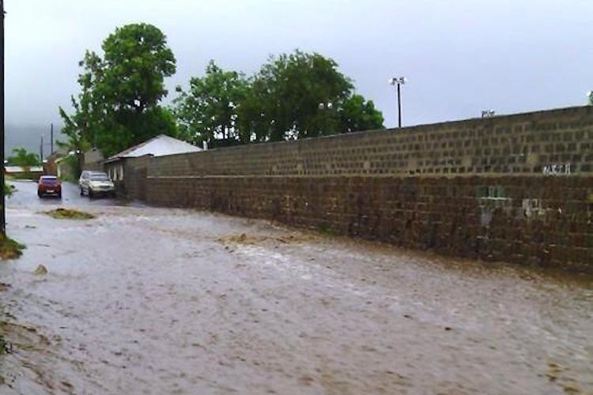
Loss and Damage overview
What is climate-related loss and damage?
  Human, health, economic, ecological, cultural and resilience related adverse impacts incurred from climate extremes and change
Drivers of loss and damage?
  Hazard: hydrometeorological, temperature and sea level rise
  Exposure: people and assets at risk
  Vulnerability: likelihood of adverse impact in exposed communities
Why is it important for SIDS?
  High hazard (eg. hurricane, SLR)
  High exposure (eg. large coastal populations)
  Varying vulnerability
  Reporting L&D -> funding -> pressure on emitters and wealthy countries

Slide 8
Framing Loss and Damage
Resilience
Disaster response
Socioeconomic vulnerability
(Im)Mobility
Environmental damage
Ecosystem services
Livelihoods and Culture
Economic growth and inequality
Health
Deaths
Injuries
New illnesses (eg. vector borne)
Exacerbated pre-existing conditions (eg. cardiovascular and respiratory)
Indirect impacts: food insecurity, energy and water disruptions, mental health
Economic
Property damage
Supply chain feedbacks
Disaster Response/Recovery
Productivity Losses
Impacts on Tourism
Investment and insurability
Growth and inequality
Sectors
Physical infrastructure and built environment
Transport system
Food systems: agriculture/fisheries
Energy
Water system
Tourism

Slide 9
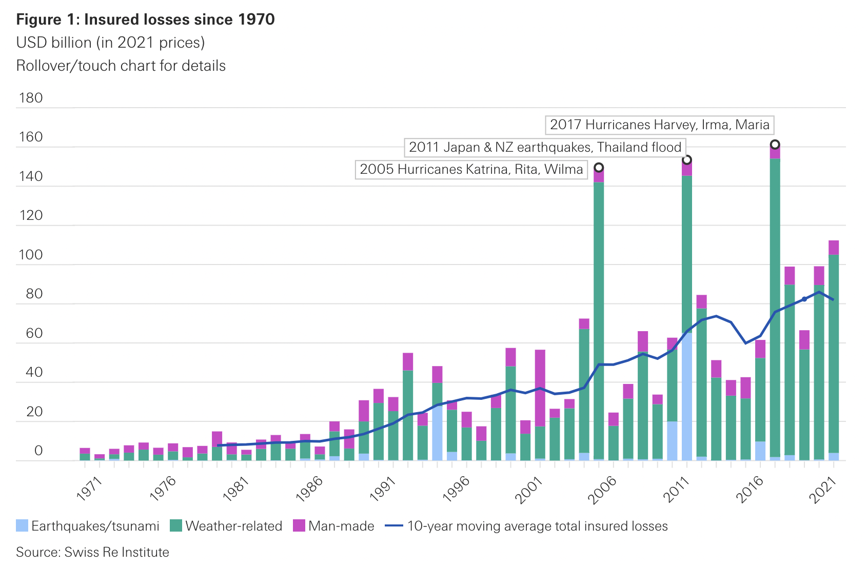
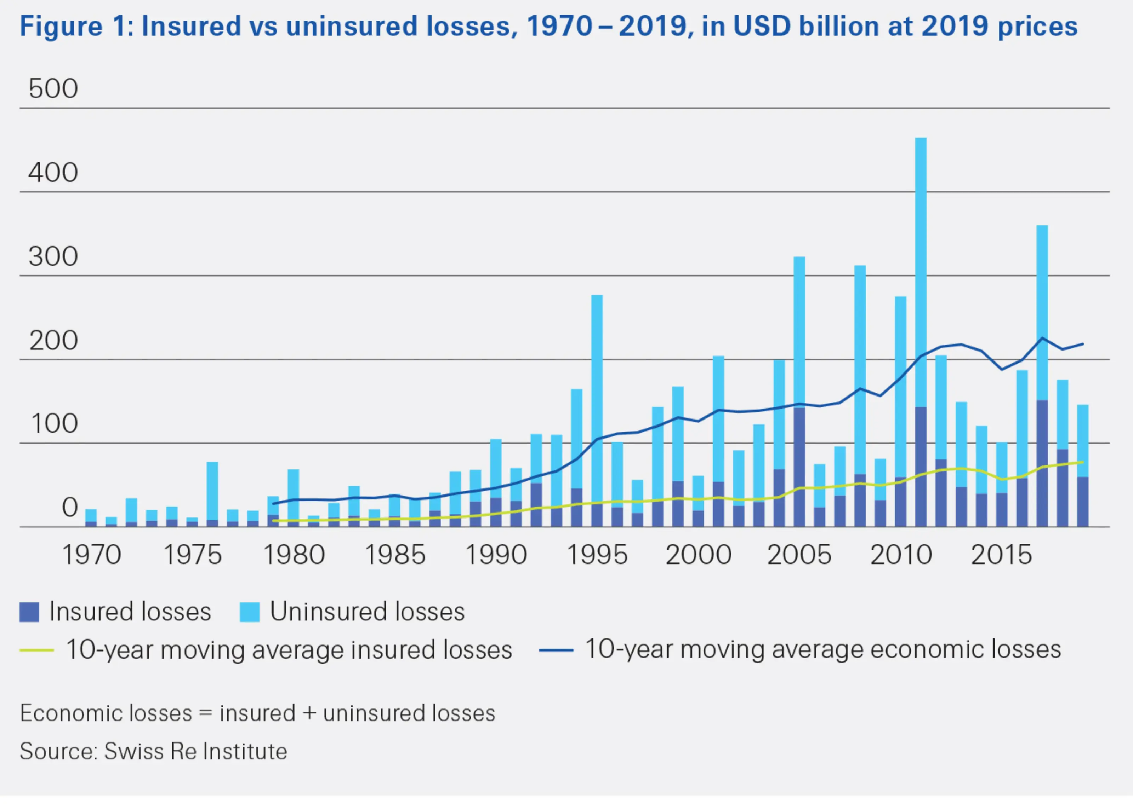
Short Term Impacts, Loss and Damage
Deaths
  Hundreds of thousands of deaths per year from climate change already (multiple sources)
  Loss of life dominant source of economic loss from extreme events attributable to climate change (Newman and Noy 2023)
  Estimates of at least 250,000 deaths/year already from all climate related causes in period from present to 2030 (WHO)
Displacements
  Majority of climate related displacements are internally displaced people - IDPs (IDMC)
  Over 30 million IDPs in 2022 from climate/weather disasters (IDMC and UNHCR) - ~40% increase from 2008
Health impacts (WHO)
  Heat: heat stroke, cardiovascular complications, respiratory impairments
  Storms: injuries, disease from floodwaters, mold, food insecurity, water borne diseases
  Vector-borne diseases: changes in ranges and suitability of pathogens
Water disruptions (WMO)
  Supply impacts – long term changes and variability/reliability
  Quality impacts – turbidity, increased temperature
  Saline intrusion – of particular concern to SIDS
Risks to food systems (AGMIP)
  Adverse impacts on yields – particularly in dryland regions
  Changes in nutrient composition
  Pest invasions
  Some agricultural benefits in high latitude regions

Slide 10
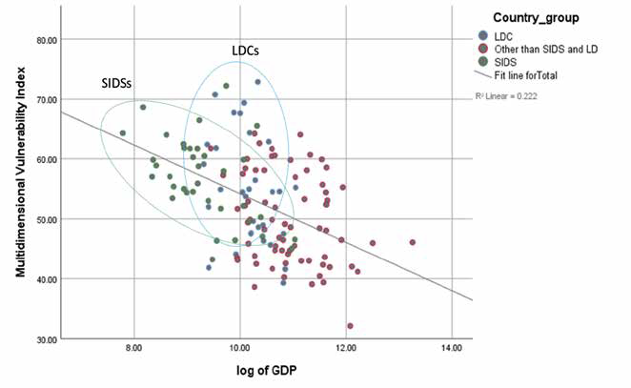
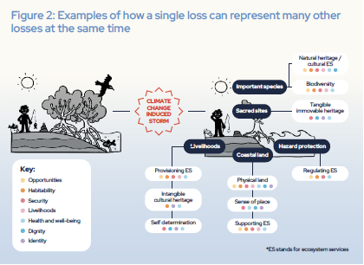
Long Term Impacts, Loss and Damage
Vulnerability and adaptability
  Risk of being trapped in disaster response cycle
  Climate impacts historically have larger proportional economic impacts on LDCs (sometimes more than 10% of GDP over time and individual events can be much higher)
Economic growth
  Economic cost of climate change has been at least hundreds of billions USD/year with the total cost in the 21st century well in the trillions (World Economic Forum)
  Unabated climate change may cost the world on the order of 7% of GDP by 2100 (Kahn et al. 2019) and may exceed 10% of GDP for warming beyond 3C (IIASA)
  Long-term downward pressure on economic growth on most impacted societies
Ability repay loans (Bharadwaj, R. et al. 2023)
  Many LDCs and SIDS have very high debt/GDP ratios
  Loan repayment schemes (especially with high interest rates) will lead to increased financial vulnerability, inability to pay and default risk
Culture and Lifestyle (UNFCCC Report on Non-Economic Losses 2024)
  Changes of landscapes, relationship between human population and flora/fauna, connection to ancestral practices, food and water security
Ecosystems Services and Biodiversity
  Habitability
  Health
  Food and water security
correlation of vulnerability with GDP
Bharadwaj, R. et al. 2023
Linkage between one loss and many others
UNFCCC Report on Non-Economic Losses 2024

Slide 11
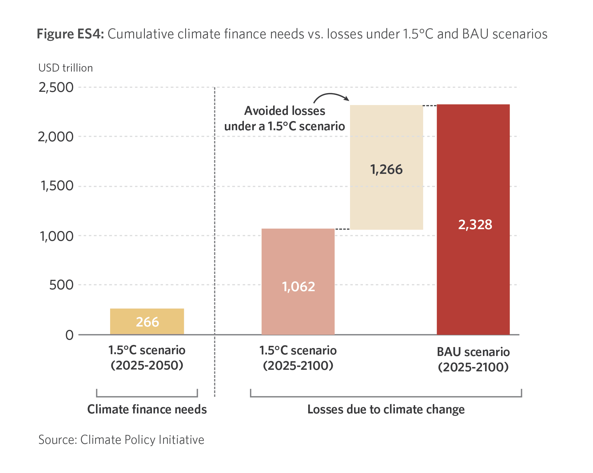
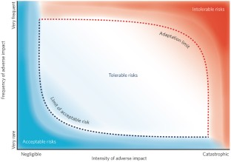
Cost of Inaction or Delayed Action
Expected migration – and resource/housing burdens to countries
  Many inhabitants of SIDS countries will have to leave country or move to higher elevations to survive
Expected health burdens
  Heat related impacts
  Water borne and storm related diseases
  Shifts in vector borne disease ranges
Expected resource limitations
  Increasing resource pressure on SIDS as sea level rise advances
  Increasing resource pressure on many regions around the world, but particularly LDCs
Expected geopolitical disruptions
  Climate change a threat multiplier – against a backdrop of other economic and geopolitical challenges
  Convergence of climate risks and violent regimes in many regions (multiple regions in Africa, Central Asia, Latin America)
Possibility of certain adaptations may slip away
  Socio-economic communities and modalities may be disrupted
  Loss of mangroves, coral reefs, protective wetlands and forests
Climate system changes beyond human ability to adapt
  Irreversible changes to landscape with sea level rise
  Extreme wildfire and flood risk
  Increasing frequency of days at very high wet bulb temperature – physiological limit
Figure on framework for limits to adaptability, Dow, K. et al. 2013

Slide 12
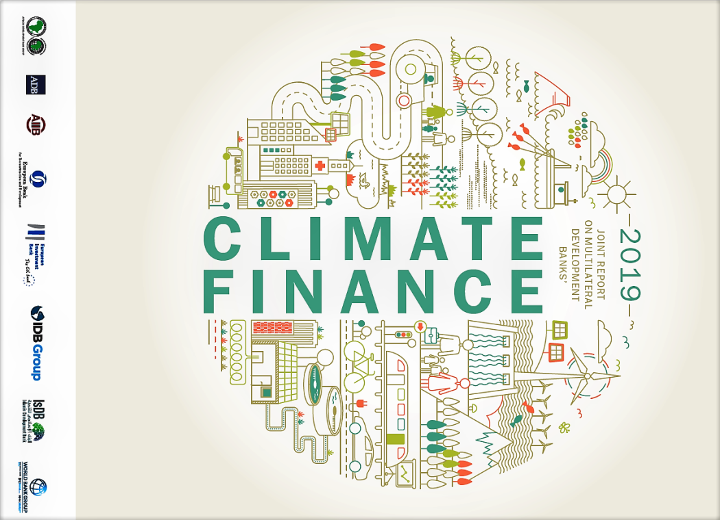
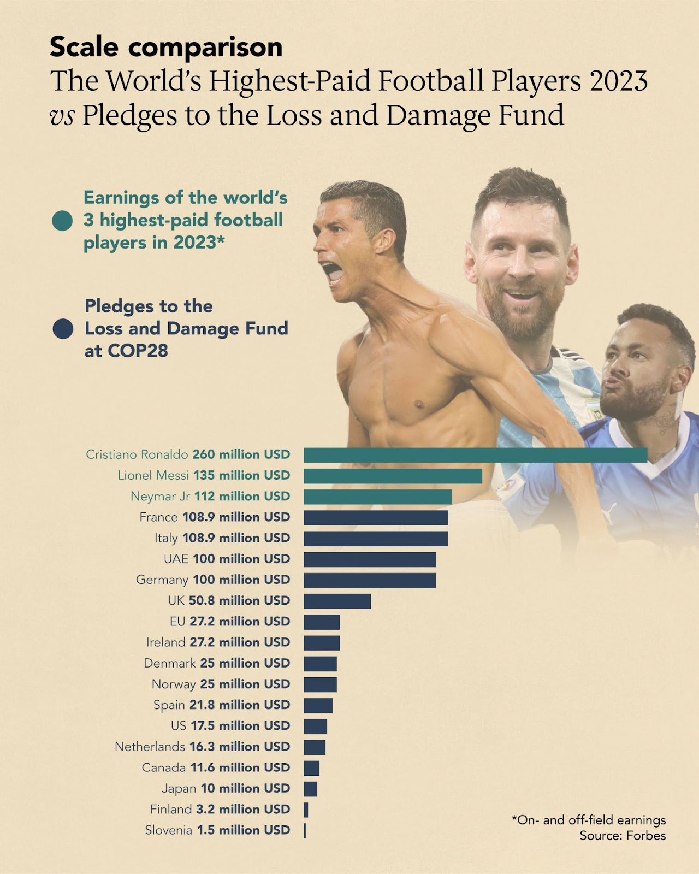
What can we do?
Global Climate Finance
  Fund for Responding to Loss and Damage (FRLD) – 700 million USD
  Green Climate Fund (GCF) – 16 billion USD
  Adaptation Fund – 1.2 billion USD
  Push for more grant financing (even outside of COP) – highlighting long-term savings
  Argue to funders that heavily loan-based system is not sustainable and will likely be more costly
  Expand climate (index) insurance: eg. Global Index Insurance Facility (GIIF), Caribbean Climate Risk Insurance Facility (CCRIF)
  Microfinance: eg. Climate Investment Funds (CIF)
Policy
  Develop, fund and support robust National Adaptation Plans
  Revise NDCs towards greater ambition, and integration with L&D
  Encourage inter-sectoral cooperation and coordination within vulnerable countries
  Pressure major polluting governments from the grassroots community level
  Engage with climate-friendly sub-national governments in large polluting countries
  Legal Action and Frameworks
Public-private partnerships across a wide range of sectors
Targeted Responses
  Targeted habitat restoration projects – some have proven very successful
  Engage with corporate ESG: both adaptation/disaster finance and mitigation/decarbonization
  Forecast-based Financing for Humanitarian Agencies in Disaster Relief

Slide 13
Ongoing Loss and Damage Work

Slide 14
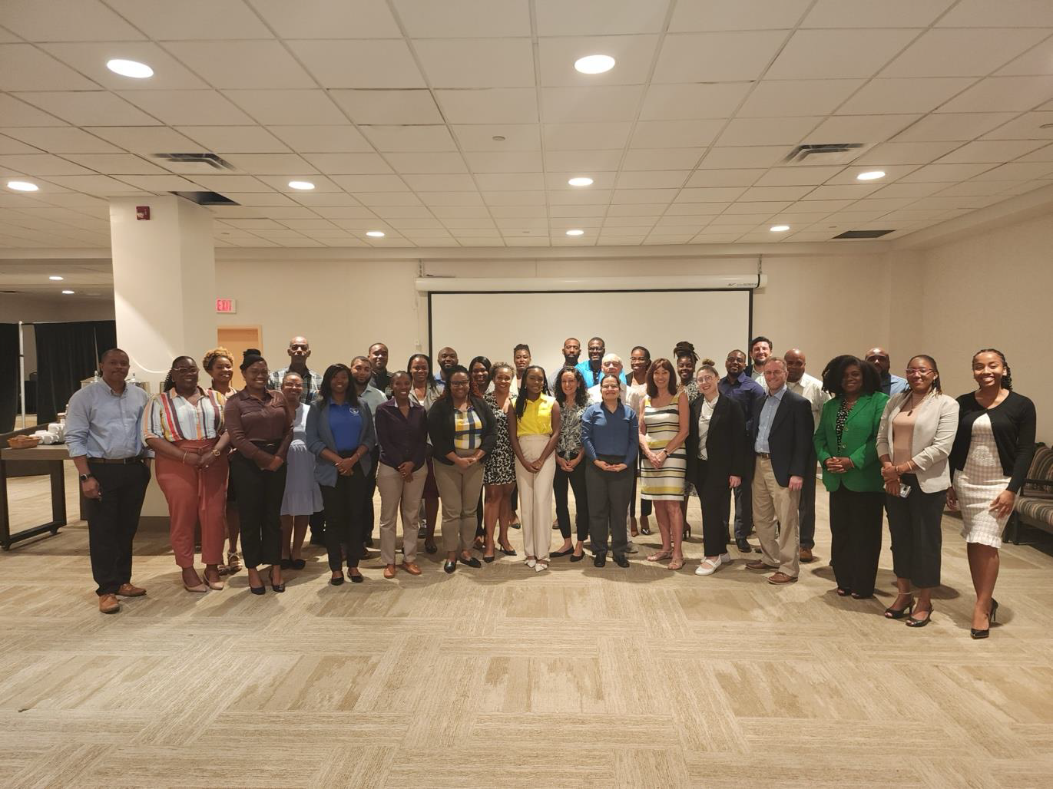
Saint Kitts and Nevis Nationally Determined Contribution Partnership Action Fund NDC PAF project
Four Components
  National Loss and Damage Strategy (2-year timeline)
  National Integrated Water Policy and Plan (1-year timeline)
  Updated National Climate Change Policy (1-year timeline)
  NDC Investment Plan (1-year timeline)
Ongoing Work and Next Steps
  Engage multiple domestic sector stakeholders across government and private sector in defining scope of future potential work
  Work with international partners on funding and disaster relief: CCCCC, OECS, CARICOM, CDEMA, NDCFI
  Work with climate science/meteorological community (CIMH, other Caribbean, US, Europe)
  Work with finance community – towards financial sustainability for L&D
  Work with local community to document non-monetary cultural, ecological and biodiversity related losses and damages
Stakeholder Workshop, Basseterre, Saint Kitts, March 2025

Slide 15
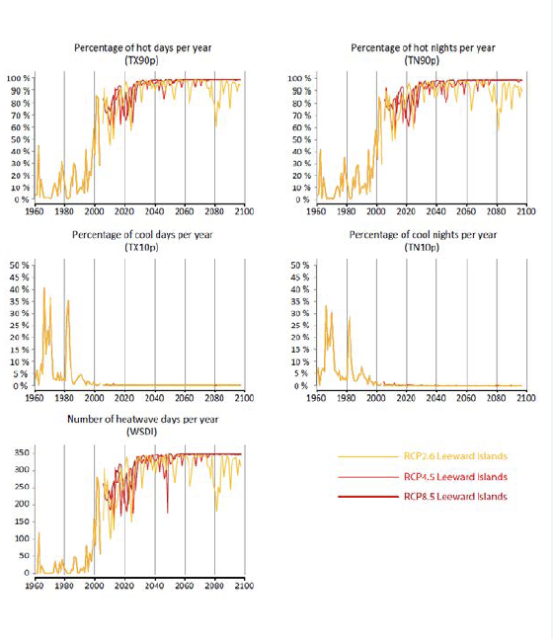
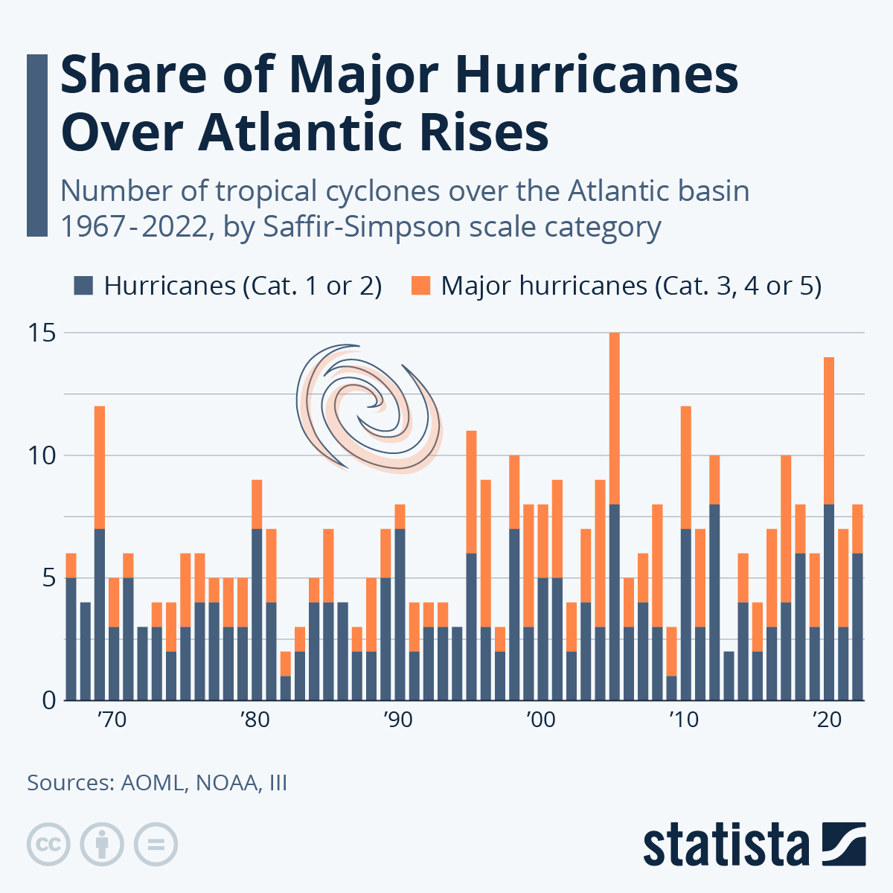
Climate Impact Projections for the Caribbean
Heat
  Projected increase in heat waves – health impacts
  Projected increase in marine heat waves – coral bleaching, impact on fisheries
Hydrometeorological
  Projected increase in category 4 and 5 hurricanes (NOAA) – deaths, injuries and illnesses
  Projected increase in drought (particularly before hurricane season) (Song et al. 2018) – food insecurity, increased energy demand, water system issues
Potential Future Work
  Couple regional and global climate model projections with downscaling and statistical simulation
  Tailor projections for sectors
  Engage with insurance, development and aid agencies to develop adaptive financial response
OECS report 2021: Projected share of hot and cool days and nights with different climate models, Leeward Islands
Atlantic Ocean and Meteorological Lab, NOAA: historical trends in hurricanes in Atlantic basin

Slide 16
Building our Loss and Damage Response (BOLD)
Broad understanding of loss
  Including non-monetary components (ecosystems, environment, cultural/heritage)
  Including traditional economic and health losses (deaths, property damage, agricultural losses)
Fiji, Samoa, Vanuatu, Tuvalu, Republic of Marshall Islands
Linking Science and Community Voices
Strengthening National and Regional Capacities
Regional Partner - Secretariat of the Pacific Regional Environment Programme (SPREP)

Slide 17
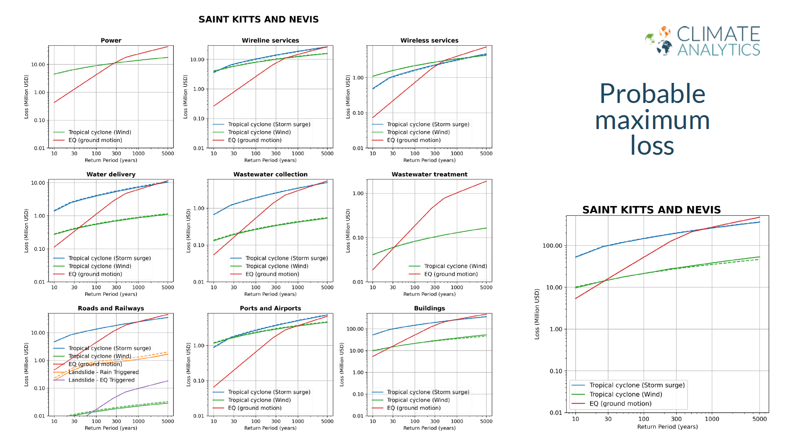
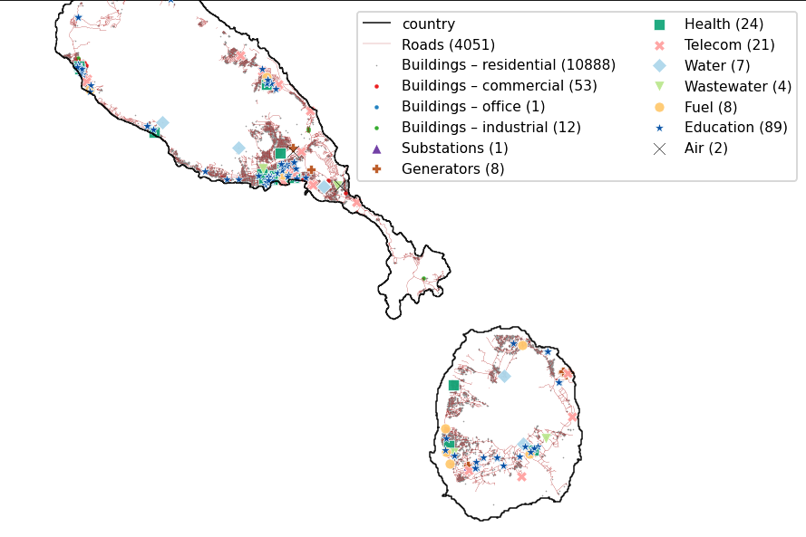

Data/Model Sources and Needs
Data and Model Examples
  International Disaster Database: EMDAT
  LitPop Exposure – population and assets exposed
  Coalition for Disaster Resilient Infrastructure Global Infrastructure Risk Model and Resilience Index (CDRI GIRI)
  International Best Track Archive for Climate Stewardship (IBTrACS)
  Climate Adaptation and Econ Integrated Assessment Model (CLIMADA)
  Integrated Model to Assess the Global Environment (IMAGE)
Needs
  Climate model and earth observation data
  Socioeconomic data
  Vulnerability and exposure data
  Connection between hazard impact and sector specific costs
  Connections between sector costs (interdependency of impacts)
  Appropriate treatment of uncertainty
Detailed population Exposure (using LitPop and Census)
Detailed infrastructure exposure (using OSM-flex with specific vulnerabilities).

Slide 18
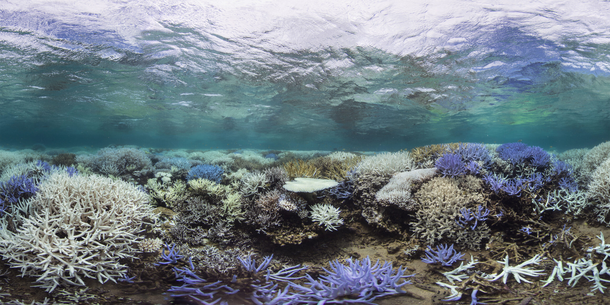
Specific concerns for SIDS
Many SIDS are also LDCs and face large climate consequences despite having minimal historical responsibility and limited power in international negotiation
Highly vulnerable to SLR, storm surge and wind damage from hurricanes, saline intrusion, intense rainfall, drought and heat waves (both atmospheric and marine)
High debt/GDP ratios make existing models of disaster finance potentially unsustainable
Cost of adapting to climate change is on the order of 4-5% of GDP (UN)
Heavy dependence on tourism - and vulnerability of tourist demand on factors like natural disasters
Majority of coral reefs in SIDS threatened by climate change
Energy and food supply chain issues with dependence on imported fossil fuels and food (UN)

Slide 19
Climate Science, Modelling, Loss and Damage

Slide 20
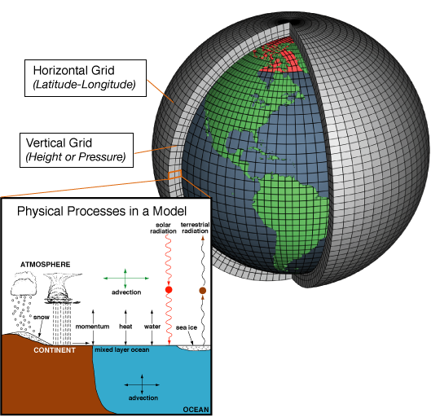
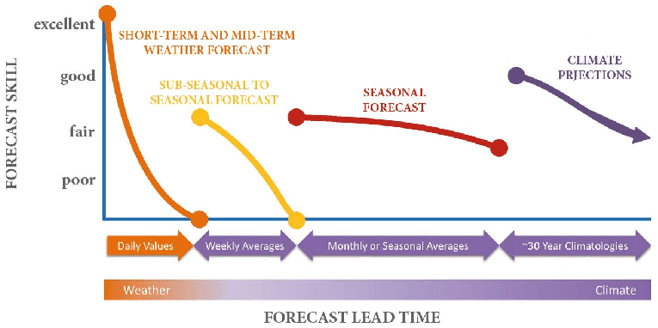
Challenges internal to GCMs and RCMs
Model resolution vs. small scale features, microclimates and extreme events
Computational limits
Biases (anomaly, positioning)
Different skill at different time scales – some improvement in S2S using AI
Parameterizations and model uncertainty
Uncertainty about climate sensitivity(ies)
Climate.gov
IRI figure on forecast skill

Slide 21
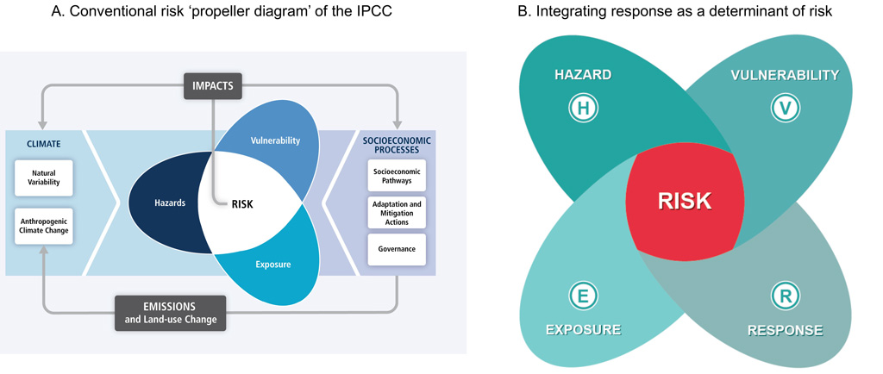
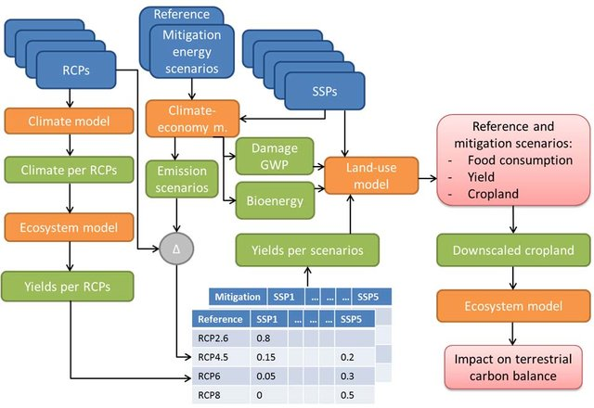
Challenges translating climate model output to L&D assessment
Translation of hazard to risk modeling (integration of exposure, vulnerability, adaptive capacity)
Translation of geophysical hazard to sector specific impacts
GCMs speak to large scale patterns, but damages are highly local
Understanding of interlinkages between sectors in disaster response
Integrated assessment modeling – damage functions, including nonlinear dependencies
Carbon Brief
Engstrom et al. 2016

Slide 22
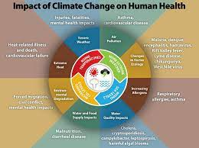
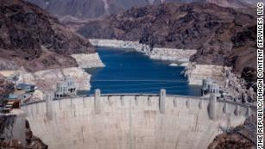
Sectors for applied L&D climate modeling work
Public Health
Water Management
Energy Utilities
Food Security/Agriculture
Disaster Management & Humanitarian Response
Infrastructure and Public Works
Financial Services (including insurance)
Biodiversity and Environment
Justice and Legal
Cultural, Gender and Social Impacts
Need for Early Warning Systems and Incentives for Proactive Adaptation

Slide 23
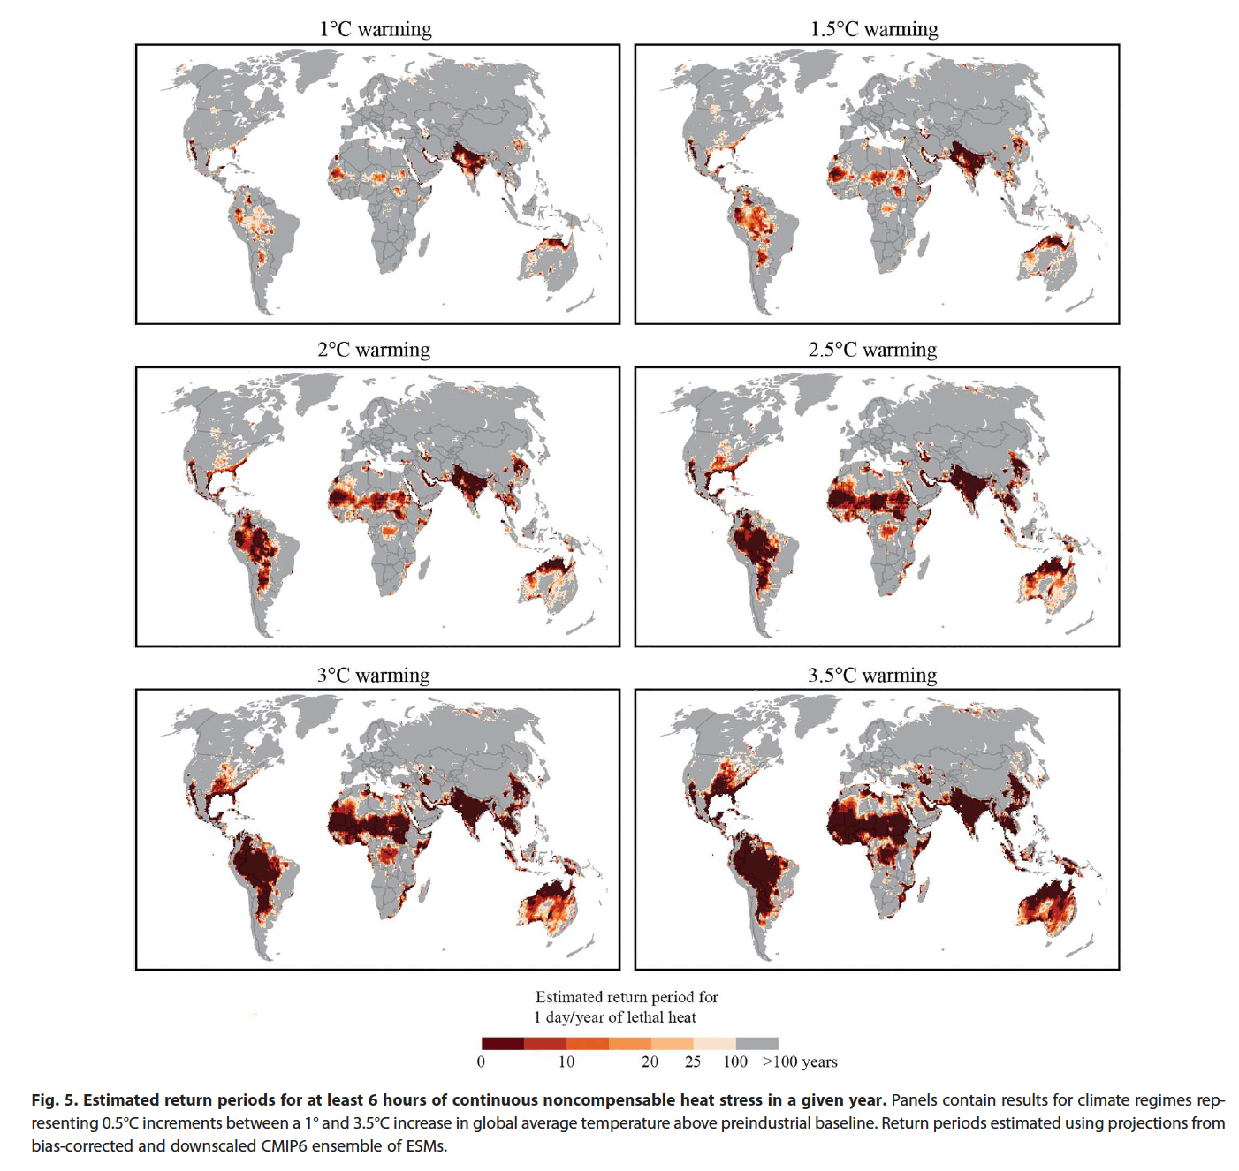
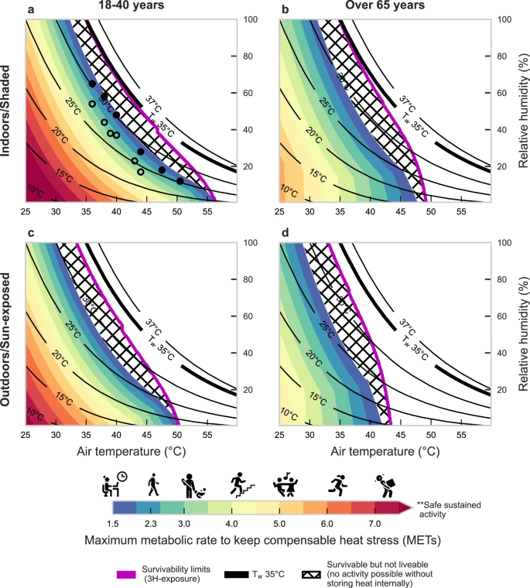
Heat – Health work
Projected increase in heat waves – health impacts
  Projected increase in marine heat waves – coral bleaching, impact on fisheries
Minderoo Lethal Heat/Humidity
Vanos et al. 2023
Powis et al. 2023

Slide 24
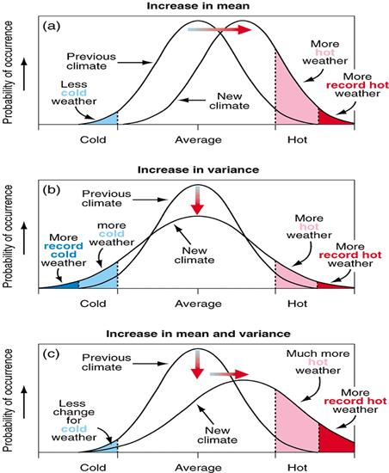
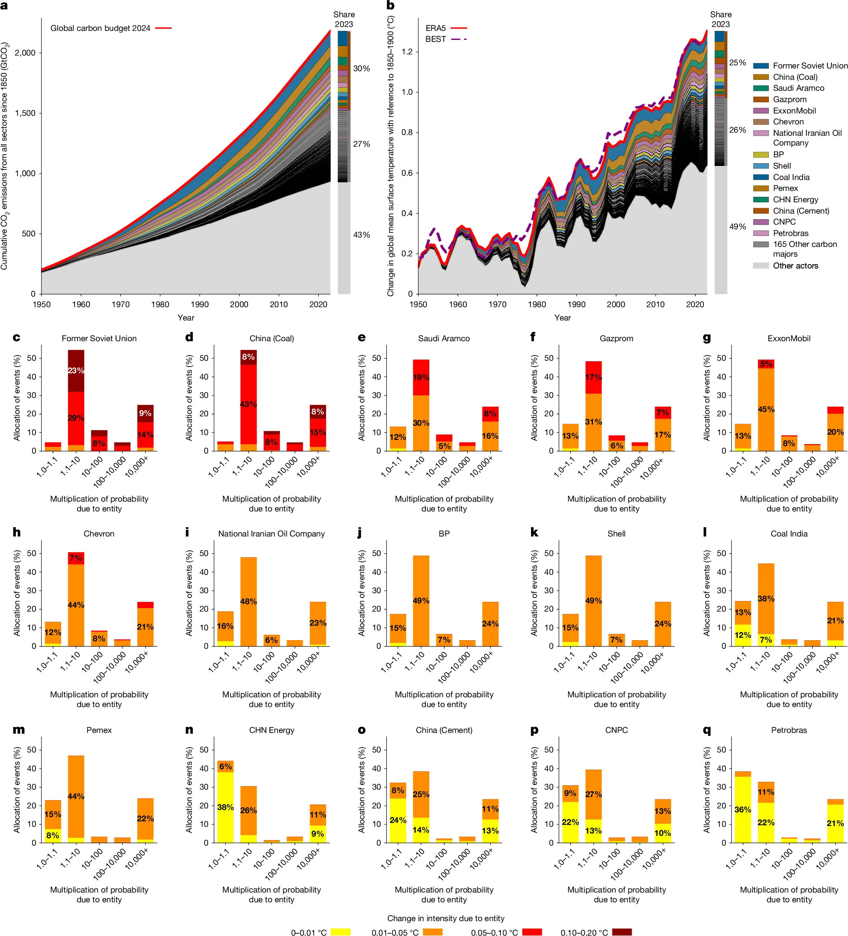
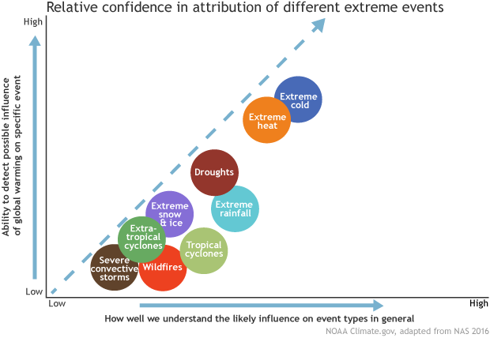
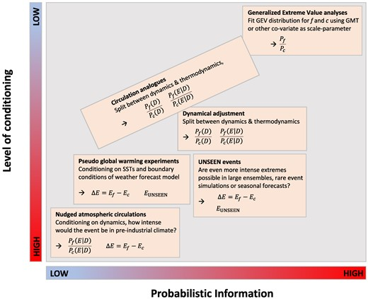
Attribution Science -> Legal Accountability
https://climateattribution.org/
https://www.worldweatherattribution.org/
Coumou et al. 2024 – methodological framework for connecting attribution to Loss and Damage finance using Bayesian framework
Quilcaille et al. 2025 – attribution of heat waves to carbon majors
From Climate Central
CPO NOAA
From Coumou et al. 2024
From Quilcaille et al. 2025

Slide 25
Resistance and Adaptation to the Present Reality

Slide 26
Resistance and the future
How do we fight back to advance science and the public interest?
Build data redundancies – SEDAC, IRIDL? various NOAA and NASA
Appeal to State and Local Funding and initiatives (C40, ICLEI, ClimateSmartNY, UCCRN etc.)
Seek Public-Private Partnerships (World Bank overview, UK CP3, etc.)
Strengthen Climate Science/User Community Connection/Collaboration and co-production of knowledge and services
Strengthen International Collaboration (WCRP, WMO, WHO, World Bank, UNEP, UNDP, NRDC, GCF, FRLD, Adaptation Fund, etc.)
Social media, protests, lobbying, lawsuits
Your thoughts on resistance?
Areas for collaboration?
Requests from Climate Modelling community regarding Loss and Damage?

Slide 27
Additional Questions?
Feedback?

Slide 28
References, materials and partners
Atlantic Oceanographic and Meteorological Laboratory, (AOML) NOAA
Caribbean Community (CARICOM)
Caribbean Institute for Meteorology and Hydrology (CIMH)
Caribbean Regional Climate Center/Climate Outlook Forum (CariCOF)
Climate Risk Dashboard
Climate Vulnerability Monitor
Global Climate Change Alliance
Green Climate Fund Country Programme for St. Kitts and Nevis 2023
IPCC AR6 WGII, Chapter 15: Impacts on Small Island States
National Climate Change Adaptation Strategy for Saint Christopher and Nevs 2018
NOAA Factsheet on Projected Hurricane Changes 2023
OECS St Kitts and Nevis Country Analysis 2021
St Kitts and Nevis Government
UNFCCC Loss and Damage Fund

Slide 29
References
Bharadwaj, R. et al. 2023, Sinking Islands, Rising Debts, IIED Report
Climate Analytics Annual Report 2023
Coumou et al. 2024, How can event attribution science underpin financial decisions on Loss and Damage?
Dow, K. et al. 2013, Limits to Adaptation, Nature Climate Change
Hare, Friedrich-Schleussner, Nauels and Kloenne, 2022, Is 1.5 Still Alive? Science Update, Climate Analytics
Kahn et al. 2019, Long-Term Macroeconomic Effects of Climate Change: A Cross-Country Study, International Monetary Fund Working Paper 2019/215
New, R. and I. Noy, 2023, The Global Costs of Extreme Weather that Are Attributable to Climate Change, Nature Communications
Powis et al. 2023, Observational and model evidence together support wide-spread exposure to noncompensable heat under continued global warming
Quilcaille et al. 2025, Systematic attribution of heatwaves to the emissions of carbon majors
Schie, D., G. Jackson, O. Serdeczny, and K. van der Geest, Economic and Non-Economic Loss and Damage: A Harmful Dichotomy, Global Sustainability
Schleussner et al. 2023 Carbon majors’ trillion-dollar damages, Climate Analytics
Sircar, Thomas, Serdeczny and Jattansingh 2024, A review of loss and damage in the Caribbean (1994 to 2024), Climate Analytics
Song et al. 2018, Future Changes in Seasonality of the North Pacific and North Atlantic Subtropical Highs
UNFCCC Report on Non-Economic Losses 2024
Vanos et al. 2023, A physiological approach for assessing human survivability and liveability to heat in a changing climate
Vousdoukas et al., 2023, Small Island Developing States under threat by rising seas even in a 1.5 °C warming world, Nature Sustainability

Slide 30
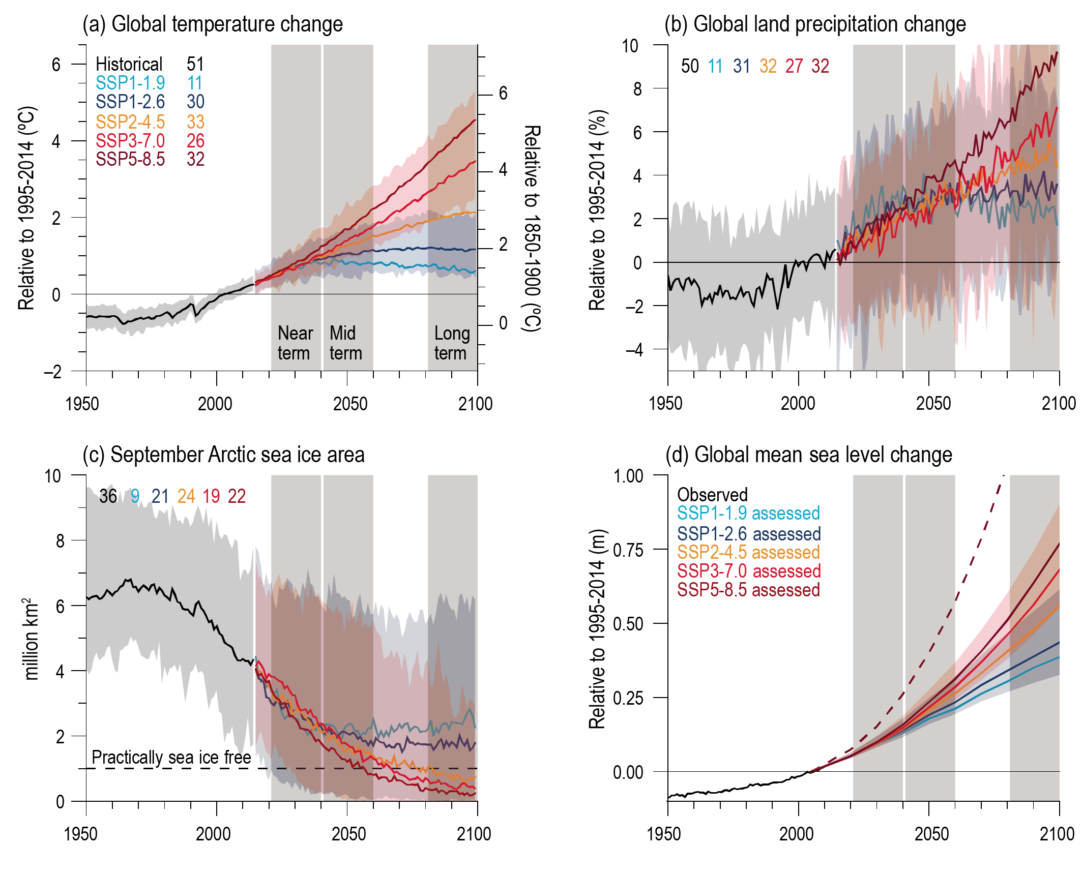
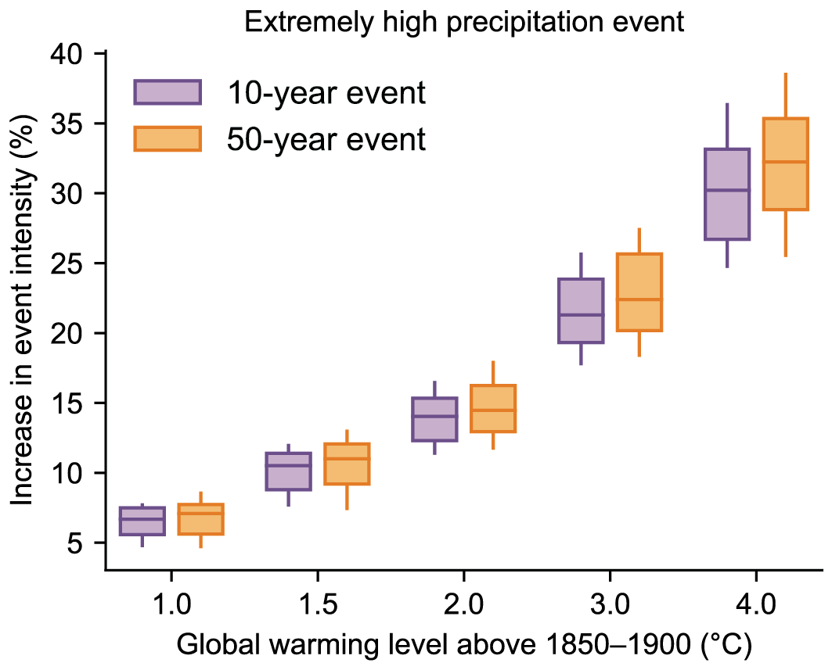
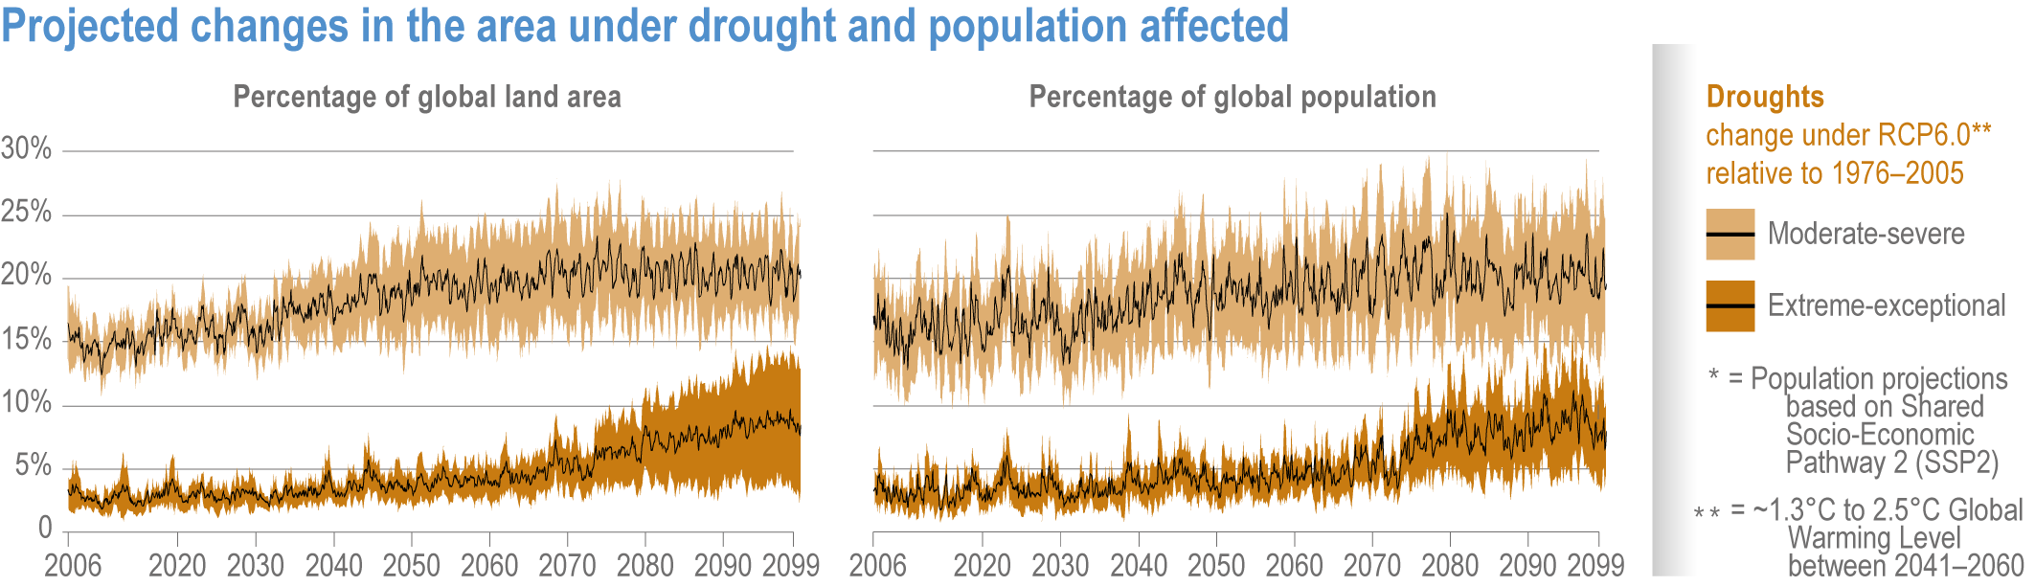
Observed and Projected Changes in the Climate System
Increase in global average temperature 1.5-5 C by 2100
Increase in global sea level 0.3-0.8 m or more by 2100
Ice-free summers in Arctic Ocean by late 21st century
Significant increases in heat extremes: particularly at high latitudes in continental interiors
Increases in area experiencing 35C wet-bulb temperatures
Hydrologic cycle intensifies – severe storms and drought
Increased share of powerful tropical cyclones – likely at least 10% increase in Cat 3+ by mid-late century
Increase in risk for wildfires – burn area may increase by multiple 100s of % in some ecologies
Other effects: ecosystems, ocean acidification (~0.06 pH change in last 35 years), ocean circulation, changes in carbon sequestration potential
IPCC AR6 WGI Figure 4.2: Temperature, Precipitation, Arctic Sea Ice and Sea Level Rise Projections
IPCC AR6 WGI Figure 11.15: Projected changes in extreme rainfall
IPCC AR6 WGI Figure 4.19: Projected changes in area and population under drought

Slide 31
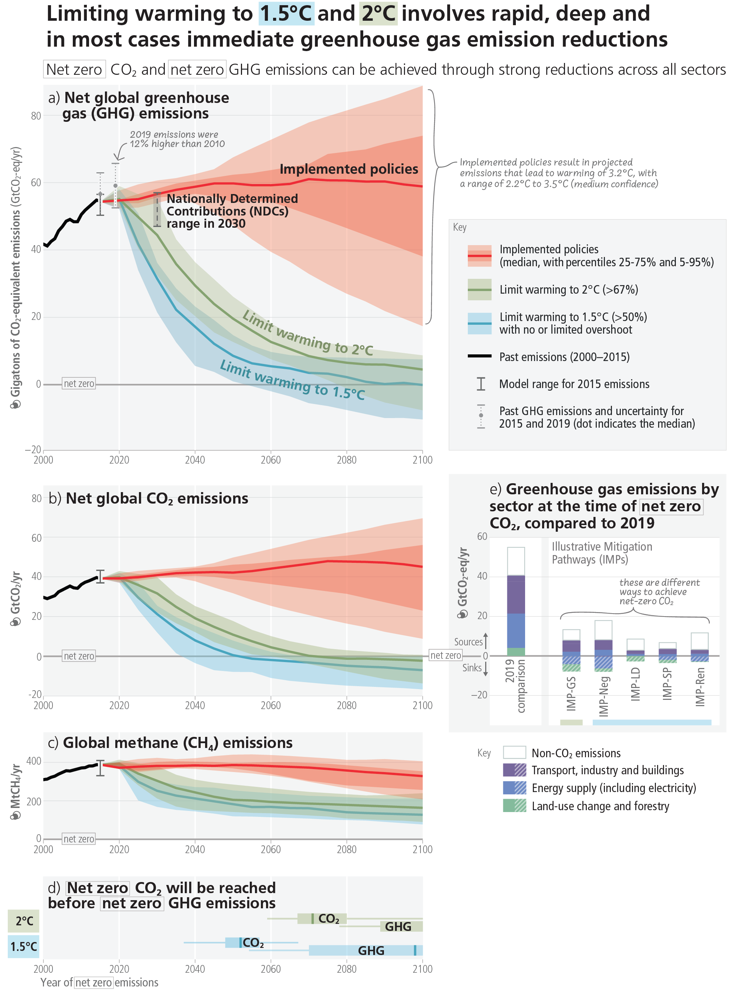
Climate Science – Prospects for Mitigation
Significant impact occurs even at 1.5C
1.5C Paris target is a long-term goal
There is still time to achieve 1.5C – but some degree of overshoot inevitable
High sensitivity to positive feedback loops and tipping points
Powerful natural sinks can stop temperature rise if we stop emitting – but may already be starting to diminish
Progress in alternative and renewable energy sector
Political and economic inertia in changing fossil fuel framework
IPCC AR6 SYR Figure 5: Summary of Paris NDC commitments and needed ambition for 2 and 1.5 C targets

Slide 32

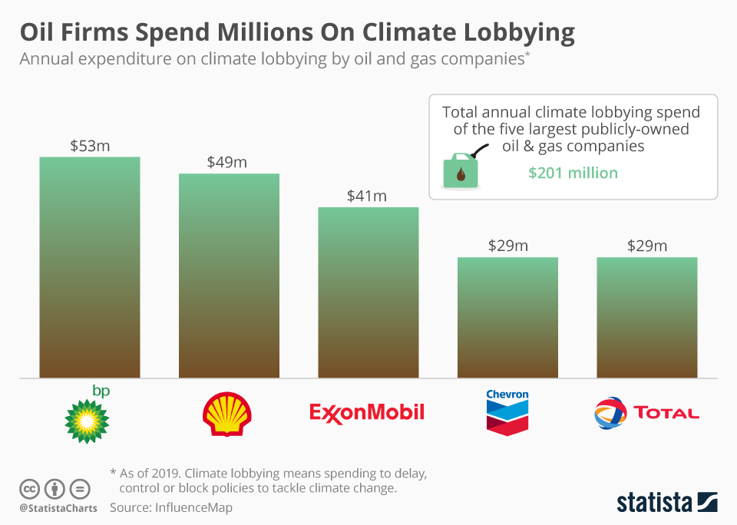
Barriers to Action
Conference of Parties (COP) to UNFCCC
  Most COPs dominated by national rather than global interests
  Agreement at COP29 for 300 billion USD/year by 2030 mostly in the form of loans to Fund for Responding to Loss and Damage Fund (FRLD)
  Over 1 trillion/year needed (and needed mostly as grants)
Global Geopolitics
  Election of Trump and implications for backsliding for global ambition
  Ongoing wars creating geopolitical unrest and volatility in energy markets
  Limited legal/financial accountability for major polluters despite historic responsibility and potential to still make profit (Schleussner et al. 2023)
  Limited legal recourse for SIDS/LDCs through existing frameworks
Observed Emissions and Climate Ambition
  Significant growth of renewable energy
  Some reduction in emissions from affluent countries
  Continued increases in fossil fuel emissions in middle income countries and LDCs leading to increased global emissions
Putting Intention into Practice
  Mobilizing and sustaining funds
  Data availability and analysis for targeted responses
  Coordination of climate responses across geography, scale and sector
  Political pressures and timelines, versus need for sustained funding/engagement
  Feelings of disempowerment at the personal level

